Slide 1
Case Illustrations in Urban Forestry Law
James Komen
BCMA #WE-9909B
RCA #555

Slide 2
Tree Failure
Turner v. Wichita 143 Kan. 808 (KS Sup. Ct. 1936)
Swope v. Wichita 141 Kan. 388 (KS Sup. Ct. 1935)
Toledo v. United States 95 F.Supp. 838 (USDC PR 1951)
Rose v. Pershing County 2014 LEXIS 1611 (NV Sup. Ct. 2014)
Siple v. Topeka 235 Kan. 167 (KS Sup. Ct. 1984)
Evans v. Spokane County 15 Wash.App.2d 1011 (WA Ct. App. 2020)
Notes:
6 cases

Slide 3
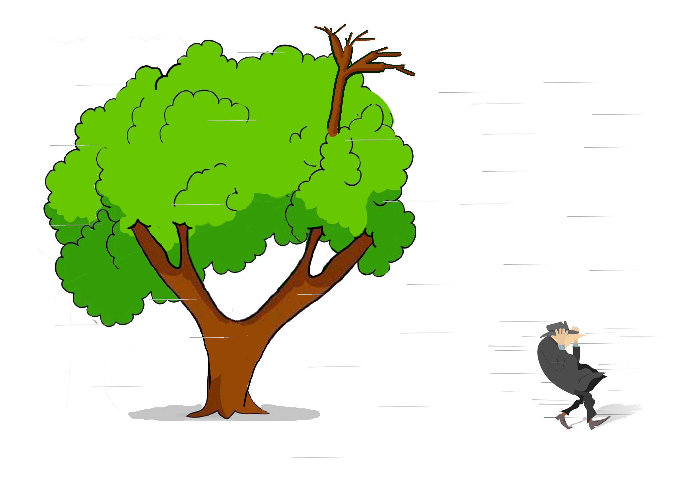
Turner v. Wichita 143 Kan. 808 (KS Sup. Ct. 1936)
Notes:
KS Supreme Court
October 18, 1932, Wichita, KS
Mr. Turner was walking during a windstorm, struck by a dead branch thrown 44 feet
Branch was from a topped part of the tree and was dead
Shortly before the incident, George Johnson called to him, “You had better step lively and get in our of this wind. This is a bad storm.”
“Oh, I have been out in worse storms that this,”
“You might get hurt by signs or broken tree limbs hitting you. Some of those limbs are liable to blow off of those trees there. I am going to get in before I get something on my bean.”
Mr. Turner had two hands on his hat in the wind.
Dead branch on topped street tree maple falls in strong wind and kills pedestrian
- Not normal wind (2 hands on hat and 44ft branch throw)
- Just because branch is dead (but not soft) doesn’t mean “extremely bad” defect
- 3 weeks isn’t too long to be an “utter disregard”

Slide 4
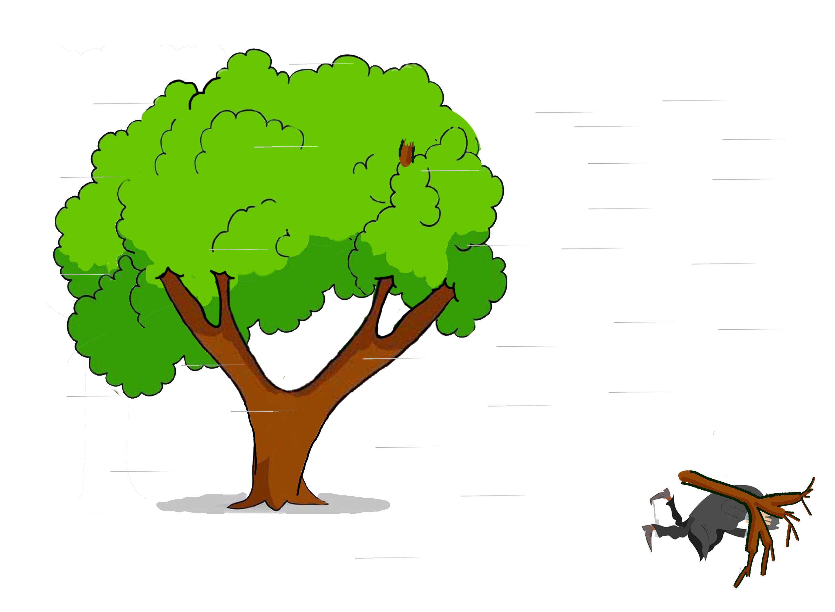
Turner v. Wichita 143 Kan. 808 (KS Sup. Ct. 1936)
Notes:
KS Supreme Court
October 18, 1932, Wichita, KS
Mr. Turner was walking during a windstorm, struck by a dead branch thrown 44 feet
Branch was from a topped part of the tree and was dead
Shortly before the incident, George Johnson called to him, “You had better step lively and get in our of this wind. This is a bad storm.”
“Oh, I have been out in worse storms that this,”
“You might get hurt by signs or broken tree limbs hitting you. Some of those limbs are liable to blow off of those trees there. I am going to get in before I get something on my bean.”
Mr. Turner had two hands on his hat in the wind.
Dead branch on topped street tree maple falls in strong wind and kills pedestrian
- Not normal wind (2 hands on hat and 44ft branch throw)
- Just because branch is dead (but not soft) doesn’t mean “extremely bad” defect
- 3 weeks isn’t too long to be an “utter disregard”

Slide 5
Turner v. Wichita 143 Kan. 808 (KS Sup. Ct. 1936)
City Liability for Falling Branches
Notice AND [failed in normal wind OR because of defect]
OR
Condition is “patently bad” AND existed a long time as “utter disregard for safety”
Notes:
KS Supreme Court
October 18, 1932, Wichita, KS
Mr. Turner was walking during a windstorm, struck by a dead branch thrown 44 feet
Branch was from a topped part of the tree and was dead
Shortly before the incident, George Johnson called to him, “You had better step lively and get in our of this wind. This is a bad storm.”
“Oh, I have been out in worse storms that this,”
“You might get hurt by signs or broken tree limbs hitting you. Some of those limbs are liable to blow off of those trees there. I am going to get in before I get something on my bean.”
Mr. Turner had two hands on his hat in the wind.
Dead branch on topped street tree maple falls in strong wind and kills pedestrian
- Not normal wind (2 hands on hat and 44ft branch throw)
- Just because branch is dead (but not soft) doesn’t mean “extremely bad” defect
- 3 weeks isn’t too long to be an “utter disregard”

Slide 6
Turner v. Wichita 143 Kan. 808 (KS Sup. Ct. 1936)
City Liability for Falling Branches
Not externally Visible
City NOT liable, no constructive notice
Visible upon inspection
City liable, constructive notice
Obvious without inspection
City NOT liable, injured party negligent
Really Friggin’ Obvious™
and tons of time to fix
City liable, “utter disregard”
Notes:
KS Supreme Court
October 18, 1932, Wichita, KS
Mr. Turner was walking during a windstorm, struck by a dead branch thrown 44 feet
Branch was from a topped part of the tree and was dead
Shortly before the incident, George Johnson called to him, “You had better step lively and get in our of this wind. This is a bad storm.”
“Oh, I have been out in worse storms that this,”
“You might get hurt by signs or broken tree limbs hitting you. Some of those limbs are liable to blow off of those trees there. I am going to get in before I get something on my bean.”
Mr. Turner had two hands on his hat in the wind.
Dead branch on topped street tree maple falls in strong wind and kills pedestrian
- Not normal wind (2 hands on hat and 44ft branch throw)
- Just because branch is dead (but not soft) doesn’t mean “extremely bad” defect
- 3 weeks isn’t too long to be an “utter disregard”

Slide 7
Turner v. Wichita 143 Kan. 808 (KS Sup. Ct. 1936)
Pre-1974 Rule
City Liability for Falling Branches
Not externally Visible
City NOT liable, no constructive notice
Visible upon inspection
City liable, constructive notice
Obvious without inspection
City NOT liable, injured party negligent
Really Friggin’ Obvious™
and tons of time to fix
City liable, “utter disregard”
Notes:
KS Supreme Court
October 18, 1932, Wichita, KS
Mr. Turner was walking during a windstorm, struck by a dead branch thrown 44 feet
Branch was from a topped part of the tree and was dead
Shortly before the incident, George Johnson called to him, “You had better step lively and get in our of this wind. This is a bad storm.”
“Oh, I have been out in worse storms that this,”
“You might get hurt by signs or broken tree limbs hitting you. Some of those limbs are liable to blow off of those trees there. I am going to get in before I get something on my bean.”
Mr. Turner had two hands on his hat in the wind.
Dead branch on topped street tree maple falls in strong wind and kills pedestrian
- Not normal wind (2 hands on hat and 44ft branch throw)
- Just because branch is dead (but not soft) doesn’t mean “extremely bad” defect
- 3 weeks isn’t too long to be an “utter disregard”

Slide 8
Turner v. Wichita 143 Kan. 808 (KS Sup. Ct. 1936)
City Liability for Falling Branches
Not externally Visible
City NOT liable, no constructive notice
Visible upon inspection
City liable, constructive notice
“Fixed” in
1974 with
Obvious without inspection
City NOT liable, injured party negligent
K.S.A §60-258a
Really Friggin’ Obvious™
and tons of time to fix
City liable, “utter disregard”
Notes:
KS Supreme Court
October 18, 1932, Wichita, KS
Mr. Turner was walking during a windstorm, struck by a dead branch thrown 44 feet
Branch was from a topped part of the tree and was dead
Shortly before the incident, George Johnson called to him, “You had better step lively and get in our of this wind. This is a bad storm.”
“Oh, I have been out in worse storms that this,”
“You might get hurt by signs or broken tree limbs hitting you. Some of those limbs are liable to blow off of those trees there. I am going to get in before I get something on my bean.”
Mr. Turner had two hands on his hat in the wind.
Dead branch on topped street tree maple falls in strong wind and kills pedestrian
- Not normal wind (2 hands on hat and 44ft branch throw)
- Just because branch is dead (but not soft) doesn’t mean “extremely bad” defect
- 3 weeks isn’t too long to be an “utter disregard”

Slide 9
Turner v. Wichita 143 Kan. 808 (KS Sup. Ct. 1936)
“If we were to lay down a rule to the effect that a city is the insurer of the safety of its streets from falling branches and limbs of trees, it might be forced to cut down every large tree”

Slide 10
Swope v. Wichita 141 Kan. 388 (KS Sup. Ct. 1935)
Notes:
KS Supreme Court
1935 Wichita, KS
Street tree failed AFTER City inspected it
- just because INSPECTION, doesn’t mean NOTICE OF DEFECT
- follows the Turner Test
Mr. Swope, parked beneath the tree, was getting out of his car, when a branch fell and struck him

Slide 11
Swope v. Wichita 141 Kan. 388 (KS Sup. Ct. 1935)
Notes:
KS Supreme Court
1935 Wichita, KS
Street tree failed AFTER City inspected it
- just because INSPECTION, doesn’t mean NOTICE OF DEFECT
- follows the Turner Test
Mr. Swope, parked beneath the tree, was getting out of his car, when a branch fell and struck him

Slide 12
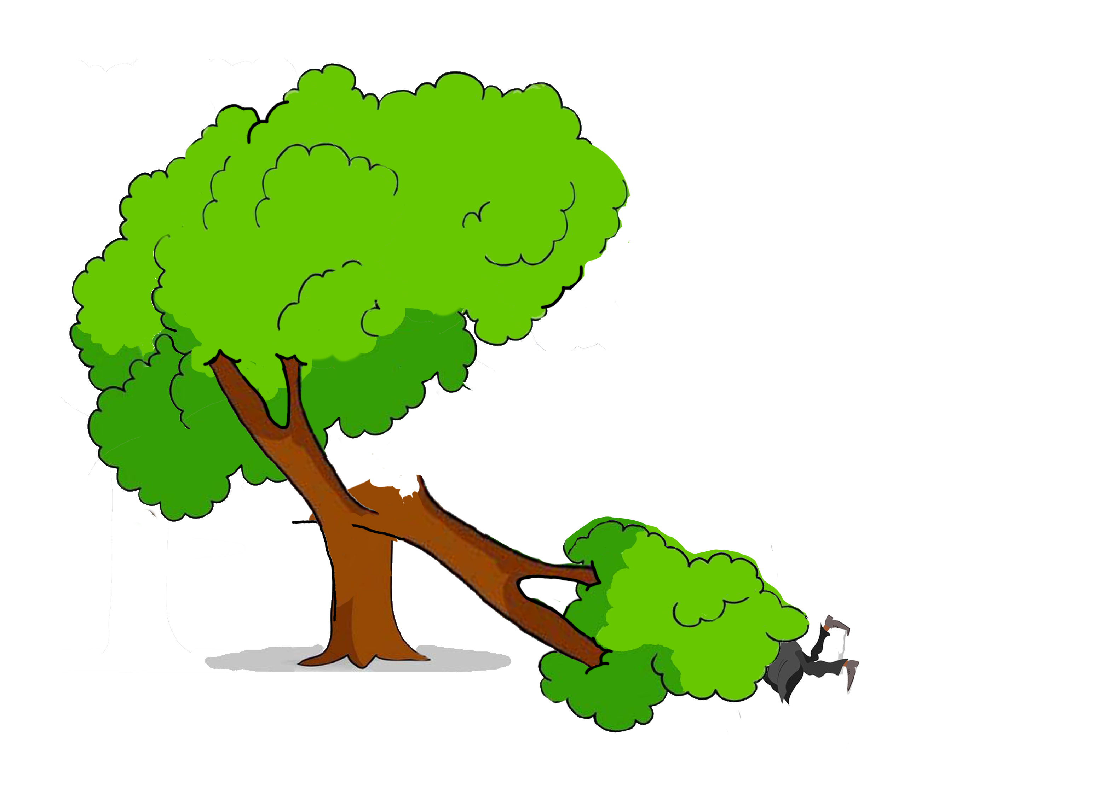
Swope v. Wichita 141 Kan. 388 (KS Sup. Ct. 1935)
Notes:
KS Supreme Court
1935 Wichita, KS
Street tree failed AFTER City inspected it
- just because INSPECTION, doesn’t mean NOTICE OF DEFECT
- follows the Turner Test
Mr. Swope, parked beneath the tree, was getting out of his car, when a branch fell and struck him

Slide 13
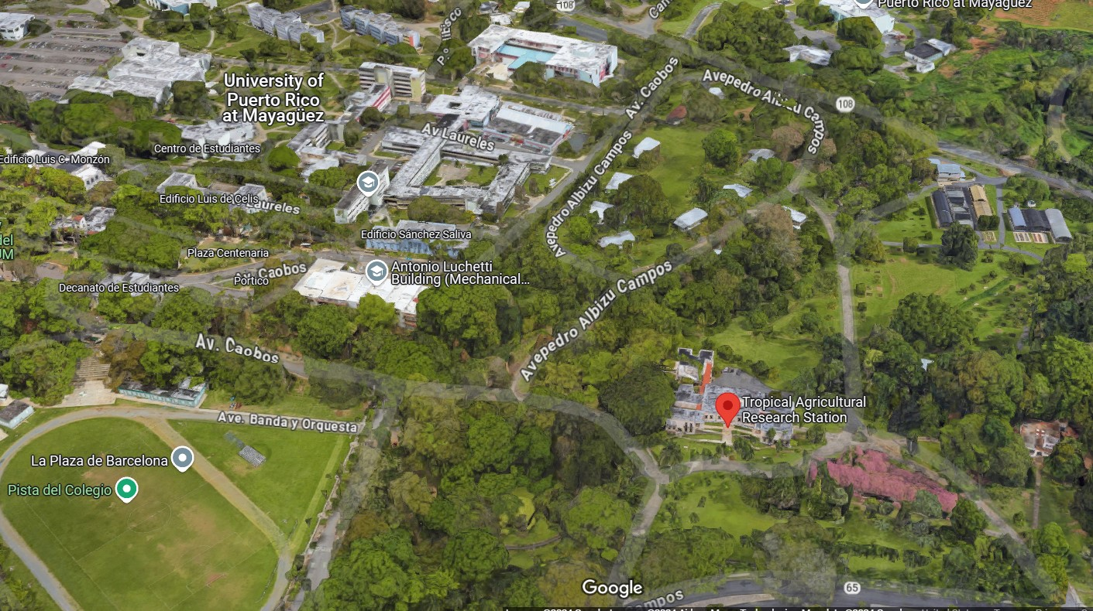
Toledo v. United States 95 F.Supp. 838 (USDC PR 1951)
Notes:
United States District Court of Puerto Rico
1949, University of Puerto Rico at Mayaguez
In 1901, US Congress established US Experimental Station. Station was managed by US Dept of Agriculture.
Purpose of the experimental station was to: “learn about adaptability and usefulness of tropical plants in PR”

Slide 14
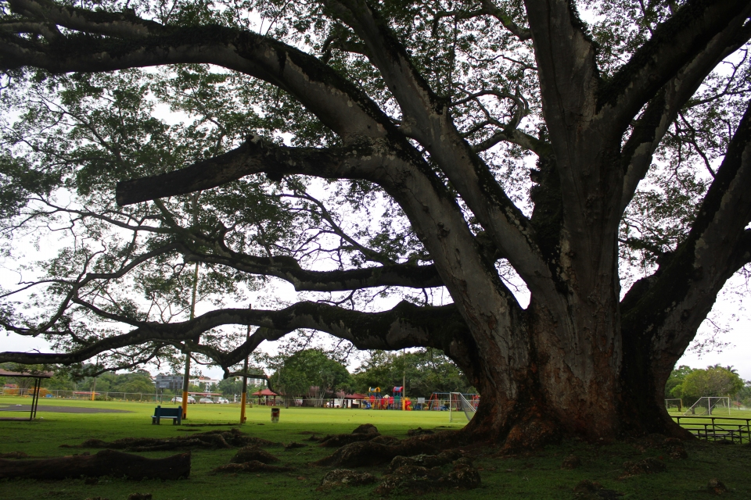
Toledo v. United States 95 F.Supp. 838 (USDC PR 1951)
Notes:
Toledo attended a sporting event and parked beneath an Earpod Tree (Enterolobium)
When he returned, the tree had crushed his car.
The tree’s foliage appeared healthy, but the trunk was completely hollow.
US Gov’t immune, under the discretionary immunity clause of the FTCA – discretion when to plant, maintain, and remove their “experiments.”

Slide 15
Toledo v. United States 95 F.Supp. 838 (USDC PR 1951)
“how long such tree should be preserved for experimentation or when it should be removed and destroyed, are precisely the kind of discretionary functions [that are immune from liability]”

Slide 16
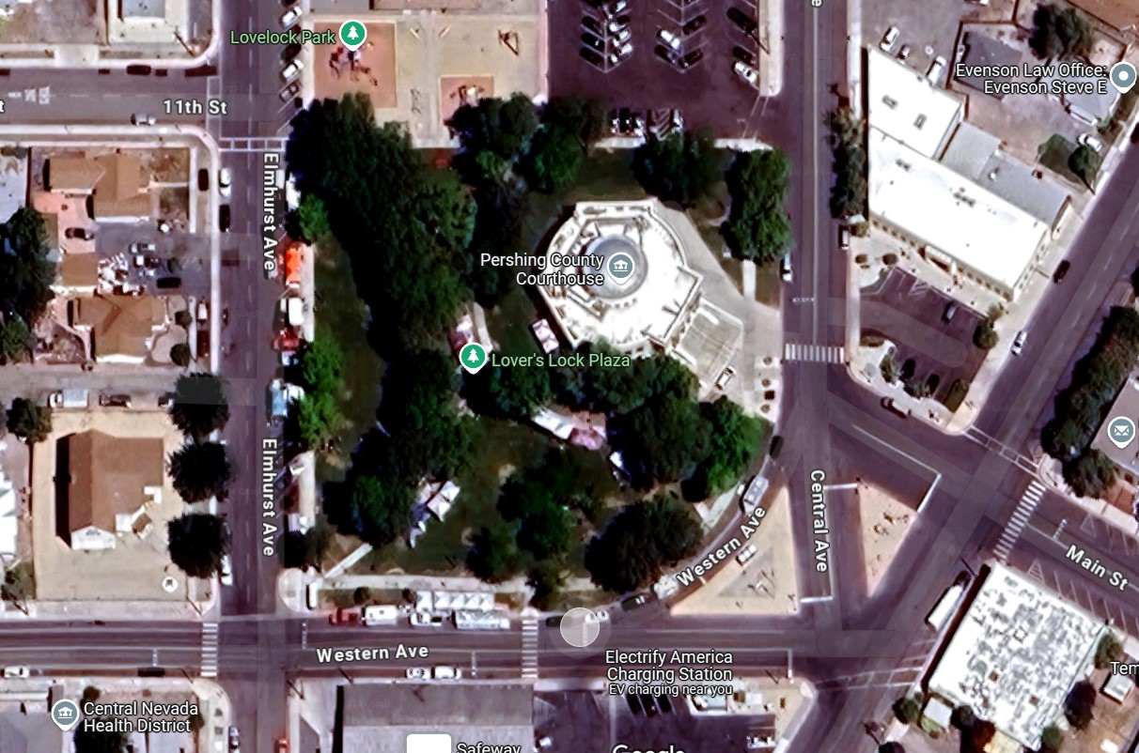
Rose v. Pershing County 2014 LEXIS 1611 (NV Sup. Ct. 2014)
Notes:
Nevada Supreme Court
July 2008 Lovelock, NV
Branch fell from different park tree, hitting nobody.
Two weeks later, another limb failed and was hanging in the tree. City cordoned off the area. Then limb fell to the ground.
City looked for arborist to inspect trees and got quote for pruning $60K. Commissioners agreed that “trees needed to be taken care of” for safety.
Two weeks later, another limb fell.
The next day, another limb fell.
A total of 4 branches 5-10 inches in diameter and 15-25 feet long fell without striking anyone.

Slide 17
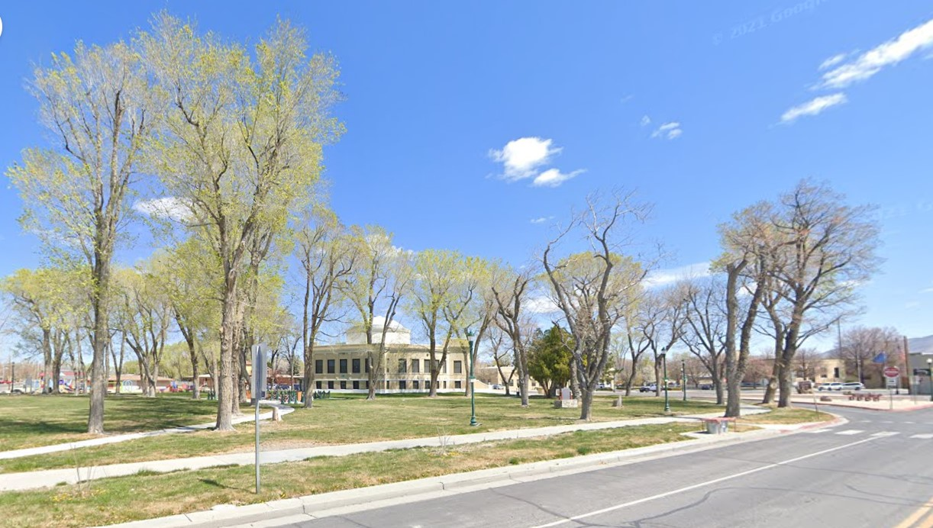
Rose v. Pershing County 2014 LEXIS 1611 (NV Sup. Ct. 2014)
Notes:
The day after that was the county’s Frontier Days festival.
Kirsten Hertz and Virginia Rose were crushed by ANOTHER falling branch.
City argued “discretionary function immunity.” They had the discretion of managing their trees, and they shouldn’t be liable.
(Image is from 2022)

Slide 18
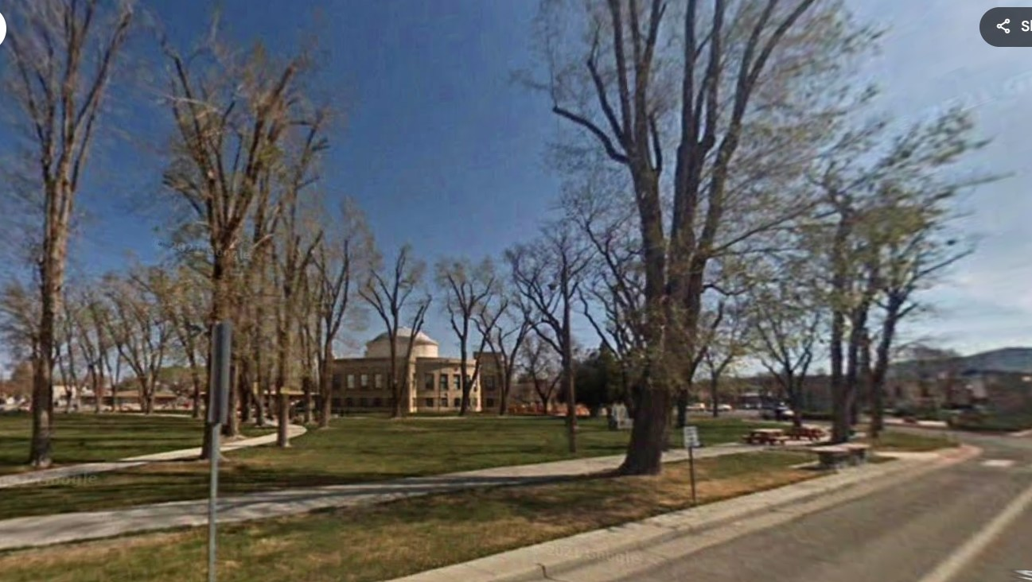
Rose v. Pershing County 2014 LEXIS 1611 (NV Sup. Ct. 2014)
Notes:
This image is from 2009, shortly after the trees were heavily pruned.

Slide 19
Rose v. Pershing County 2014 LEXIS 1611 (NV Sup. Ct. 2014)
“serious safety issues…were too far removed from a policy consideration”
“removing an obvious health hazard is a matter of safety and not policy”
“decision not to warn of a specific known hazard…is not the kind of broader…policy decision that the discretionary function exception is intended to protect.”
Notes:
Note that they didn’t have notice of the SPECIFIC BRANCH that fell.
Only that OTHER BRANCHES were failing on the trees in the park.

Slide 20
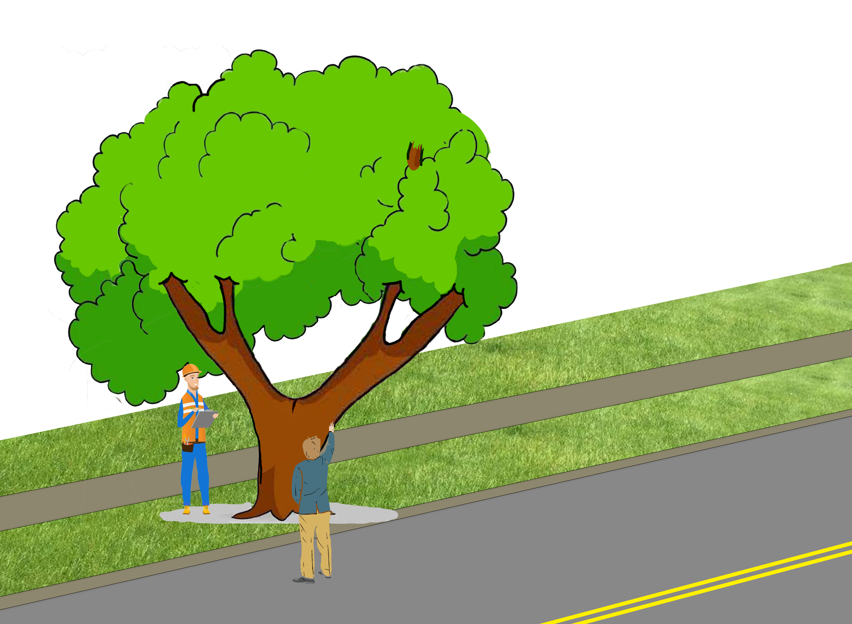
Siple v. Topeka 235 Kan. 167 (KS Sup. Ct. 1984)
Notes:
KS Supreme Court 1984
Street tree with a large crake and oozing sap
Multiple neighbors alerted the city about the defect, but they declined to act
Lyle and Betty Siple bought a BRAND NEW 1981 Chevrolet Chavette, parked it directly under the tree
Private property owned to center of street
Street tree failed AFTER City inspected it NEGLIGENTLY
- immunity under inspection statute

Slide 21
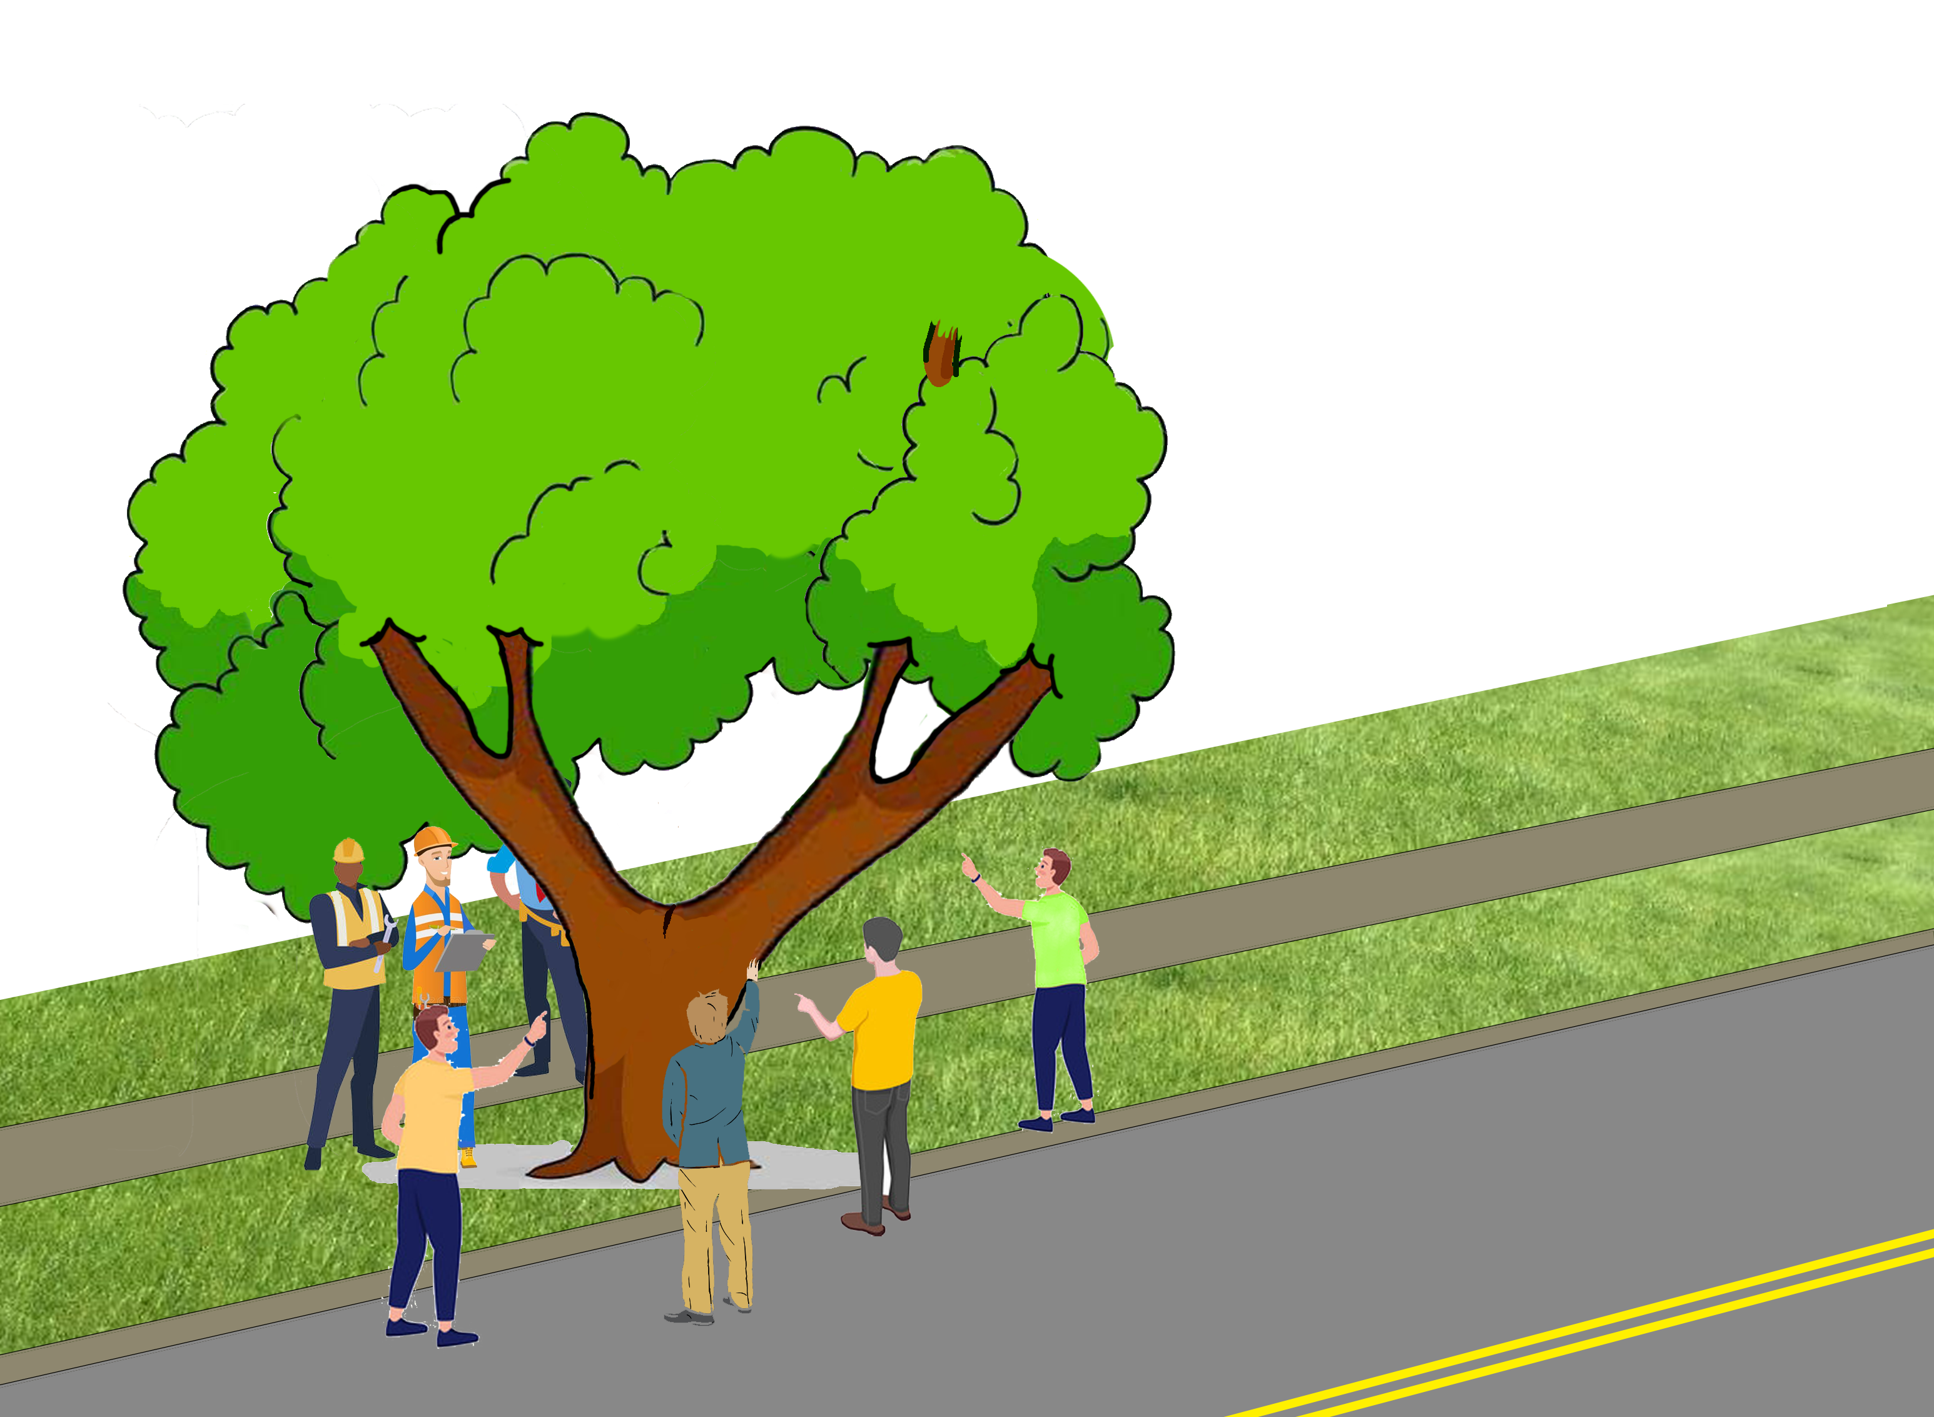
Siple v. Topeka 235 Kan. 167 (KS Sup. Ct. 1984)
Notes:
KS Supreme Court 1984
Street tree with a large crake and oozing sap
Multiple neighbors alerted the city about the defect, but they declined to act
Lyle and Betty Siple bought a BRAND NEW 1981 Chevrolet Chavette, parked it directly under the tree
Private property owned to center of street
Street tree failed AFTER City inspected it NEGLIGENTLY
- immunity under inspection statute

Slide 22
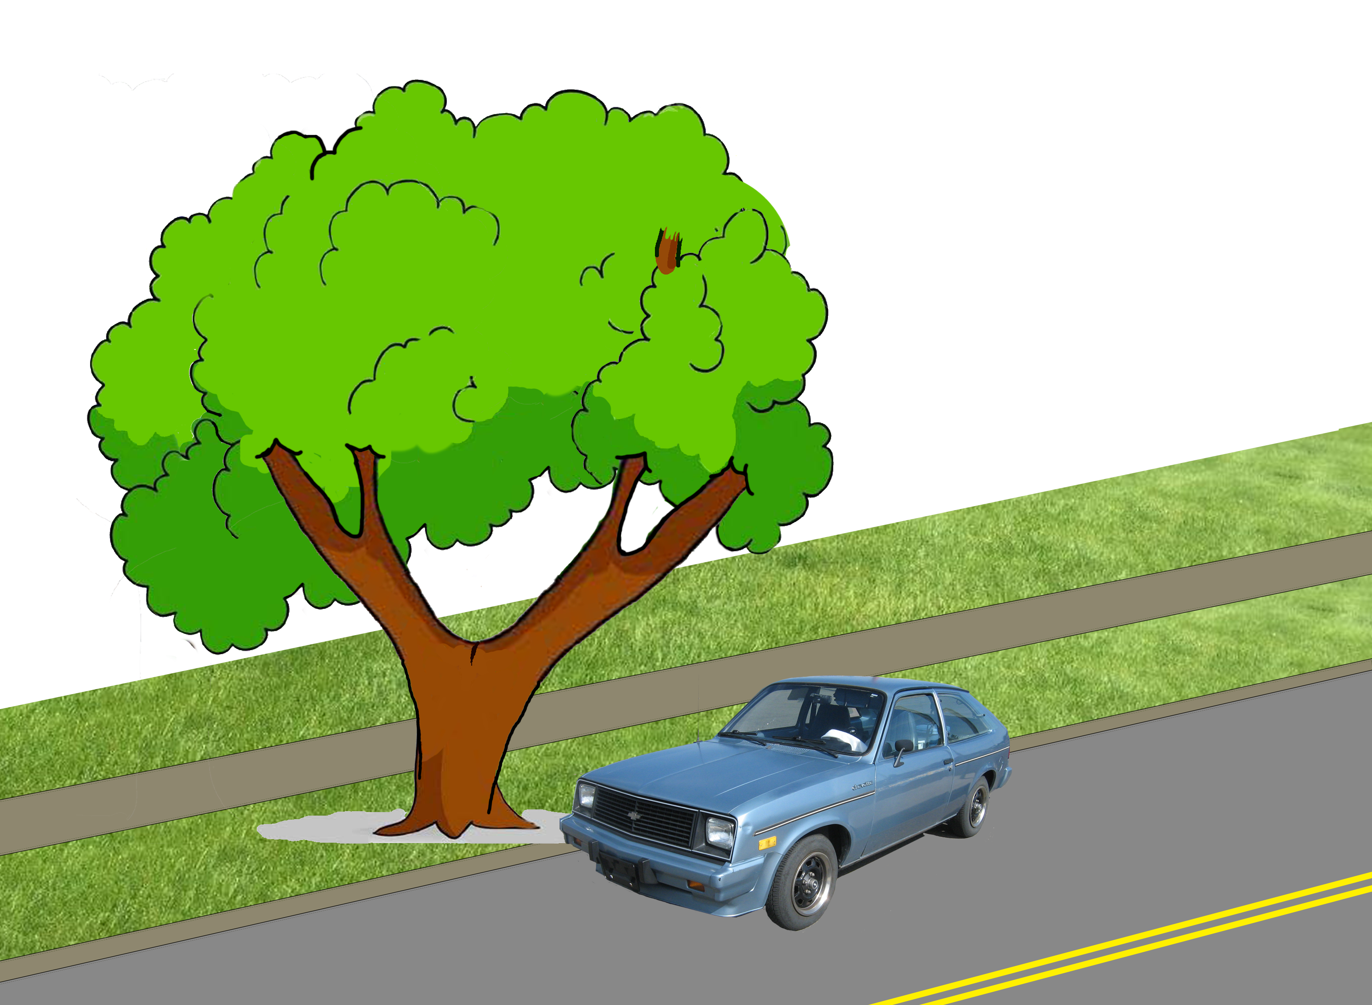
Siple v. Topeka 235 Kan. 167 (KS Sup. Ct. 1984)
Notes:
KS Supreme Court 1984
Street tree with a large crake and oozing sap
Multiple neighbors alerted the city about the defect, but they declined to act
Lyle and Betty Siple bought a BRAND NEW 1981 Chevrolet Chavette, parked it directly under the tree
Private property owned to center of street
Street tree failed AFTER City inspected it NEGLIGENTLY
- immunity under inspection statute

Slide 23
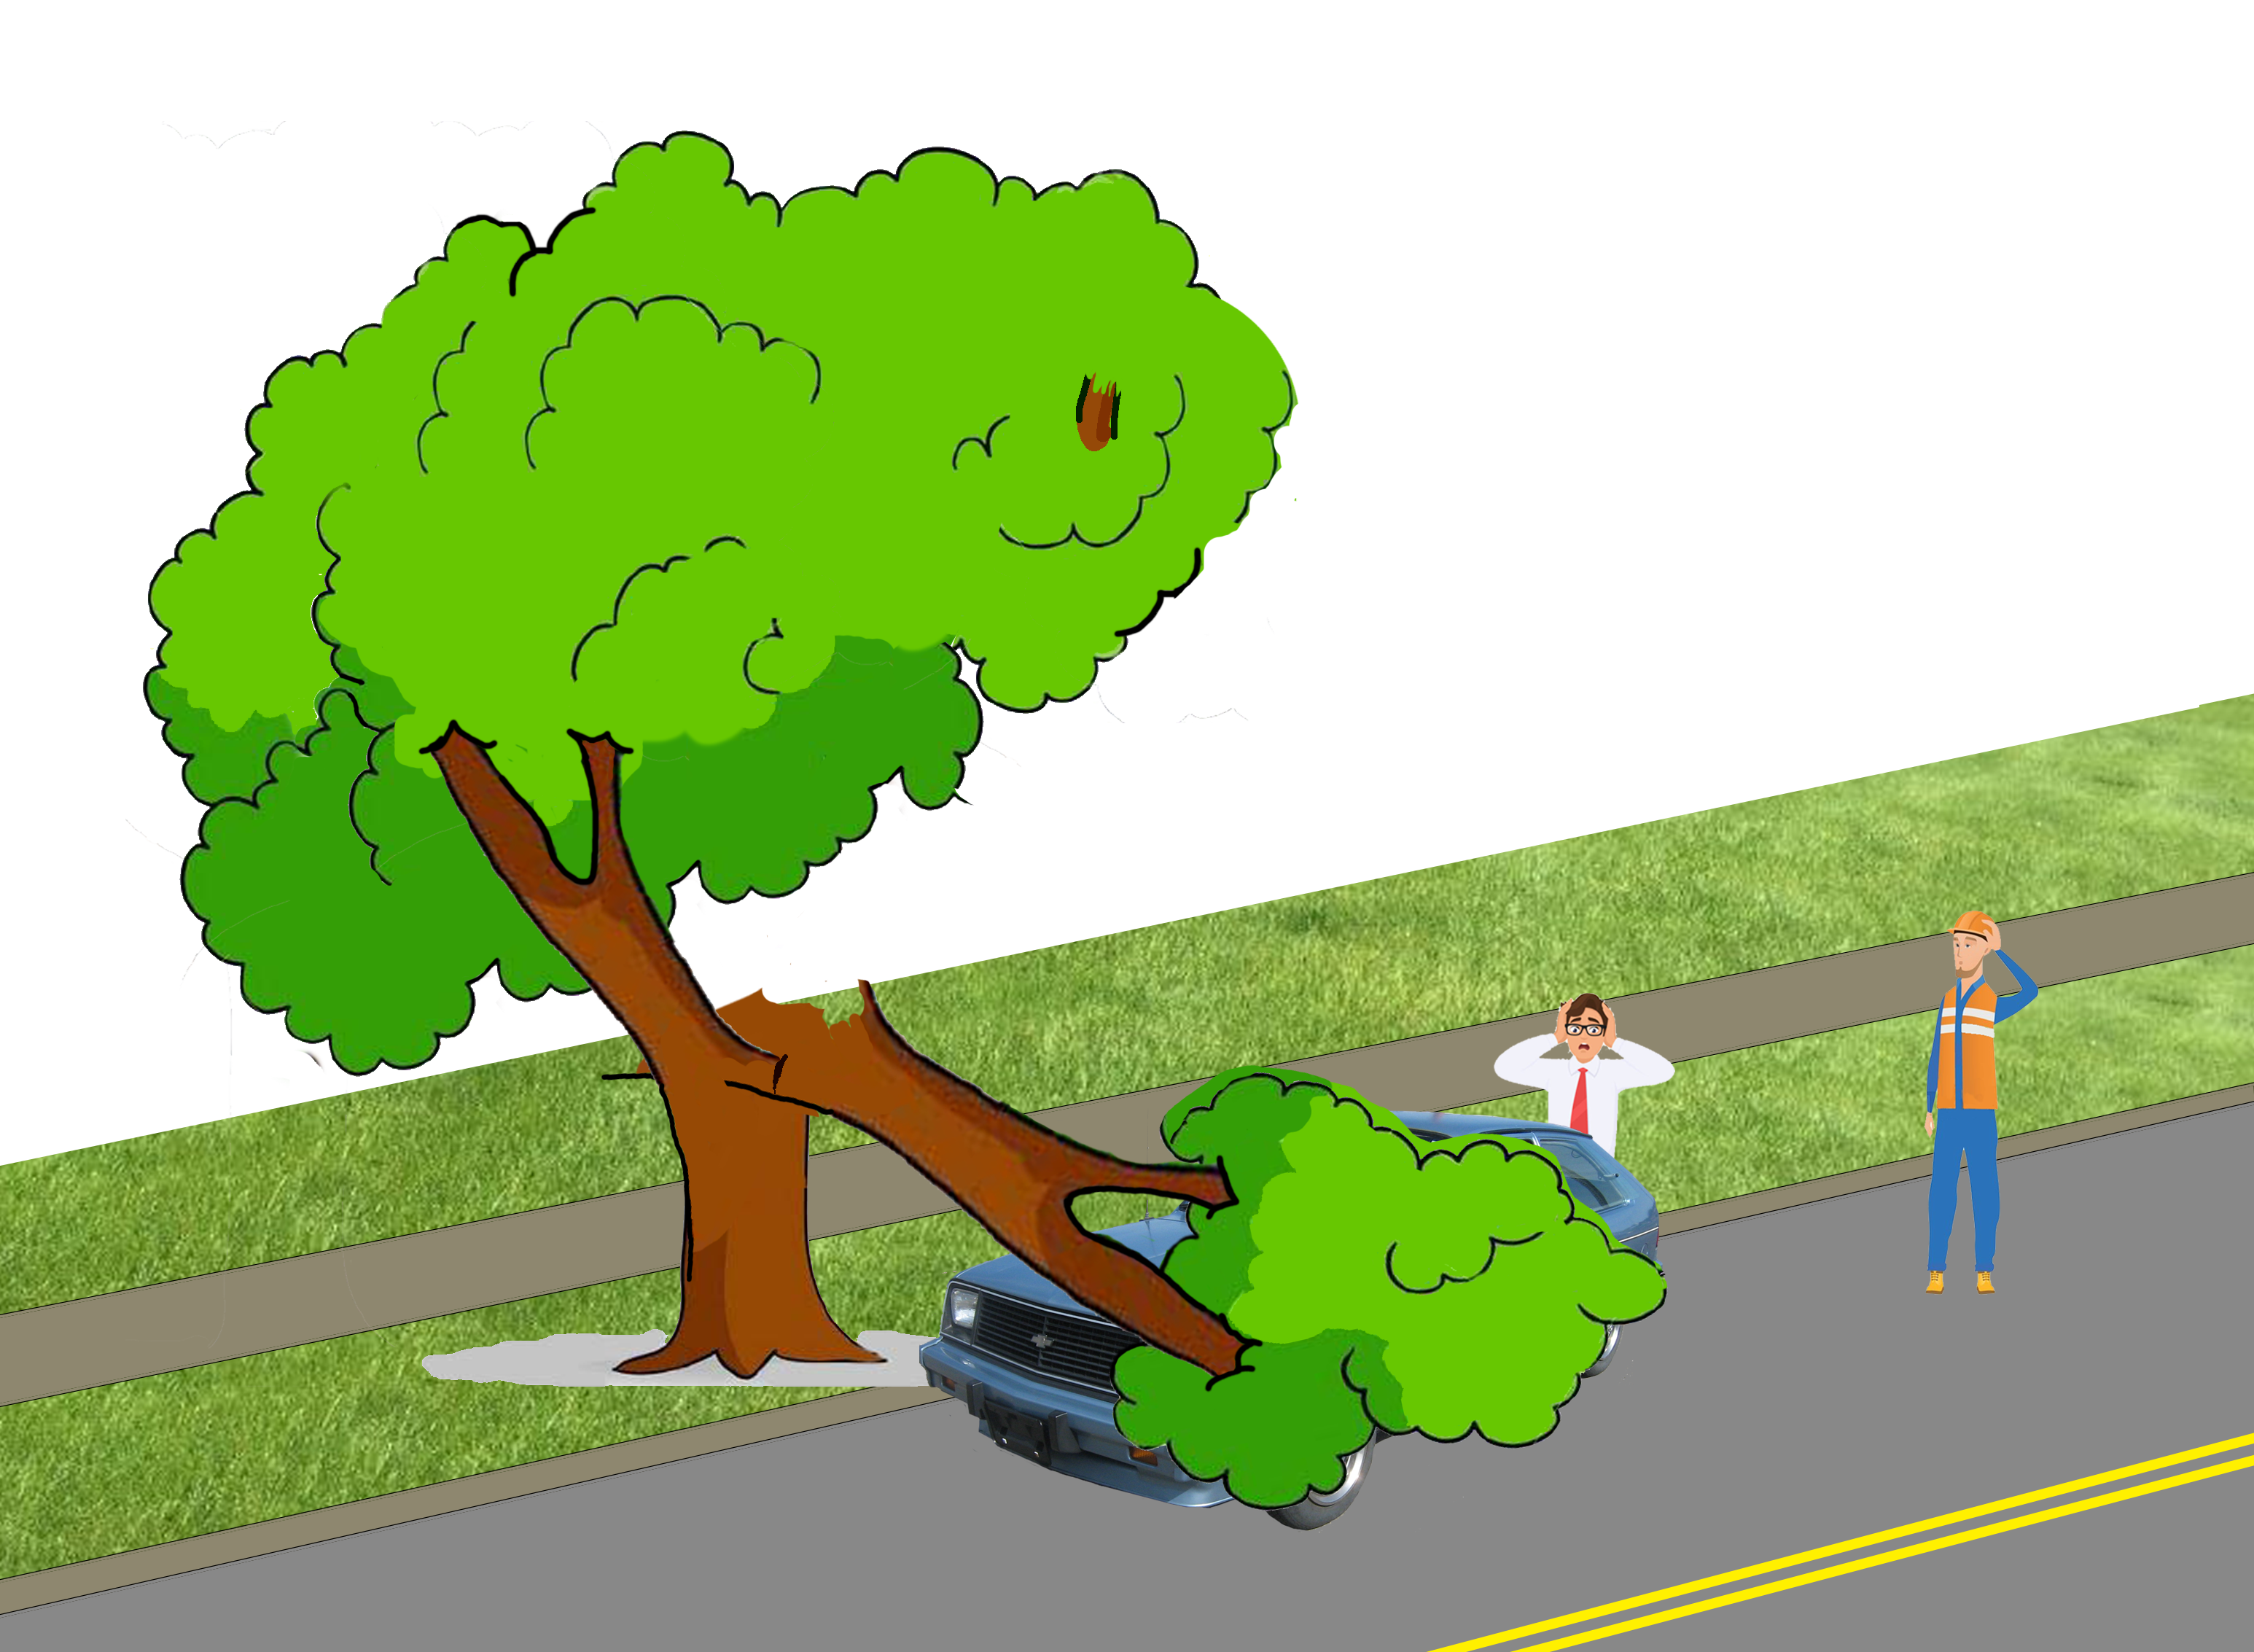
Siple v. Topeka 235 Kan. 167 (KS Sup. Ct. 1984)
Notes:
KS Supreme Court 1984
Street tree with a large crake and oozing sap
Multiple neighbors alerted the city about the defect, but they declined to act
Lyle and Betty Siple bought a BRAND NEW 1981 Chevrolet Chavette, parked it directly under the tree
Private property owned to center of street
Street tree failed AFTER City inspected it NEGLIGENTLY
- immunity under inspection statute

Slide 24
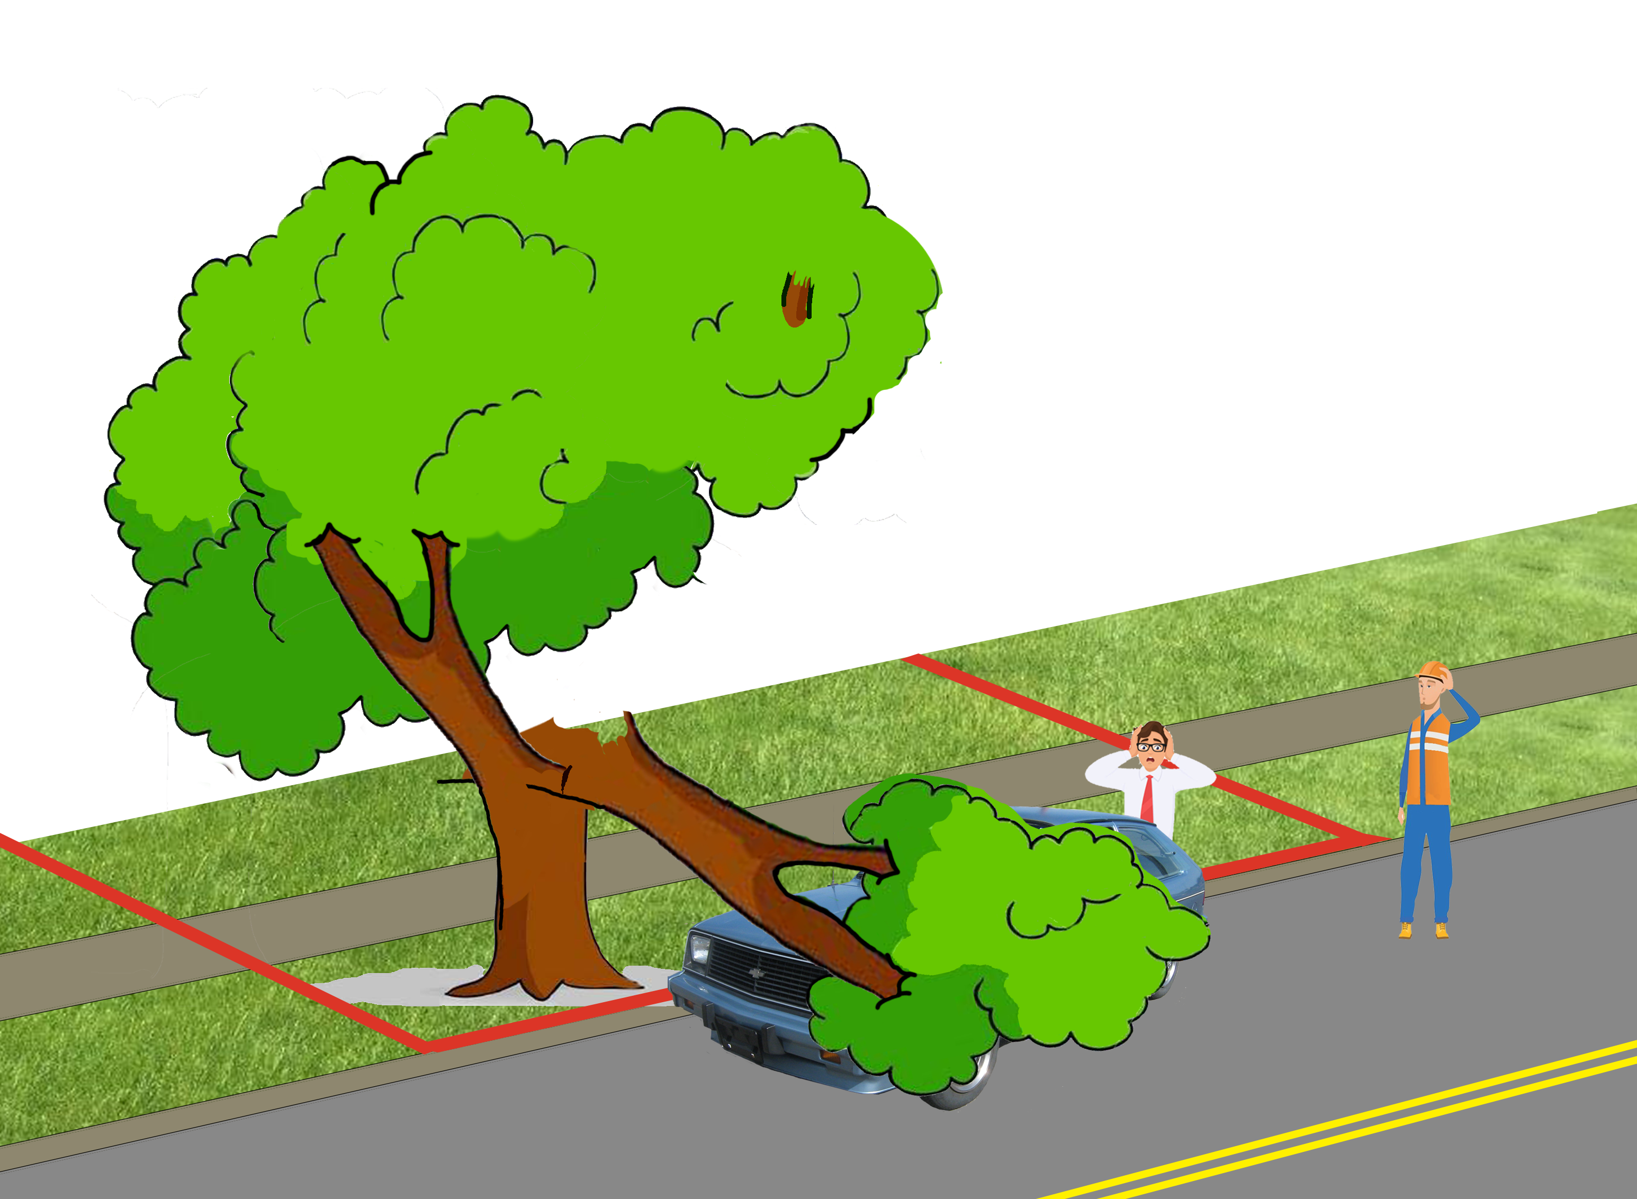
Siple v. Topeka 235 Kan. 167 (KS Sup. Ct. 1984)
Notes:
KS Supreme Court 1984
Street tree with a large crake and oozing sap
Multiple neighbors alerted the city about the defect, but they declined to act
Lyle and Betty Siple bought a BRAND NEW 1981 Chevrolet Chavette, parked it directly under the tree
Private property owned to center of street
Street tree failed AFTER City inspected it NEGLIGENTLY
- immunity under inspection statute

Slide 25
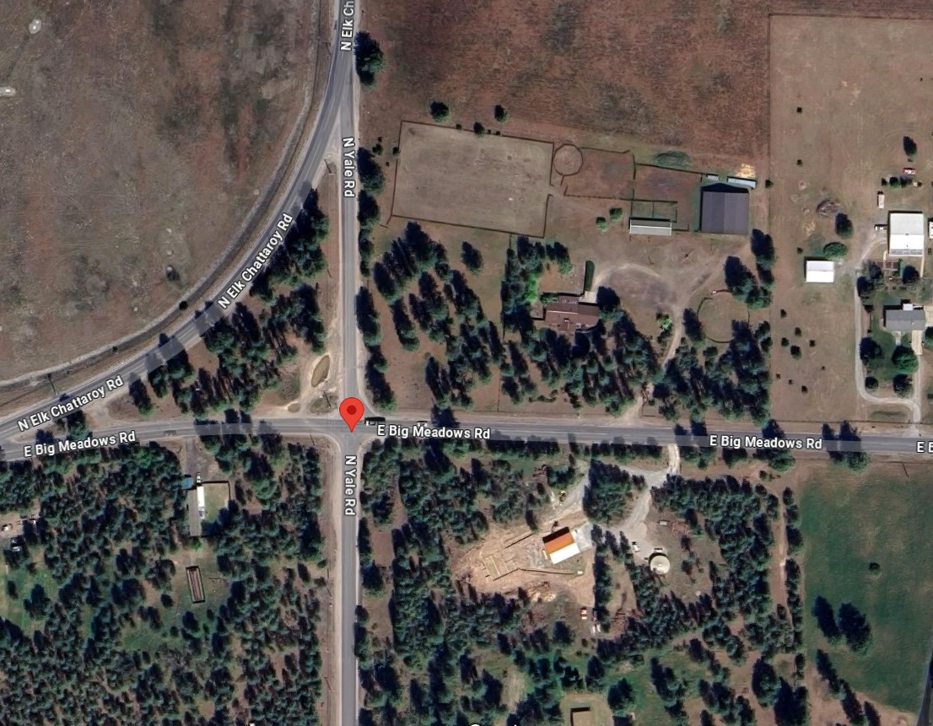
Evans v. Spokane County 15 Wash.App.2d 1011 (WA Ct. App. 2020)
Notes:
WA Court of Appeals
July 23, 2014 – Severe windstorm
Carlton Evans was driving towards Chattaroy on E. Big Meadows Road

Slide 26
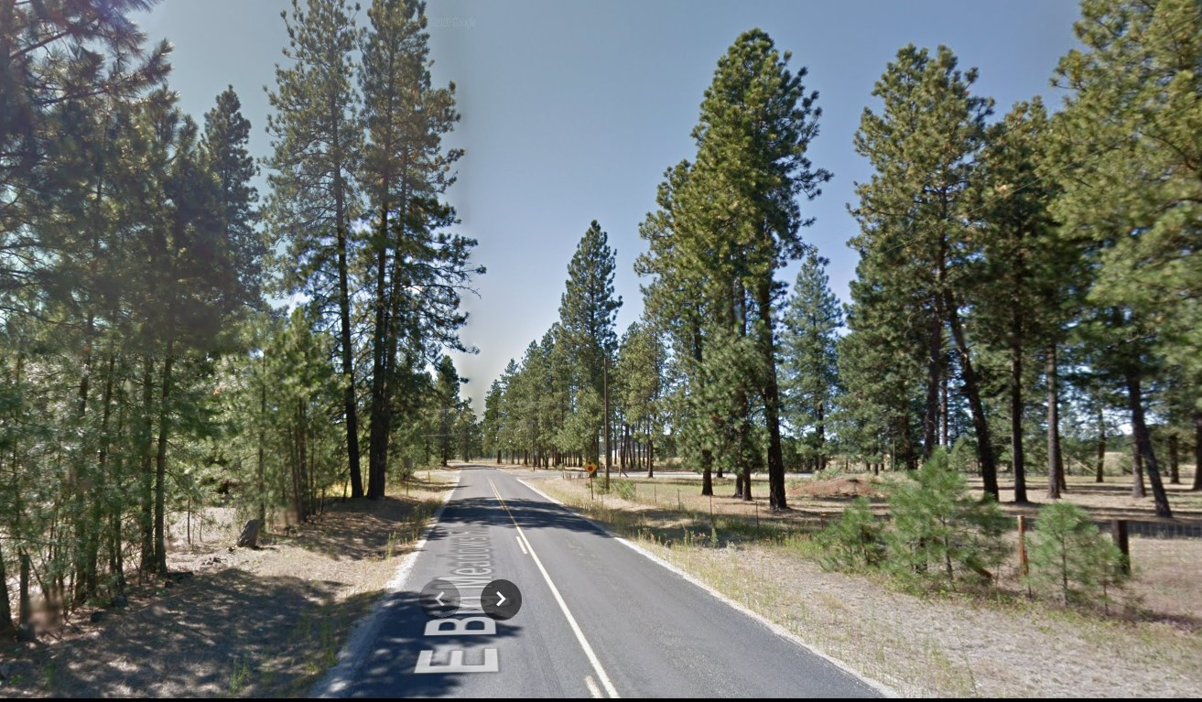
Evans v. Spokane County 15 Wash.App.2d 1011 (WA Ct. App. 2020)
Notes:
July 23, 2014 – Severe windstorm
Carlton Evans was driving towards Chattaroy on E. Big Meadows Road
80-90 foot Ponderosa pine fell on his car, impaling him and severing his left hand.
He survived.
Jury instructions that “no liab. if no reason to know THIS tree would fail” And instruction for no liab. if “act of god”
Carlton’s expert said if city had sounded the tree, it would have detected the decay and would have removed the tree.

Slide 27
Evans v. Spokane County 15 Wash.App.2d 1011 (WA Ct. App. 2020)
“Act of God”: “natural phenomenon…so far outside the range of human experience that ordinary care did not require that it should be anticipated”
“…it is not sufficient that such phenomena are unusual or of rare occurrence.”

Slide 28
Evans v. Spokane County 15 Wash.App.2d 1011 (WA Ct. App. 2020)
“…the fact that harm is brought about through the intervention of another force does not relieve the actor of liability.”
“…the risk that a diseased tree would snap in strong winds was within the ambit of the hazards covered by the County’s duty.”

Slide 29
Evans v. Spokane County 15 Wash.App.2d 1011 (WA Ct. App. 2020)
π expert testified tree failed due to disease caused by negligent application of herbicides
“…a duty may arise…where an owner…takes the trees out of their natural condition such that the premises become an artificial condition.”

Slide 30
Evans v. Spokane County 15 Wash.App.2d 1011 (WA Ct. App. 2020)
“there is no duty to consistently and constantly check…for non-visible rot.”
“…decay must be visible, apparent, and patent…”

Slide 31
Evans v. Spokane County 15 Wash.App.2d 1011 (WA Ct. App. 2020)
“there is no duty to consistently and constantly check…for non-visible rot.”
“…decay must be visible, apparent, and patent…”
FOR A LAYPERSON

Slide 32
Evans v. Spokane County 15 Wash.App.2d 1011 (WA Ct. App. 2020)
“there is no duty to consistently and constantly check…for non-visible rot.”
“…decay must be visible, apparent, and patent…”
FOR A LAYPERSON
But “…for those who have acquired knowledge beyond that of an ordinary person in the course of their work, the law will demand conduct consistent with that acquired knowledge.“

Slide 33
“The Omaha Cases”
McGinn v. Omaha 352 N.W.2d 545 (NE Sup. Ct. 1984)
Mott v. City of Omaha 1993 Neb. App. LEXIS 358 (NE Ct. App. 1993)
Holts v. City of Omaha 2002 Neb. App. LEXIS 203 (NE Ct. App. 2002)
Notes:
3 cases

Slide 34
Who Decides a Case

Slide 35
Who Decides a Case
Findings of Fact
Conclusions of Law

Slide 36
Who Decides a Case
Findings of Fact
Conclusions of Law
OR
Jury Trial
Bench Trial
Judge Only

Slide 37
Standard of Review
Appellate Court

Slide 38
Standard of Review
Appellate Court
Findings of Fact
Conclusions of Law

Slide 39
Standard of Review
Appellate Court
Findings of Fact
Conclusions of Law

Slide 40
Standard of Review

Slide 41
Standard of Review

Slide 42
Standard of Review

Slide 43
Standard of Review

Slide 44
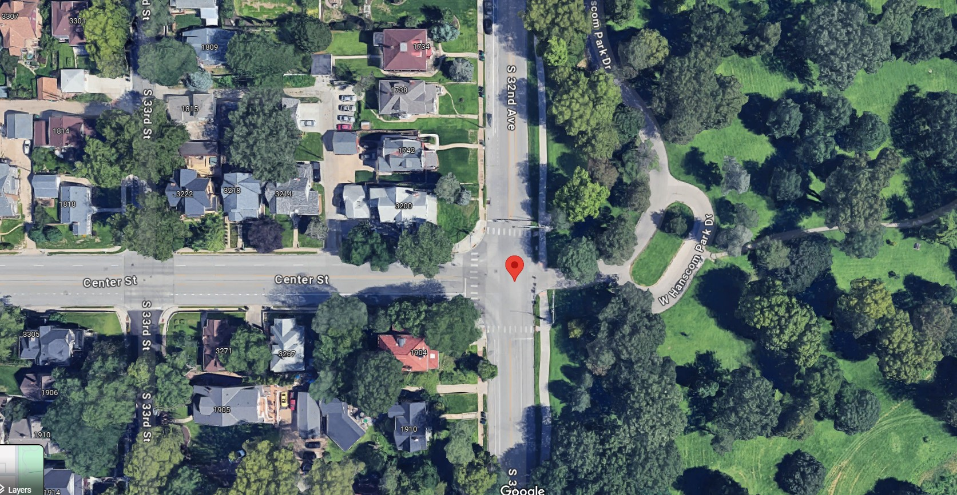
McGinn v. Omaha 352 N.W.2d 545 (NE Sup. Ct. 1984)
Notes:
June 1980 failure
Peter McGinn
32nd and Center Streets, near Hanscom Park in Omaha
Driver pulled over in a violent storm, parking beneath silver maple street tree
Quadriplegia

Slide 45
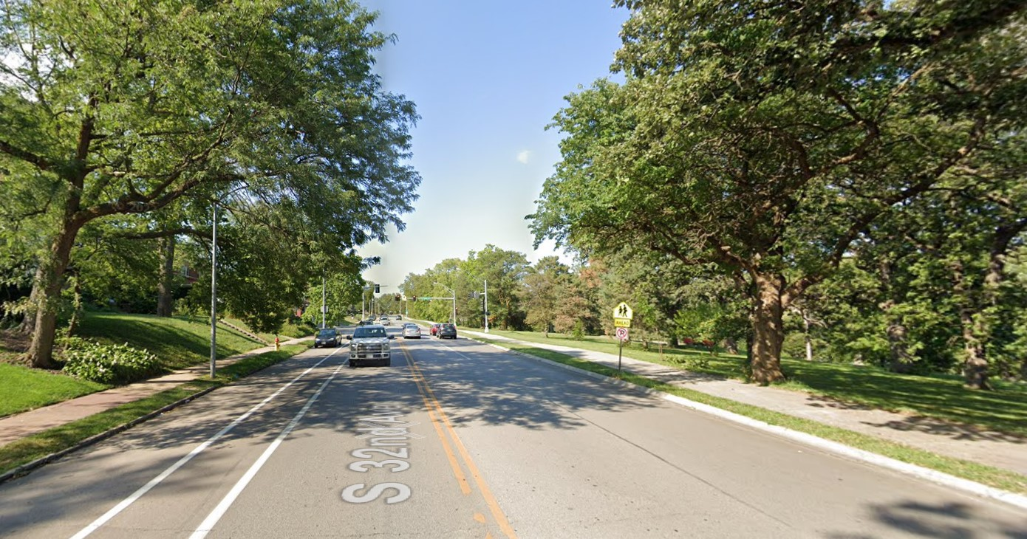
McGinn v. Omaha 352 N.W.2d 545 (NE Sup. Ct. 1984)
Notes:
June 1980 failure
Peter McGinn
32nd and Center Streets, near Hanscom Park in Omaha
Driver pulled over in a violent storm, parking beneath silver maple street tree
Quadriplegia

Slide 46
McGinn v. Omaha 352 N.W.2d 545 (NE Sup. Ct. 1984)
π Evidence
Δ Evidence
Silver maple
35-100 years old
Extensive decay
Prior branch failures
“Swollen knots”/ woundwood
“V-crotch”
59,600 street trees & 153,000 park trees
Managed by city forester + 26 field staff
Annual windshield inspections
No open wounds
No conks, cracks, breaks, holes
Notes:
June 1980 failure
Driver pulled over in a violent storm, parking beneath silver maple street tree
Quadriplegia

Slide 47
McGinn v. Omaha 352 N.W.2d 545 (NE Sup. Ct. 1984)
π Expert Witness
Δ Expert Witness
Removal ALL 50+ year old silver maples
ALL trees get 15-30 min Level 2 Basic Inspection
Half the city’s trees would be removed
12 min/tree inspection would take 6 inspectors a full year
“One of the best” urban tree inspection programs
Notes:
June 1980 failure
Driver pulled over in a violent storm, parking beneath silver maple street tree
Quadriplegia

Slide 48
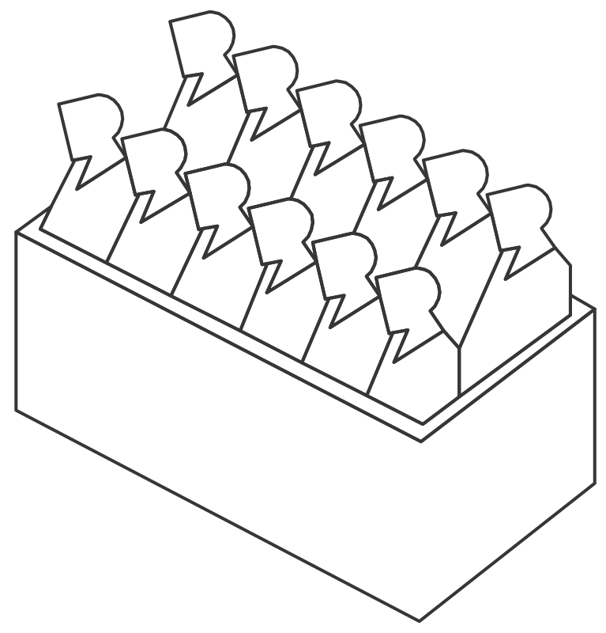
McGinn v. Omaha 352 N.W.2d 545 (NE Sup. Ct. 1984)
Notes:
June 1980 failure
Driver pulled over in a violent storm, parking beneath silver maple street tree
Quadriplegia

Slide 49
McGinn v. Omaha 352 N.W.2d 545 (NE Sup. Ct. 1984)
“π Wins”
Notes:
June 1980 failure
Driver pulled over in a violent storm, parking beneath silver maple street tree
Quadriplegia

Slide 50
McGinn v. Omaha 352 N.W.2d 545 (NE Sup. Ct. 1984)
“π Wins”
NE Supreme Ct.
Notes:
June 1980 failure
Driver pulled over in a violent storm, parking beneath silver maple street tree
Quadriplegia

Slide 51
McGinn v. Omaha 352 N.W.2d 545 (NE Sup. Ct. 1984)
Notes:
June 1980 failure
Driver pulled over in a violent storm, parking beneath silver maple street tree
Quadriplegia

Slide 52
McGinn v. Omaha 352 N.W.2d 545 (NE Sup. Ct. 1984)
π Evidence
Δ Evidence
Silver maple
35-100 years old
Extensive decay
Prior branch failures
“Swollen knots”/ woundwood
“V-crotch”
59,600 street trees & 153,000 park trees
Managed by city forester + 26 field staff
Annual windshield inspections
No open wounds
No conks, cracks, breaks, holes
Notes:
June 1980 failure
Driver pulled over in a violent storm, parking beneath silver maple street tree
Quadriplegia

Slide 53
McGinn v. Omaha 352 N.W.2d 545 (NE Sup. Ct. 1984)
π Evidence
Δ Evidence
Silver maple
35-100 years old
Extensive decay
Prior branch failures
“Swollen knots”/ woundwood
“V-crotch”
59,600 street trees & 153,000 park trees
Managed by city forester + 26 field staff
Annual windshield inspections
No open wounds
No conks, cracks, breaks, holes
Notes:
June 1980 failure
Driver pulled over in a violent storm, parking beneath silver maple street tree
Quadriplegia

Slide 54
McGinn v. Omaha 352 N.W.2d 545 (NE Sup. Ct. 1984)
π Evidence
Δ Evidence
Silver maple
35-100 years old
Extensive decay
Prior branch failures
“Swollen knots”/ woundwood
“V-crotch”
59,600 street trees & 153,000 park trees
Managed by city forester + 26 field staff
Annual windshield inspections
No open wounds
No conks, cracks, breaks, holes
Notes:
June 1980 failure
Driver pulled over in a violent storm, parking beneath silver maple street tree
Quadriplegia

Slide 55
McGinn v. Omaha 352 N.W.2d 545 (NE Sup. Ct. 1984)
π Evidence
Δ Evidence
Silver maple
35-100 years old
Extensive decay
Prior branch failures
“Swollen knots”/ woundwood
“V-crotch”
59,600 street trees & 153,000 park trees
Managed by city forester + 26 field staff
Annual windshield inspections
No open wounds
No conks, cracks, breaks, holes
Notes:
June 1980 failure
Driver pulled over in a violent storm, parking beneath silver maple street tree
Quadriplegia

Slide 56
McGinn v. Omaha 352 N.W.2d 545 (NE Sup. Ct. 1984)
π Evidence
Δ Evidence
Silver maple
35-100 years old
Extensive decay
Prior branch failures
“Swollen knots”/ woundwood
“V-crotch”
59,600 street trees & 153,000 park trees
Managed by city forester + 26 field staff
Annual windshield inspections
No open wounds
No conks, cracks, breaks, holes
Notes:
June 1980 failure
Driver pulled over in a violent storm, parking beneath silver maple street tree
Quadriplegia

Slide 57
McGinn v. Omaha 352 N.W.2d 545 (NE Sup. Ct. 1984)
π Evidence
Δ Evidence
Silver maple
35-100 years old
Extensive decay
Prior branch failures
“Swollen knots”/ woundwood
“V-crotch”
59,600 street trees & 153,000 park trees
Managed by city forester + 26 field staff
Annual windshield inspections
No open wounds
No conks, cracks, breaks, holes
Notes:
June 1980 failure
Driver pulled over in a violent storm, parking beneath silver maple street tree
Quadriplegia

Slide 58
McGinn v. Omaha 352 N.W.2d 545 (NE Sup. Ct. 1984)
π Evidence
Δ Evidence
Silver maple
35-100 years old
Extensive decay
Prior branch failures
“Swollen knots”/ woundwood
“V-crotch”
59,600 street trees & 153,000 park trees
Managed by city forester + 26 field staff
Annual windshield inspections
No open wounds
No conks, cracks, breaks, holes
Notes:
June 1980 failure
Driver pulled over in a violent storm, parking beneath silver maple street tree
Quadriplegia

Slide 59
McGinn v. Omaha 352 N.W.2d 545 (NE Sup. Ct. 1984)
“…no testimony…that a reasonable investigation would have revealed the extent of the decay”
“[no evidence that] indicators of decay…were readily visible from an onstreet inspection.”
“…external symptoms did not reveal the extent of decay”
“…a careful examination would not indicate the extent of the decay”

Slide 60
McGinn v. Omaha 352 N.W.2d 545 (NE Sup. Ct. 1984)
Notes:
Court decides the case AS A MATTER OF LAW, not FACT

Slide 61
McGinn v. Omaha 352 N.W.2d 545 (NE Sup. Ct. 1984)
Notes:
Court decides the case AS A MATTER OF LAW, not FACT

Slide 62
McGinn v. Omaha 352 N.W.2d 545 (NE Sup. Ct. 1984)
Level 1 Inspection

Slide 63
McGinn v. Omaha 352 N.W.2d 545 (NE Sup. Ct. 1984)
Level 1 Inspection
IF EXTERNAL INDICATOR:
Level 2 Inspection

Slide 64
McGinn v. Omaha 352 N.W.2d 545 (NE Sup. Ct. 1984)
Level 1 Inspection
IF EXTERNAL INDICATOR:
Level 2 Inspection
IF INDICATOR OF EXTENSIVE DECAY:
Mitigation Action

Slide 65
McGinn v. Omaha 352 N.W.2d 545 (NE Sup. Ct. 1984)
Level 1 Inspection
IF EXTERNAL INDICATOR:
Level 2 Inspection
IF INDICATOR OF EXTENSIVE DECAY:
Mitigation Action

Slide 66
McGinn v. Omaha 352 N.W.2d 545 (NE Sup. Ct. 1984)
Level 1 Inspection
IF EXTERNAL INDICATOR:
Level 2 Inspection
IF INDICATOR OF EXTENSIVE DECAY:
Mitigation Action

Slide 67
McGinn v. Omaha 352 N.W.2d 545 (NE Sup. Ct. 1984)
Dissent:
“…the crux of this case is not inspection of 10,000 silver maples, but the city’s inspection of just one tree.”

Slide 68
McGinn v. Omaha 352 N.W.2d 545 (NE Sup. Ct. 1984)
Dissent:
Silver maple
35-100 years old
Extensive decay
Prior branch failures
“Swollen knots”/ woundwood
“V-crotch”
59,600 street trees & 153,000 park trees
Managed by city forester + 26 field staff
Annual windshield inspections
No open wounds
No conks, cracks, breaks, holes

Slide 69
McGinn v. Omaha 352 N.W.2d 545 (NE Sup. Ct. 1984)
Dissent:
Silver maple
35-100 years old
Extensive decay
Prior branch failures
“Swollen knots”/ woundwood
“V-crotch”
59,600 street trees & 153,000 park trees
Managed by city forester + 26 field staff
Annual windshield inspections
No open wounds
No conks, cracks, breaks, holes

Slide 70
McGinn v. Omaha 352 N.W.2d 545 (NE Sup. Ct. 1984)
Dissent:
Notes:
June 1980 failure
Driver pulled over in a violent storm, parking beneath silver maple street tree
Quadriplegia

Slide 71
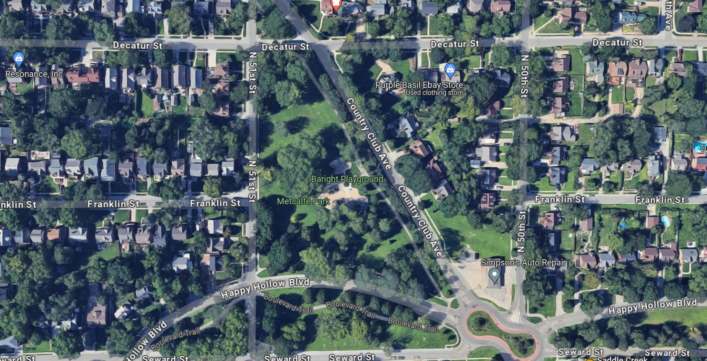
Mott v. City of Omaha 1993 Neb. App. LEXIS 358 (NE Ct. App. 1993)
Notes:
June 1988 failure
Clayton Mott driving by Metcalfe Park
Large branch from silver maple park tree fell on passing driver in severe thunderstorm, quadriplegic

Slide 72
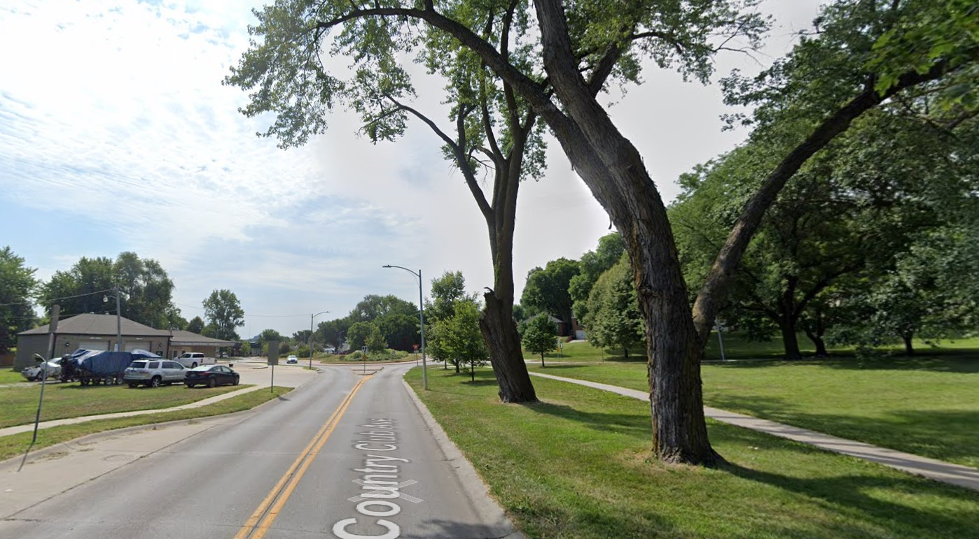
Mott v. City of Omaha 1993 Neb. App. LEXIS 358 (NE Ct. App. 1993)
Notes:
June 1988 failure
Clayton Mott driving by Metcalfe Park
Large branch from silver maple park tree fell on passing driver in severe thunderstorm, quadriplegic

Slide 73
Mott v. City of Omaha 1993 Neb. App. LEXIS 358 (NE Ct. App. 1993)
π Evidence
Δ Evidence
Epicormic branching
Old pruning wound
Open cavity at base
Mower-damaged roots
Bark loss on buttress roots
Chlorotic leaves
“Frass”
City removed tree after failure
Callous formation
Cavity only 5 inches deep
Splintered break at point of failure
>50% holding wood
Included bark at union visible from aerial lift, but not the ground
Drive-by inspection observed chlorosis and mower damage but did not probe cavity

Slide 74
Mott v. City of Omaha 1993 Neb. App. LEXIS 358 (NE Ct. App. 1993)
π Expert Witness
Δ Expert Witness
Epicormic branching indicates tree was stressed
“Frass” indicates wood-boring insects
Chlorosis indicates stress
Callous wood indicates the tree has successfully responded to decay
“Frass” was only soil or sawdust, but not insect detritus
Splintered wood indicates little decay
Mower damage not significant for branch failure

Slide 75
Mott v. City of Omaha 1993 Neb. App. LEXIS 358 (NE Ct. App. 1993)
Other Notable Points:
Changed testimony
Spoliation
Subsequent remedial measures
Notes:
- City forester changed testimony at deposition. First, he was presented a photo of the tree, and he said he would take it out. Then he was told it was THE tree, and he said he would keep it.
Just because testimony is different doesn’t mean it should be excluded. He got new information (ID of the tree), so maybe he incorporated info he knew about his in-person inspection of the tree.
- Just because branch destroyed doesn’t mean adverse inference. Branch cleanup is normal, court didn’t impose a duty to preserve the branch here
- “Hindsight” is not measured by the same standard as “foresight”

Slide 76
Mott v. City of Omaha 1993 Neb. App. LEXIS 358 (NE Ct. App. 1993)
Notes:
June 1980 failure
Driver pulled over in a violent storm, parking beneath silver maple street tree
Quadriplegia

Slide 77
Mott v. City of Omaha 1993 Neb. App. LEXIS 358 (NE Ct. App. 1993)
Bench Trial
Notes:
June 1980 failure
Driver pulled over in a violent storm, parking beneath silver maple street tree
Quadriplegia

Slide 78
Mott v. City of Omaha 1993 Neb. App. LEXIS 358 (NE Ct. App. 1993)
Bench Trial
“equipoise”
Notes:
June 1980 failure
Driver pulled over in a violent storm, parking beneath silver maple street tree
Quadriplegia

Slide 79
Mott v. City of Omaha 1993 Neb. App. LEXIS 358 (NE Ct. App. 1993)
Bench Trial
NE Ct. App.
“equipoise”
Notes:
June 1980 failure
Driver pulled over in a violent storm, parking beneath silver maple street tree
Quadriplegia

Slide 80
Mott v. City of Omaha 1993 Neb. App. LEXIS 358 (NE Ct. App. 1993)
Changed testimony: new information OK
Spoliation: no bad faith
Subsequent remediation: “hindsight” is not “foresight”
Notes:
- City forester changed testimony at deposition. First, he was presented a photo of the tree, and he said he would take it out. Then he was told it was THE tree, and he said he would keep it.
Just because testimony is different doesn’t mean it should be excluded. He got new information (ID of the tree), so maybe he incorporated info he knew about his in-person inspection of the tree.
- Just because branch destroyed doesn’t mean adverse inference. Branch cleanup is normal, court didn’t impose a duty to preserve the branch here
- “Hindsight” is not measured by the same standard as “foresight”

Slide 81
Mott v. City of Omaha 1993 Neb. App. LEXIS 358 (NE Ct. App. 1993)

Slide 82
Mott v. City of Omaha 1993 Neb. App. LEXIS 358 (NE Ct. App. 1993)

Slide 83
Mott v. City of Omaha 1993 Neb. App. LEXIS 358 (NE Ct. App. 1993)
Level 1 Inspection
IF EXTERNAL INDICATOR:
Level 2 Inspection
IF INDICATOR OF EXTENSIVE DECAY:
Mitigation Action

Slide 84
Mott v. City of Omaha 1993 Neb. App. LEXIS 358 (NE Ct. App. 1993)
Level 1 Inspection
IF EXTERNAL INDICATOR:
Level 2 Inspection
IF INDICATOR OF EXTENSIVE DECAY:
Mitigation Action

Slide 85
Mott v. City of Omaha 1993 Neb. App. LEXIS 358 (NE Ct. App. 1993)
Level 1 Inspection
IF EXTERNAL INDICATOR:
Level 2 Inspection
IF INDICATOR OF EXTENSIVE DECAY:
Mitigation Action

Slide 86
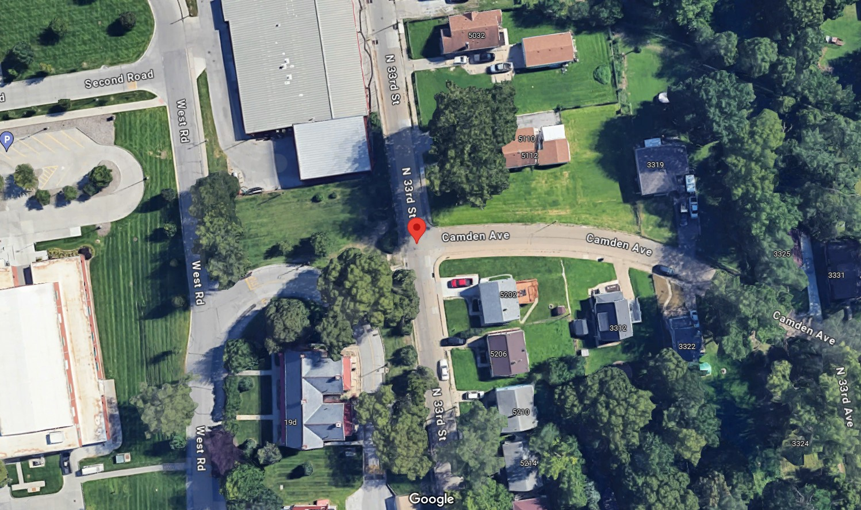
Holts v. City of Omaha 2002 Neb. App. LEXIS 203 (NE Ct. App. 2002)
Notes:
April 1996 failure
Alois Holts, 13 y/o riding a go-cart on his sidewalk was killed, mother brought wrongful death action
Street Tree Green Ash failed in a 50-mph wind

Slide 87
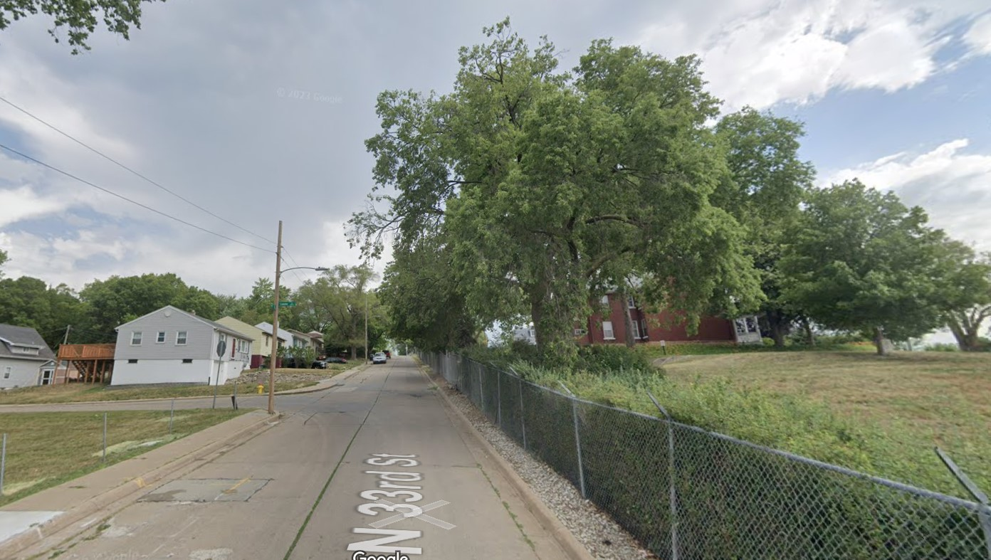
Holts v. City of Omaha 2002 Neb. App. LEXIS 203 (NE Ct. App. 2002)
Notes:
April 1996 failure
Alois Holts, 13 y/o riding a go-cart on his sidewalk was killed, mother brought wrongful death action
Street Tree Green Ash failed in a 50-mph wind

Slide 88
Holts v. City of Omaha 2002 Neb. App. LEXIS 203 (NE Ct. App. 2002)
Inspection
π Evidence
Δ Evidence
Tree was marked with a yellow “X” for more than 1 year
Prior branch failures over past 10 years
City inspected tree after failures and didn’t remove it
Neighbor requested removal 3 or 4 more times, City refused
Same windshield inspection protocol from McGinn
No city records of marking that tree

Slide 89
Holts v. City of Omaha 2002 Neb. App. LEXIS 203 (NE Ct. App. 2002)
Tree Failure
π Evidence
Δ Evidence
Epicormic shoots
Bulge around branch tearout
Extensive decay
Cavity at base of tree
Roots overlapping curb
Prior branch failures
Failed in 50 mph wind
Cavity at branch union was concealed

Slide 90
Holts v. City of Omaha 2002 Neb. App. LEXIS 203 (NE Ct. App. 2002)
π Expert Witness
Δ Expert Witness
Epicormics indicate stress
Bulge indicated unsuccessful compartmentalization
Windshield inspection is NOT reasonable
Drilling tests would have revealed the cavity
Epicormics stimulated by light, not rot
Bulge was response growth that strengthened union
Windshield inspection is reasonable and common
Trunk sounding is imprecise
Drilling tests are invasive

Slide 91
Holts v. City of Omaha 2002 Neb. App. LEXIS 203 (NE Ct. App. 2002)
Trial Court:
“the manner in which the City inspects for hazardous trees is problematic”
“the [green ash] had been designated by an X for removal years prior to the time it fell”
“even if the green ash had not been marked with an X, … it still should have been removed”
Notes:
Trial court rested findings on TWO ALTERNATIVE THEORIES:
- problematic inspection
-

Slide 92
Holts v. City of Omaha 2002 Neb. App. LEXIS 203 (NE Ct. App. 2002)
Notes:
June 1980 failure
Driver pulled over in a violent storm, parking beneath silver maple street tree
Quadriplegia

Slide 93
Holts v. City of Omaha 2002 Neb. App. LEXIS 203 (NE Ct. App. 2002)
Bench Trial
Notes:
June 1980 failure
Driver pulled over in a violent storm, parking beneath silver maple street tree
Quadriplegia

Slide 94
Holts v. City of Omaha 2002 Neb. App. LEXIS 203 (NE Ct. App. 2002)
Bench Trial
“π Wins”
Notes:
June 1980 failure
Driver pulled over in a violent storm, parking beneath silver maple street tree
Quadriplegia

Slide 95
Holts v. City of Omaha 2002 Neb. App. LEXIS 203 (NE Ct. App. 2002)
Bench Trial
NE Ct. App.
“π Wins”
Notes:
June 1980 failure
Driver pulled over in a violent storm, parking beneath silver maple street tree
Quadriplegia

Slide 96
Holts v. City of Omaha 2002 Neb. App. LEXIS 203 (NE Ct. App. 2002)
Windshield inspections OK generally
BUT must inspect L2 if defect
Does not opine on whether City’s methods of inspection are OK
π wins IF EITHER:
Tree marked for removal (city knew) OR
External indicators would have led to inspection/removal

Slide 97
Holts v. City of Omaha 2002 Neb. App. LEXIS 203 (NE Ct. App. 2002)

Slide 98
Holts v. City of Omaha 2002 Neb. App. LEXIS 203 (NE Ct. App. 2002)

Slide 99
Holts v. City of Omaha 2002 Neb. App. LEXIS 203 (NE Ct. App. 2002)
Level 1 Inspection
IF EXTERNAL INDICATOR:
Level 2 Inspection
IF INDICATOR OF EXTENSIVE DECAY:
Mitigation Action

Slide 100
Holts v. City of Omaha 2002 Neb. App. LEXIS 203 (NE Ct. App. 2002)
Level 1 Inspection
IF EXTERNAL INDICATOR:
Level 2 Inspection
IF INDICATOR OF EXTENSIVE DECAY:
Mitigation Action

Slide 101
“The Omaha Cases”
McGinn
Mott
Holts
NE Supreme Court
(1984)
NE Court of Appeals
(1993)
NE Court of Appeals
(2002)

Slide 102
“The Omaha Cases”
McGinn
Mott
Holts

Slide 103
Sidewalk Trip and Fall
Maloney v. City of Grand Forks 15 N.W.2d 769 (ND Sup. Ct. 1944)
Joyce v. City of High Point 30 N.C.App. 346 (NC Ct. App. 1976)
Roman v. City of Plainfield 388 N.J. Super. 527 (NJ Super. Ct. App. 2006)
Moore v. County of Union 2006 N.J. Super. LEXIS 2884 (NJ Super. Ct. App. 2006)
Notes:
4 cases

Slide 104
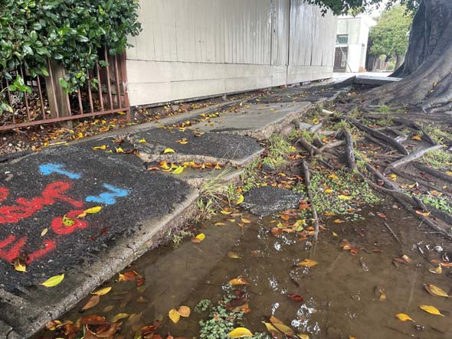
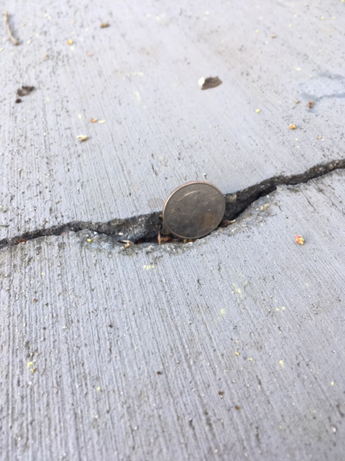
Maloney v. City of Grand Forks 15 N.W.2d 769 (ND Sup. Ct. 1944)
Notes:
Trip and fall
Sometimes displacement is very large. Other times, it is very small. When should a city be liable for trip and fall injuries caused by dangerous conditions of the sidewalk?
1944 Grand Forks, ND
Helen Maloney tripped and fell on a 1-inch crack in a sidewalk lifted by the roots of a tree
Defect existed for at least 2 years
LIABILITY vs. DE MINIMIS
1-inch displacement ENOUGH for a jury question

Slide 105
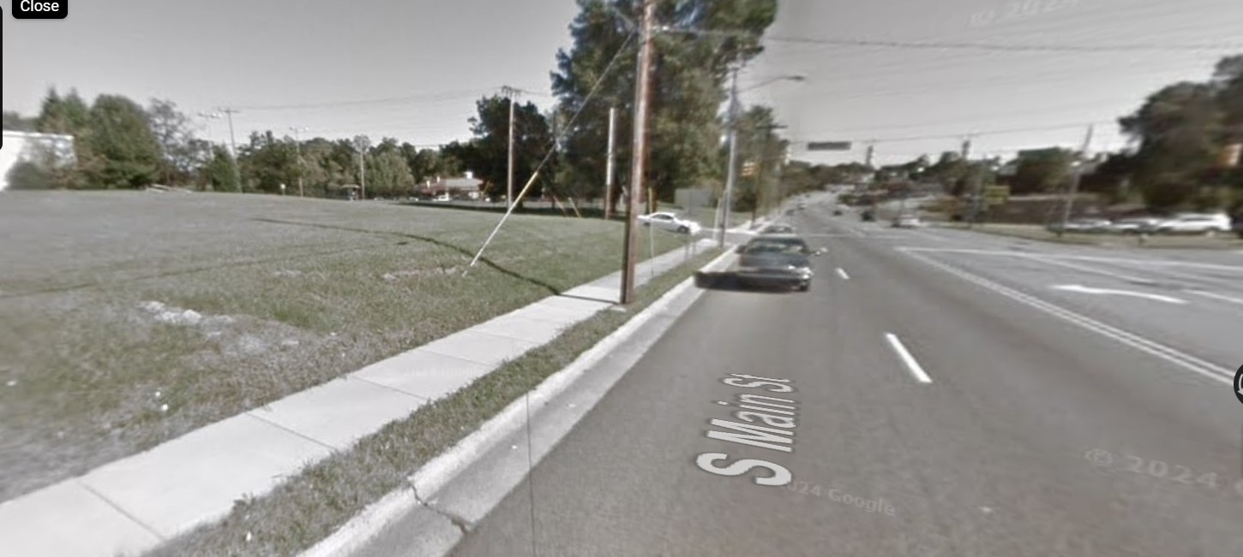
Joyce v. City of High Point 30 N.C.App. 346 (NC Ct. App. 1976)
Notes:
North Carolina Court of Appeals
1976 High Point, NC
Nannie Joyce walked along South Main Street in High Point, NC
Trip and fall on a 1-inch displacement caused by the roots of a tree
Sidewalk was dry, sun was shining
1-inch displacement is obvious enough to be CONTRIBUTORY NEGLIGENCE AS A MATTER OF LAW

Slide 106
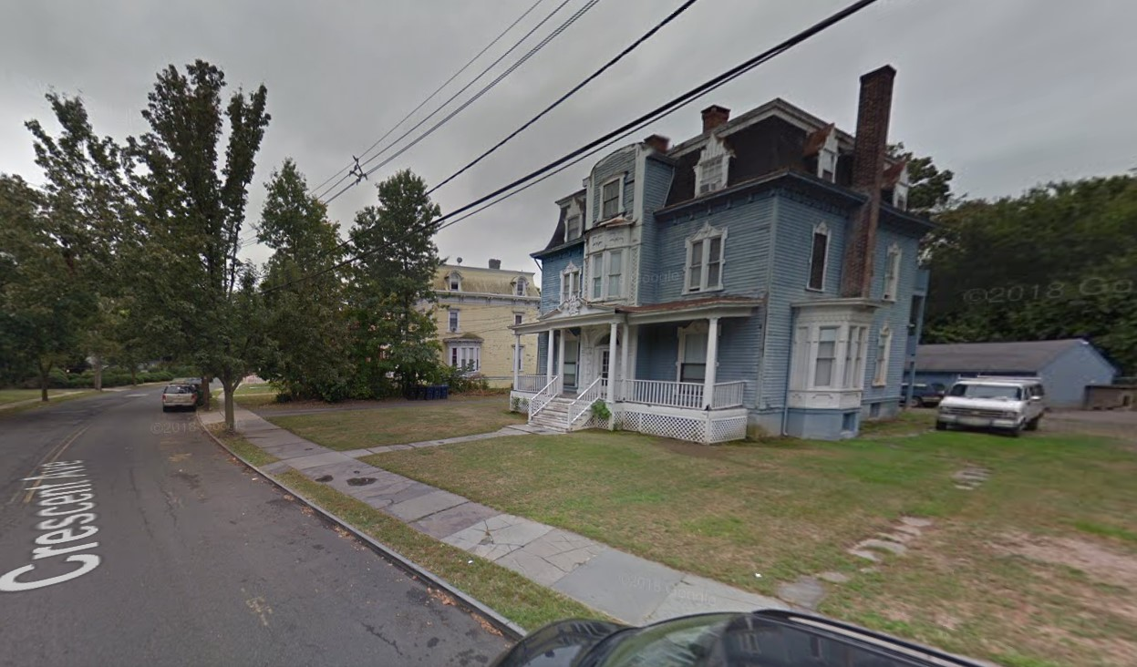
Roman v. City of Plainfield 388 N.J. Super. 527 (NJ Super. Ct. App. 2006)
Notes:
New Jersey Superior Court of Appeals
February 2002, Crescent Ave in Plainfield NJ
Beverly Roman tripped and and fell on raised 2-inch sidewalk crack
Walkway was privately owned at multifamily residential building, but it was lifted by street tree roots
City ordinance says permit required to fix sidewalk or encroach upon street tree
Beverly DID NOT sue OWNER, ONLY sued CITY
Tort Claims Act waived immunity for claims on PUBLIC property. Was this PUBLIC property?
Public property is owned OR CONTROLLED by gov’t
JURY Q whether City controlled walkway

Slide 107
Roman v. City of Plainfield 388 N.J. Super. 527 (NJ Super. Ct. App. 2006)
X
Notes:
New Jersey Superior Court of Appeals
February 2002, Crescent Ave in Plainfield NJ
Beverly Roman tripped and and fell on raised 2-inch sidewalk crack
Walkway was privately owned at multifamily residential building, but it was lifted by street tree roots
City ordinance says permit required to fix sidewalk or encroach upon street tree
Beverly DID NOT sue OWNER, ONLY sued CITY
Tort Claims Act waived immunity for claims on PUBLIC property. Was this PUBLIC property?
Public property is owned OR CONTROLLED by gov’t
JURY Q whether City controlled walkway

Slide 108
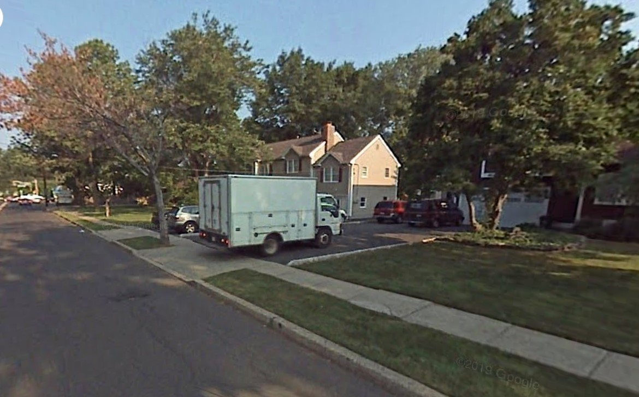
Moore v. County of Union 2006 N.J. Super. LEXIS 2884 (NJ Super. Ct. App. 2006)
Notes:
New Jersey Superior Court of Appeals
2006, Clark, NJ
Phyllis Moore was “power walkng” on a sidewalk along Madison Hill Road
Trip and fall in HOLE left by TREE REMOVAL after soil settled
No notice to city of hole
Not “patently unreasonable” to not inspect grassy strip

Slide 109
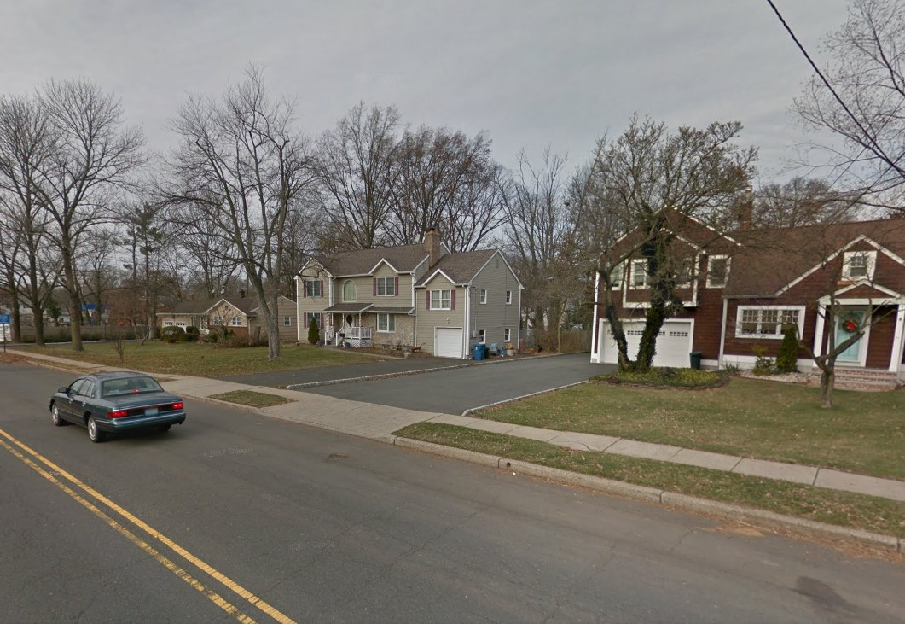
Moore v. County of Union 2006 N.J. Super. LEXIS 2884 (NJ Super. Ct. App. 2006)
Notes:
New Jersey Superior Court of Appeals
2006, Clark, NJ
Phyllis Moore was “power walkng” on a sidewalk along Madison Hill Road
Trip and fall in HOLE left by TREE REMOVAL after soil settled
No notice to city of hole
Not “patently unreasonable” to not inspect grassy strip

Slide 110
Moore v. County of Union 2006 N.J. Super. LEXIS 2884 (NJ Super. Ct. App. 2006)
X
Notes:
New Jersey Superior Court of Appeals
2006, Clark, NJ
Phyllis Moore was “power walkng” on a sidewalk along Madison Hill Road
Trip and fall in HOLE left by TREE REMOVAL after soil settled
No notice to city of hole
Not “patently unreasonable” to not inspect grassy strip

Slide 111
Street Obstructions
Brown v. State Highway Com. 202 Kan. 1 (KS Sup. Ct. 1968)
Embler v. Wallkill 10 N.Y.S 797 (NY Sup. Ct. 1890)
Williams v. Davis 974 So. 2d 1052 (FL Sup. Ct. 2007)
Notes:
3 cases

Slide 112
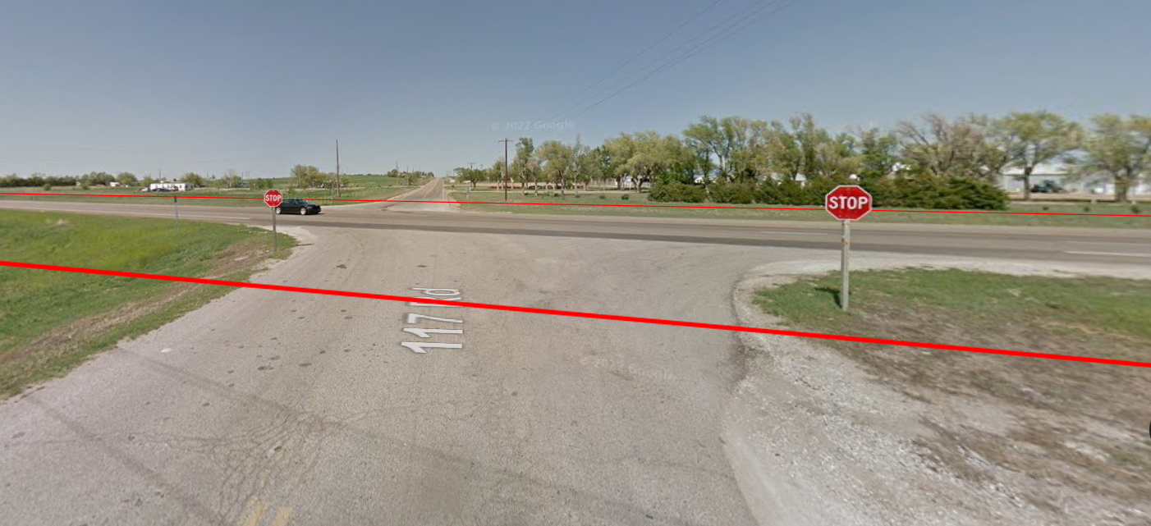
Brown v. State Highway Com 202 Kan. 1 (KS Sup. Ct. 1968)
Notes:
KS Supreme Court
1963, US 400 (formerly US 154) and Coronado Bridge Rd, 2 miles east of Dodge City
Private trees blocking stop sign in rural area
- Brown (driving east), Vogel (driving west), Eggleston (itinerant farm laborer with blind right eye)
- Private property trees CAN be a “road defect”
- Need NOT be in traveled portion
- Sufficient evidence state KNEW of defect

Slide 113
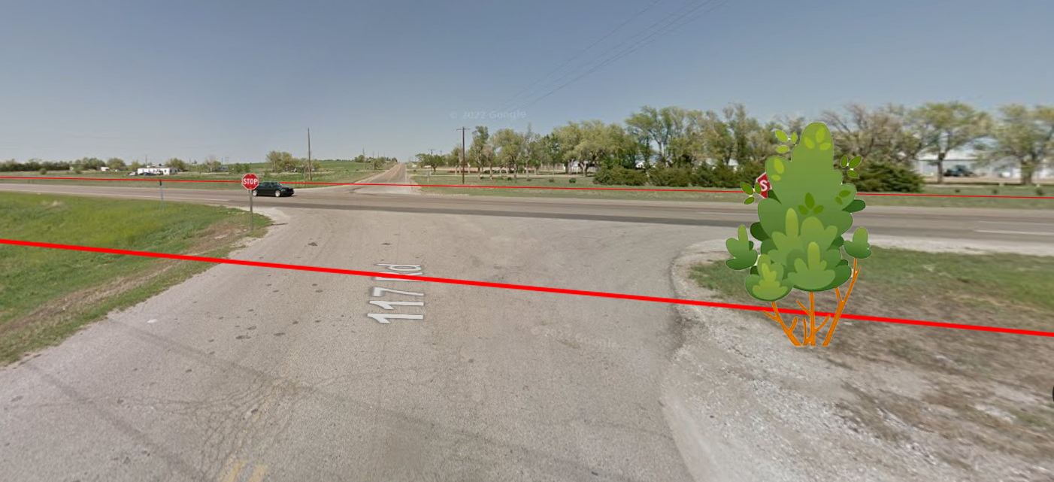
Brown v. State Highway Com 202 Kan. 1 (KS Sup. Ct. 1968)
Notes:
KS Supreme Court
1963, US 400 (formerly US 154) and Coronado Bridge Rd, 2 miles east of Dodge City
Private trees blocking stop sign in rural area
- Brown (driving east), Vogel (driving west), Eggleston (itinerant farm laborer with blind right eye)
- Private property trees CAN be a “road defect”
- Need NOT be in traveled portion
- Sufficient evidence state KNEW of defect

Slide 114
Brown v. State Highway Com 202 Kan. 1 (KS Sup. Ct. 1968)
π
Notes:
KS Supreme Court
1963, US 400 (formerly US 154) and Coronado Bridge Rd, 2 miles east of Dodge City
Private trees blocking stop sign in rural area
- Brown (driving east), Vogel (driving west), Eggleston (itinerant farm laborer with blind right eye)
- Private property trees CAN be a “road defect”
- Need NOT be in traveled portion
- Sufficient evidence state KNEW of defect

Slide 115
Brown v. State Highway Com 202 Kan. 1 (KS Sup. Ct. 1968)
π
Notes:
KS Supreme Court
1963, US 400 (formerly US 154) and Coronado Bridge Rd, 2 miles east of Dodge City
Private trees blocking stop sign in rural area
- Brown (driving east), Vogel (driving west), Eggleston (itinerant farm laborer with blind right eye)
- Private property trees CAN be a “road defect”
- Need NOT be in traveled portion
- Sufficient evidence state KNEW of defect

Slide 116
Stop Sign Cases
Brown v. State Highway Com. 202 Kan. 1 (KS Sup. Ct. 1968)
Physicians Plus Ins. Corp. v. Midwest Mut. Ins. Co. 254 Wis.2d 77 (WI Sup. Ct. 2002)
Kenneally v. Thurn 653 S.W.2d 69 (TX Ct. App. 1983)
Fanning v. Laramie 402 P.2d 460 (WY Sup. Ct. 1965)
Notes:
In ALL these cases, the CITY can be liable for branches obscuring a stop sign
EVEN IF tree is privately owned
EVEN IF the tree is entirely off the ROW

Slide 117
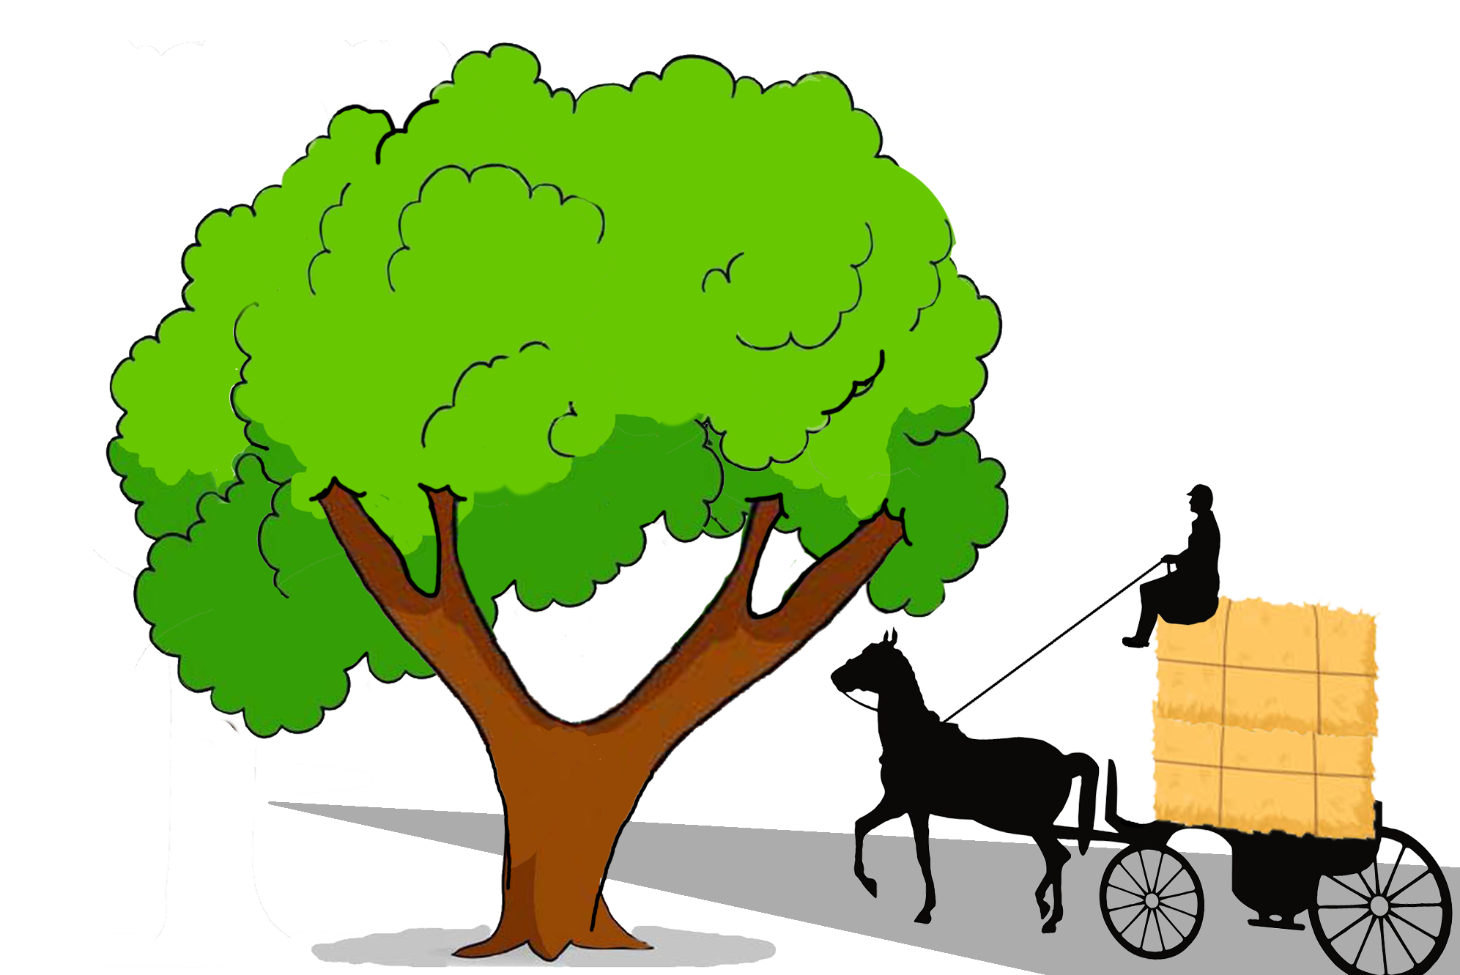
Embler v. Wallkill 10 N.Y.S 797 (NY Sup. Ct. 1890)
Notes:
New York Supreme Court (lower court)
1890 in Town of Walkill, New York
Embler led a horse drawn carriage through town, sitting on top of a stack of hay
Embler struck a low branch overhanging the road, getting clotheslined
Low branch had existed for 10 years
City liable. This was “inexcusable negligence”

Slide 118
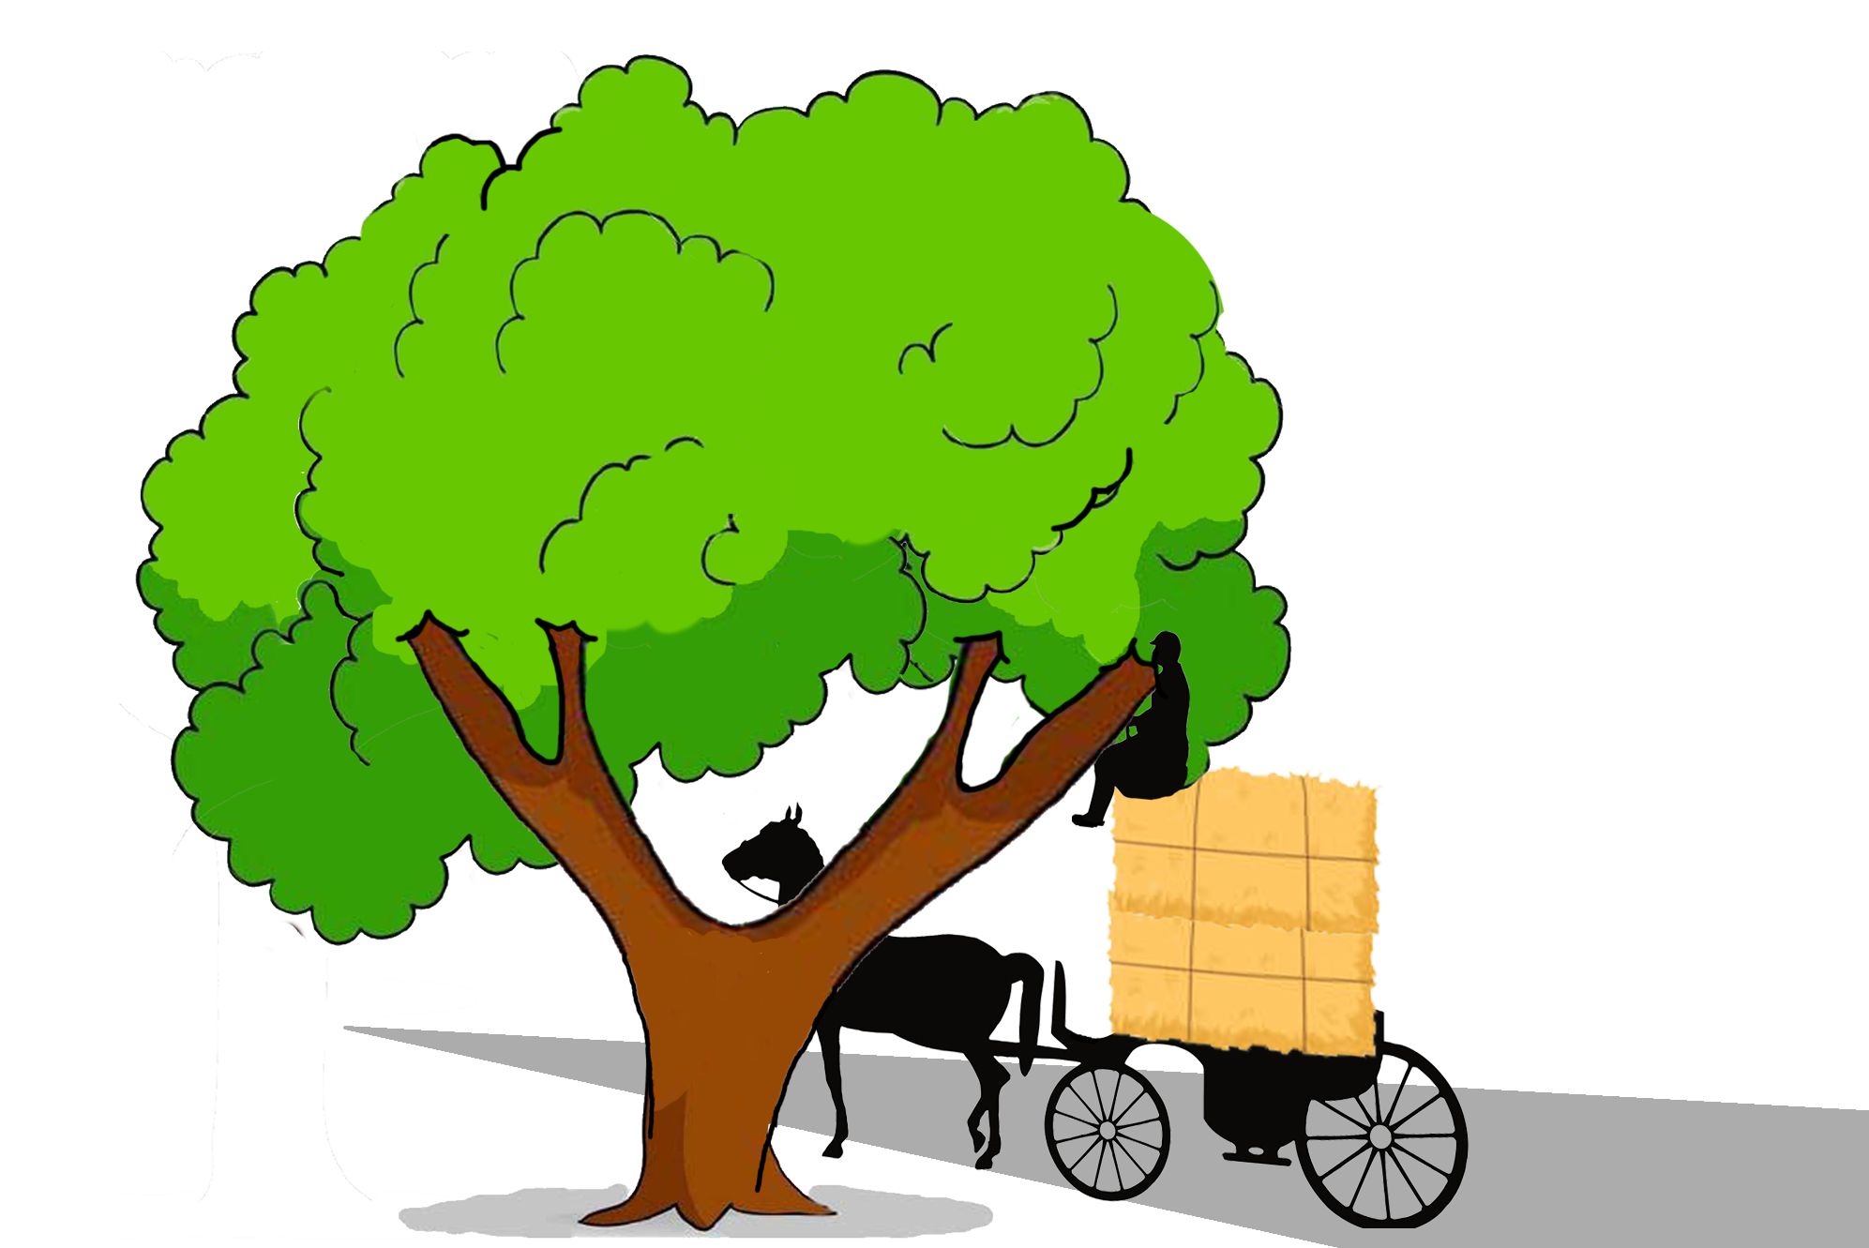
Embler v. Wallkill 10 N.Y.S 797 (NY Sup. Ct. 1890)
Notes:
New York Supreme Court (lower court)
1890 in Town of Walkill, New York
Embler led a horse drawn carriage through town, sitting on top of a stack of hay
Embler struck a low branch overhanging the road, getting clotheslined
Low branch had existed for 10 years
City liable. This was “inexcusable negligence”

Slide 119
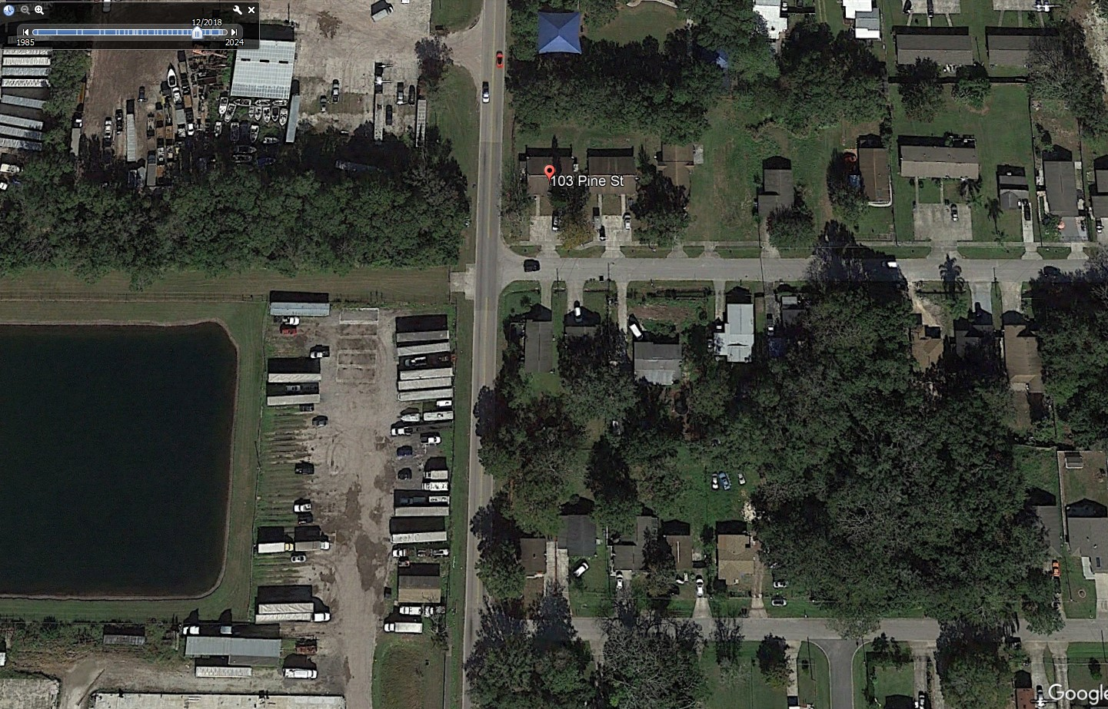
Williams v. Davis 974 So. 2d 1052 (FL Supr. Ct. 2007)
Notes:
The intersection of Pine St and Sidney Hayes Road in Orlando FL today

Slide 120
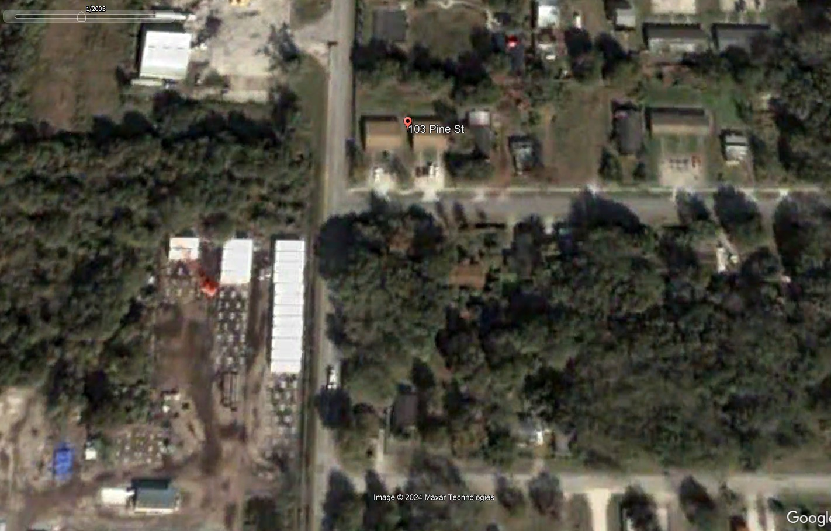
Williams v. Davis 974 So. 2d 1052 (FL Supr. Ct. 2007)
Notes:
Back in 2003, there were dense trees at the southeast corner of the intersection of Pine St and Sidney Hayes Road

Slide 121
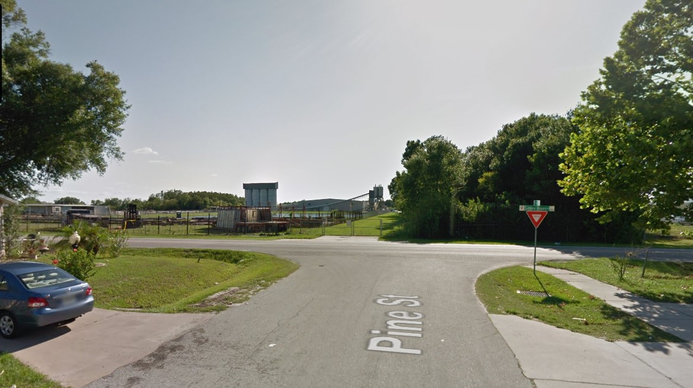
Williams v. Davis 974 So. 2d 1052 (FL Supr. Ct. 2007)
Notes:
Twanda Green was driving west along Pine St in a procession of rental car relocation
As she was turning left onto Sidney Hayes Rd, she was struck by a dump truck obscured by foliage

Slide 122
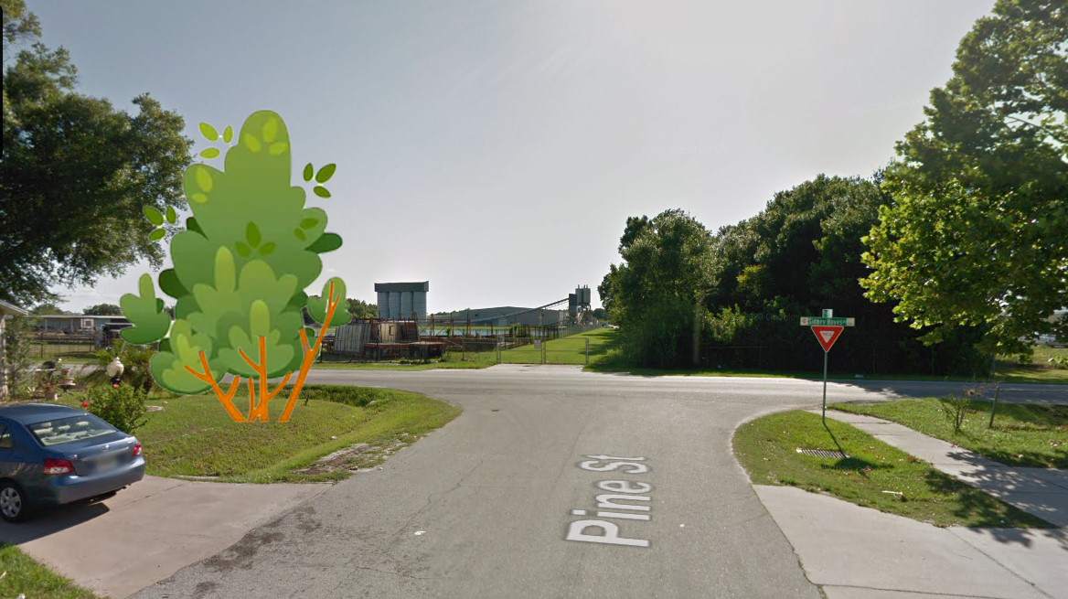
Williams v. Davis 974 So. 2d 1052 (FL Supr. Ct. 2007)
Notes:
Twanda Green was driving west along Pine St in a procession of rental car relocation
As she was turning left onto Sidney Hayes Rd, she was struck by a dump truck obscured by foliage

Slide 123
Williams v. Davis 974 So. 2d 1052 (FL Supr. Ct. 2007)

Slide 124
Williams v. Davis 974 So. 2d 1052 (FL Supr. Ct. 2007)

Slide 125
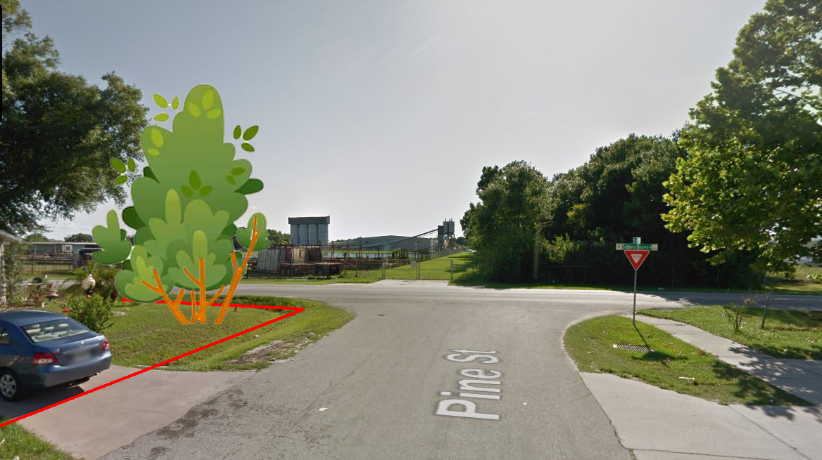
Williams v. Davis 974 So. 2d 1052 (FL Supr. Ct. 2007)
Notes:
Unclear from evidence whether the foliage extended into the ROW.
If all the foliage is WHOLLY within private property, then no private landowner liability.
Not foreseeable that leaving foliage wholly within a forested lot would endanger the public.
Private landowner CAN be liable if foliage EXTENDS INTO ROW

Slide 126
Property Rights
Colston v. St. Joseph 106 Mo. App. 714 (MO Ct. App. 1904)
City of Paola v. Wentz 79 Kan. 148 (KS Sup. Ct. 1908)
Carstens v. De Sellem 82 Wash. 643 (WA Supr. Ct. 1914)
Notes:
3 cases

Slide 127
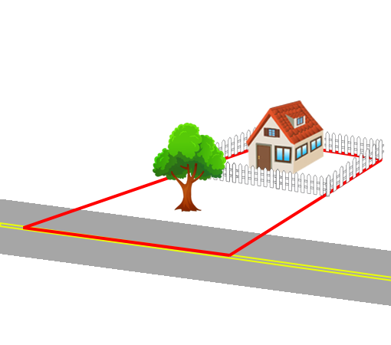
Colston v. St. Joseph 106 Mo. App. 714 (MO Ct. App. 1904)
Notes:
MO Court of Appeals
1904, City of St. Joseph graded a street and cut down trees along the street on Mr. Colston’s property
Plaintiff has no recourse.
Liability ONLY IF “unnecessary” or “unreasonable”

Slide 128
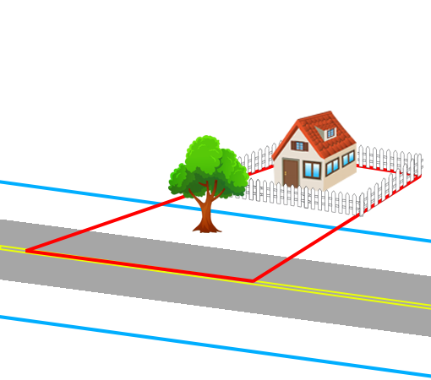
Colston v. St. Joseph 106 Mo. App. 714 (MO Ct. App. 1904)
Notes:
MO Court of Appeals
1904, City of St. Joseph graded a street and cut down trees along the street on Mr. Colston’s property
Plaintiff has no recourse.
Liability ONLY IF “unnecessary” or “unreasonable”

Slide 129
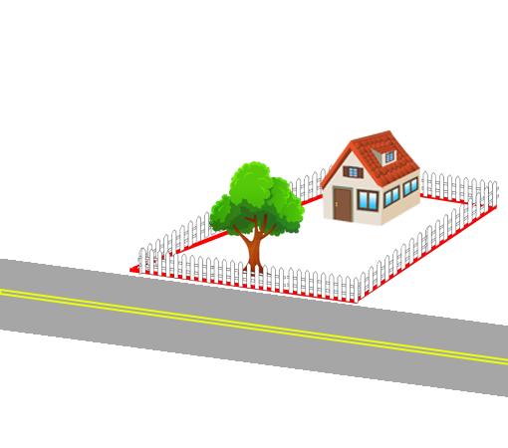
City of Paola v. Wentz 79 Kan. 148 (KS Sup. Ct. 1908)
Notes:
KS Supreme Court
City of Paola, KS
Unnecessary cutting of street trees
City enjoined from cutting plaintiff’s trees
“we’re building a sidewalk 5 feet beyond road” (but tree wasn’t within the area surveyed)

Slide 130
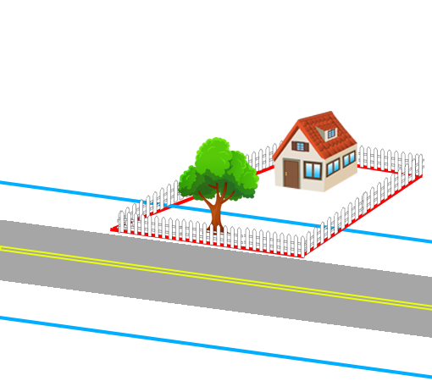
City of Paola v. Wentz 79 Kan. 148 (KS Sup. Ct. 1908)
Notes:
KS Supreme Court
City of Paola, KS
Unnecessary cutting of street trees
City enjoined from cutting plaintiff’s trees
“we’re building a sidewalk 5 feet beyond road” (but tree wasn’t within the area surveyed)

Slide 131
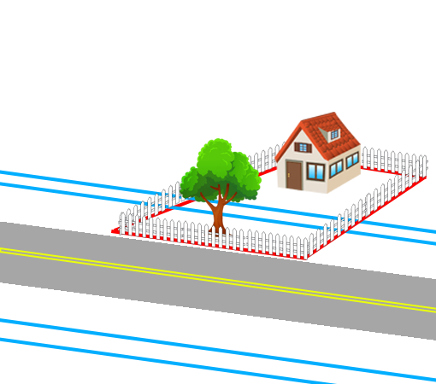
City of Paola v. Wentz 79 Kan. 148 (KS Sup. Ct. 1908)
Notes:
KS Supreme Court
City of Paola, KS
Unnecessary cutting of street trees
City enjoined from cutting plaintiff’s trees
“we’re building a sidewalk 5 feet beyond road” (but tree wasn’t within the area surveyed)

Slide 132
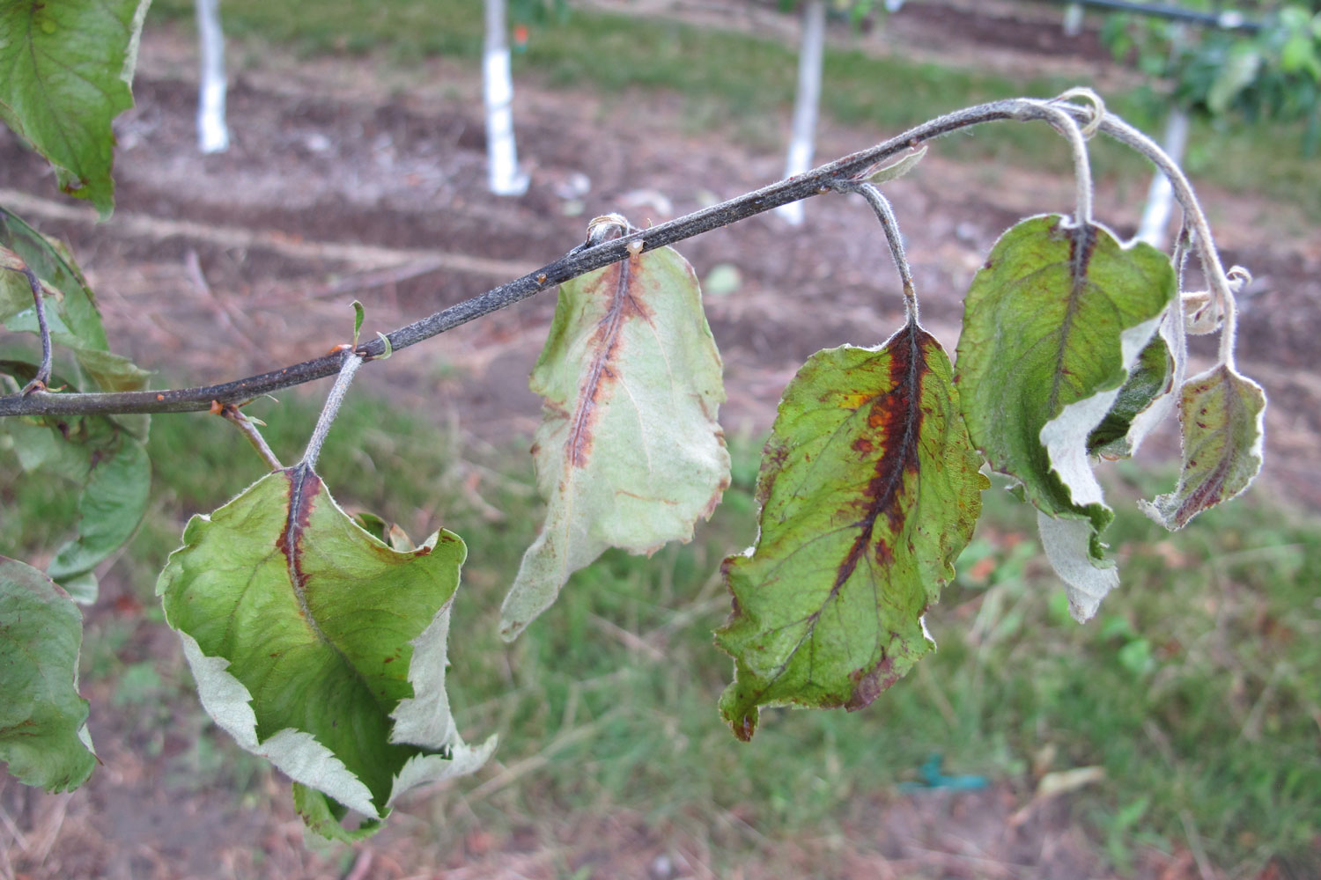
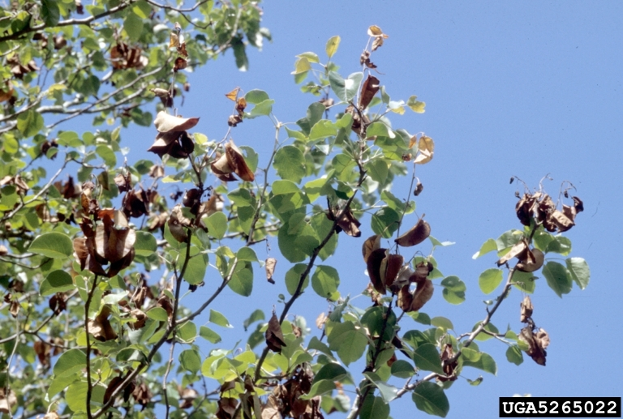
Carstens v. De Sellem 82 Wash. 643 (WA Supr. Ct. 1914)
Notes:
Washington Supreme Court
1914 in Yakima County – Carstens owned a pear orchard
Ag inspector De Sellem found fireblight in the orchard, demanded destruction of Carsten’s trees
Over Carsten’s objections, De Sellem’s crew destroyed all of Carstens’ infected pear trees

Slide 133
Carstens v. De Sellem 82 Wash. 643 (WA Supr. Ct. 1914)
“Salus populi suprema lex”
Public welfare is supreme law

Slide 134
Carstens v. De Sellem 82 Wash. 643 (WA Supr. Ct. 1914)
“Salus populi suprema lex”
Public welfare is supreme law
Ag. commissioner MAY destroy infected trees

Slide 135
Carstens v. De Sellem 82 Wash. 643 (WA Supr. Ct. 1914)
“Salus populi suprema lex”
Public welfare is supreme law
Ag. commissioner MAY destroy infected trees
No compensation is owed

Slide 136
Summary
Tree Failure
Sidewalk Trip and Fall
Street Obstructions
Property Rights
Notes:
TOTAL:
Tree Failure: 9
Sidewalk Trip and Fall: 4
Street Obstructions: 3
Property Rights: 3

Slide 137
Case Illustrations in Urban Forestry Law
James Komen
BCMA #WE-9909B
RCA #555

