Slide 1
Is Your Tree Protection Ordinance Constitutional?
James Komen
BCMA #WE-9909B
RCA #555

Slide 2
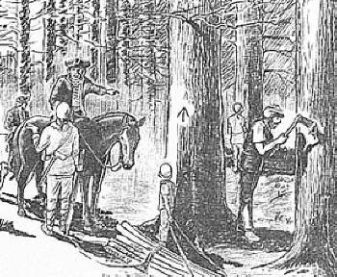
Weare, NH (1772)
Notes:
1772: pine tree riots
1776: independence
1788: constitution ratified
1791: bill of rights ratified

Slide 3
Constitutional Challenges to Tree Ordinances

Slide 4
Constitutional Challenges to Tree Ordinances
1st A: Free Speech
4th A: Unreasonable Seizure
5th A: Takings and Exactions
8th A: Excessive Fines
14th A: Due Process and Equal Protection
Police Power
Taxation

Slide 5
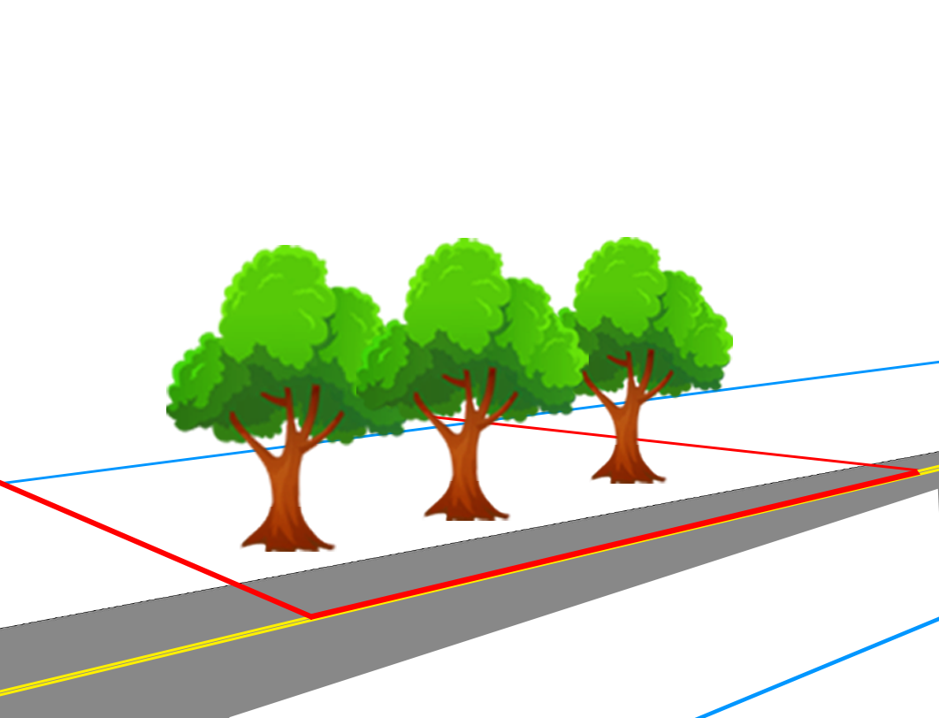
Bigelow v. Whitcomb (1904 NH Sup. Ct.)
5th A
Notes:
Town of Hinsdale, NH

Slide 6
Bigelow v. Whitcomb (1904 NH Sup. Ct.)
5th A

Slide 7
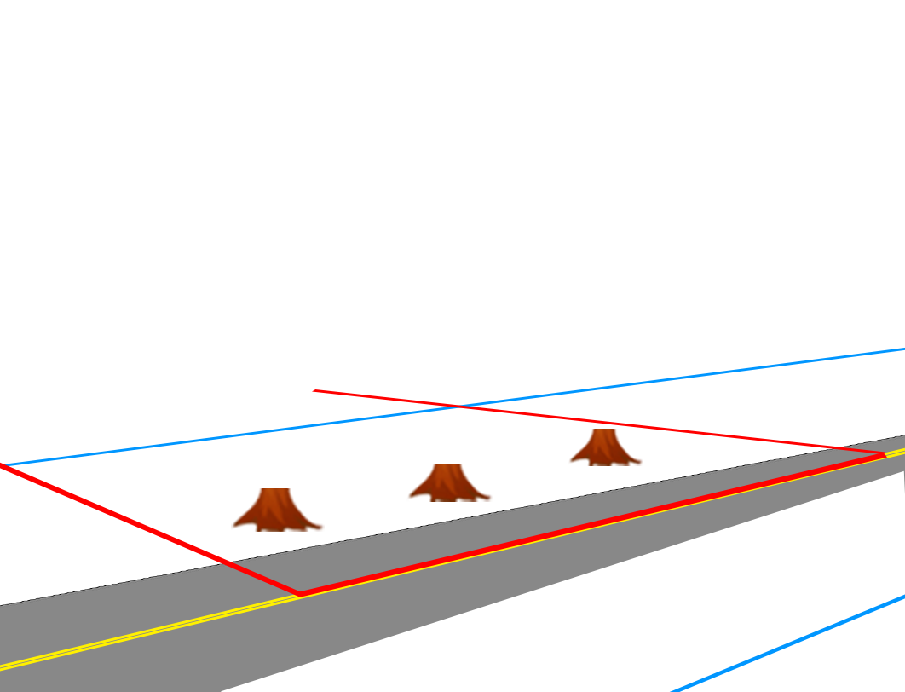
Bigelow v. Whitcomb (1904 NH Sup. Ct.)
5th A

Slide 8
Bigelow v. Whitcomb (1904 NH Sup. Ct.)
5th A
“To prevent a man from using his property is virtually taking it from him”
“[the] trees…belong to the owner of the adjacent land, who cannot be deprived of his right…without compensation”

Slide 9
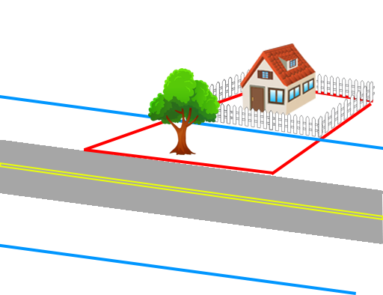
Lancaster v. Richardson (1871 NY Sup. Ct. App.)
5th A
Notes:
Town of Lancaster, NY

Slide 10
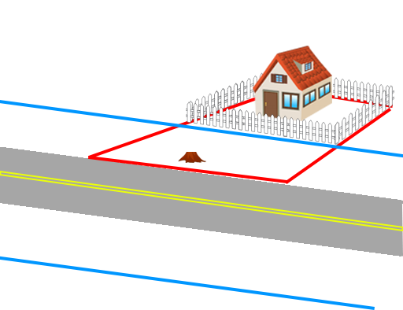
Lancaster v. Richardson (1871 NY Sup. Ct. App.)
5th A

Slide 11
Lancaster v. Richardson (1871 NY Sup. Ct. App.)
5th A
“A law that would place trees…under the care of the public officers…would be a very wholesome…exercise of legislative power.”

Slide 12
Lancaster v. Richardson (1871 NY Sup. Ct. App.)
5th A
“A law that would place trees…under the care of the public officers…would be a very wholesome…exercise of legislative power.”
BUT

Slide 13
Lancaster v. Richardson (1871 NY Sup. Ct. App.)
5th A
“A law that would place trees…under the care of the public officers…would be a very wholesome…exercise of legislative power.”
BUT
“Before the public can…say that a man cannot cut down his own trees, they must have acquired an interest therein by purchase or by the right of eminent domain.”

Slide 14
F.P. Dev., LLC v. Charter Twp. of Canton (2021 6th Cir. Ct. App.)
Notes:
Township of Canton, MI

Slide 15
F.P. Dev., LLC v. Charter Twp. of Canton (2021 6th Cir. Ct. App.)

Slide 16
F.P. Dev., LLC v. Charter Twp. of Canton (2021 6th Cir. Ct. App.)
Notes:
Issued a stop-work order, conditioned upon payment of tree replacement fine

Slide 17
F.P. Dev., LLC v. Charter Twp. of Canton (2021 6th Cir. Ct. App.)
4th A
4th A:

Slide 18
F.P. Dev., LLC v. Charter Twp. of Canton (2021 6th Cir. Ct. App.)
4th A
4th A:
Preserves the right of the people “to be secure in their persons, houses, papers, and effects, against unreasonable searches and seizures.”

Slide 19
F.P. Dev., LLC v. Charter Twp. of Canton (2021 6th Cir. Ct. App.)
4th A
4th A:
Preserves the right of the people “to be secure in their persons, houses, papers, and effects, against unreasonable searches and seizures.”

Slide 20
F.P. Dev., LLC v. Charter Twp. of Canton (2021 6th Cir. Ct. App.)
4th A
4th A:
Preserves the right of the people “to be secure in their persons, houses, papers, and effects, against unreasonable searches and seizures.”

Slide 21
F.P. Dev., LLC v. Charter Twp. of Canton (2021 6th Cir. Ct. App.)
4th A
4th A:
Preserves the right of the people “to be secure in their persons, houses, papers, and effects, against unreasonable searches and seizures.”

Slide 22
F.P. Dev., LLC v. Charter Twp. of Canton (2021 6th Cir. Ct. App.)
4th A
4th A:
Preserves the right of the people “to be secure in their persons, houses, papers, and effects, against unreasonable searches and seizures.”

Slide 23
F.P. Dev., LLC v. Charter Twp. of Canton (2021 6th Cir. Ct. App.)
4th A
4th A:
Preserves the right of the people “to be secure in their persons, houses, papers, and effects, against unreasonable searches and seizures.”
Ordinance does not implicate 4th A

Slide 24
F.P. Dev., LLC v. Charter Twp. of Canton (2021 6th Cir. Ct. App.)
8th A
8th A:

Slide 25
F.P. Dev., LLC v. Charter Twp. of Canton (2021 6th Cir. Ct. App.)
8th A
8th A:
“Excessive bail shall not be required, nor excessive fines imposed, nor cruel and unusual punishments inflicted.”

Slide 26
F.P. Dev., LLC v. Charter Twp. of Canton (2021 6th Cir. Ct. App.)
8th A
8th A:
“Excessive bail shall not be required, nor excessive fines imposed, nor cruel and unusual punishments inflicted.”
“limits the government’s power to extract payments…as punishment”

Slide 27
F.P. Dev., LLC v. Charter Twp. of Canton (2021 6th Cir. Ct. App.)
8th A
8th A:
“Excessive bail shall not be required, nor excessive fines imposed, nor cruel and unusual punishments inflicted.”
“limits the government’s power to extract payments…as punishment”
“[The tree replacement fine] is remedial, not punitive

Slide 28
F.P. Dev., LLC v. Charter Twp. of Canton (2021 6th Cir. Ct. App.)
8th A
8th A:
“Excessive bail shall not be required, nor excessive fines imposed, nor cruel and unusual punishments inflicted.”
“limits the government’s power to extract payments…as punishment”
“[The tree replacement fine] is remedial, not punitive, so it does not implicate the 8th A.”

Slide 29
F.P. Dev., LLC v. Charter Twp. of Canton (2021 6th Cir. Ct. App.)
5th A
5th A Exactions:
Notes:
“…removal of regulated trees triggers the mitigation requirements, regardless of the specific impact caused by their removal.”

Slide 30
F.P. Dev., LLC v. Charter Twp. of Canton (2021 6th Cir. Ct. App.)
5th A
5th A Exactions:
“[Canton]may not leverage its legitimate interest in mitigation to pursue governmental ends that lack an essential nexus and rough proportionality to those impacts.”
Notes:
“…removal of regulated trees triggers the mitigation requirements, regardless of the specific impact caused by their removal.”

Slide 31
F.P. Dev., LLC v. Charter Twp. of Canton (2021 6th Cir. Ct. App.)
5th A
5th A Exactions:
Tree removal “triggers the mitigation requirements, regardless of the specific impact caused by their removal.”
Notes:
“…removal of regulated trees triggers the mitigation requirements, regardless of the specific impact caused by their removal.”

Slide 32
F.P. Dev., LLC v. Charter Twp. of Canton (2021 6th Cir. Ct. App.)
5th A
5th A Exactions:
Tree removal “triggers the mitigation requirements, regardless of the specific impact caused by their removal.”
Canton failed to show “tree removal effects a certain level of environmental degradation on the surrounding area.”
Notes:
“…removal of regulated trees triggers the mitigation requirements, regardless of the specific impact caused by their removal.”

Slide 33
F.P. Dev., LLC v. Charter Twp. of Canton (2021 6th Cir. Ct. App.)
5th A
5th A Exactions:
Tree removal “triggers the mitigation requirements, regardless of the specific impact caused by their removal.”
Canton failed to show “tree removal effects a certain level of environmental degradation on the surrounding area.”
“Canton’s Tree Ordinance, as applied to F.P., …is thus an unconstitutional condition.”
Notes:
“…removal of regulated trees triggers the mitigation requirements, regardless of the specific impact caused by their removal.”

Slide 34
F.P. Dev., LLC v. Charter Twp. of Canton (2021 6th Cir. Ct. App.)
5th A
5th A Exactions:
Tree removal “triggers the mitigation requirements, regardless of the specific impact caused by their removal.”
Canton failed to show “tree removal effects a certain level of environmental degradation on the surrounding area.”
“Canton’s Tree Ordinance, as applied to F.P., …is thus an unconstitutional condition.”
Notes:
“…removal of regulated trees triggers the mitigation requirements, regardless of the specific impact caused by their removal.”

Slide 35
People v. Novie (2013 NY Sup. Ct. App.)
Notes:
Village of Montebello

Slide 36
People v. Novie (2013 NY Sup. Ct. App.)
Notes:
Village of Montebello

Slide 37
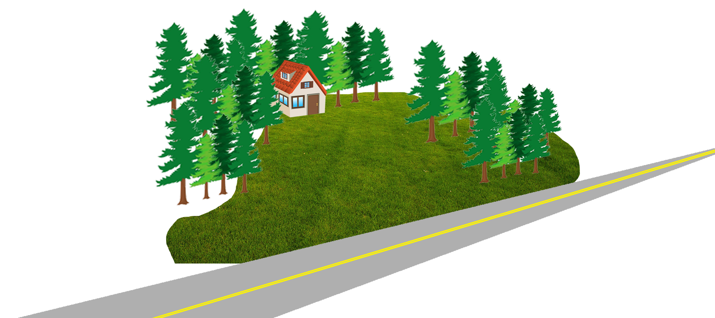
People v. Novie (2013 NY Sup. Ct. App.)
Notes:
Village of Montebello
Charged with violating Montebello ordinance,
Started application to appeal the fine imposed with the city, but then moved the court to dismiss for invalid ordinance

Slide 38
People v. Novie (2013 NY Sup. Ct. App.)
14th A
14th A “due process”:
“No State shall…deprive any person of life, liberty, or property, without due process of law.”
Procedural
Substantive

Slide 39
People v. Novie (2013 NY Sup. Ct. App.)
14th A
14th A “due process”:
“[the tree ordinance] clearly provides for adequate process, which the defendant…has chosen not to pursue.”
“[the ordinance is not] so outrageously arbitrary as to constitute a gross abuse of governmental authority.”

Slide 40
People v. Novie (2013 NY Sup. Ct. App.)
14th A
14th A “equal protection”:
“no person shall be denied the equal protection of the laws”
Notes:
Fundamental Rights: e.g. Right to marry, Right to have children
Suspect Class: e.g. race, color, creed, religion

Slide 41
People v. Novie (2013 NY Sup. Ct. App.)
14th A
14th A “equal protection”:
“no person shall be denied the equal protection of the laws”
“unless a suspect class or a fundamental right is involved,...classifications that create distinctions between similarly-situated individuals will be upheld if they are rationally related to a legitimate government interest.”
Notes:
Fundamental Rights: e.g. Right to marry, Right to have children
Suspect Class: e.g. race, color, creed, religion

Slide 42
People v. Novie (2013 NY Sup. Ct. App.)
1st A
1st A “freedom of speech”:

Slide 43
People v. Novie (2013 NY Sup. Ct. App.)
1st A
1st A “freedom of speech”:
“artistic expression, whether written or visual, is clearly protected by the First Amendment”

Slide 44
People v. Novie (2013 NY Sup. Ct. App.)
1st A
1st A “freedom of speech”:
“artistic expression, whether written or visual, is clearly protected by the First Amendment”
BUT

Slide 45
People v. Novie (2013 NY Sup. Ct. App.)
1st A
1st A “freedom of speech”:
“artistic expression, whether written or visual, is clearly protected by the First Amendment”
BUT
“[Novie] has not shown that his desire to landscape …amounts to artwork that is a quintessential form of expression.”

Slide 46
NJ Shore Builders Ass'n v. Twp. of Jackson (2009 NJ Sup. Ct.)
Notes:
Tree removal requires replanting on site
Or if not feasible, then payment into “tree escrow fund” to facilitate offsite planting
6-12” DBH: $200 per tree
12-18” DBH: $400 per tree
18-24” DBH: $600 per tree

Slide 47
NJ Shore Builders Ass'n v. Twp. of Jackson (2009 NJ Sup. Ct.)
Police Power
Police Power
Notes:
“…removal of regulated trees triggers the mitigation requirements, regardless of the specific impact caused by their removal.”

Slide 48
NJ Shore Builders Ass'n v. Twp. of Jackson (2009 NJ Sup. Ct.)
Police Power
Police Power
“All police power legislation is subject to the constitutional limitation that it be not unreasonable, arbitrary, or capricious.”
Notes:
“…removal of regulated trees triggers the mitigation requirements, regardless of the specific impact caused by their removal.”

Slide 49
NJ Shore Builders Ass'n v. Twp. of Jackson (2009 NJ Sup. Ct.)
Police Power
Police Power
“All police power legislation is subject to the constitutional limitation that it be not unreasonable, arbitrary, or capricious.”
“An ordinance is not invalid because it could have done more to combat the evils which is seeks to address.”
Notes:
“…removal of regulated trees triggers the mitigation requirements, regardless of the specific impact caused by their removal.”

Slide 50
NJ Shore Builders Ass'n v. Twp. of Jackson (2009 NJ Sup. Ct.)
Police Power
Police Power
“Removal of trees on any property affects the healthy, safety, and general well-being of the inhabitants.”
Notes:
“…removal of regulated trees triggers the mitigation requirements, regardless of the specific impact caused by their removal.”

Slide 51
NJ Shore Builders Ass'n v. Twp. of Jackson (2009 NJ Sup. Ct.)
Police Power
Police Power
“Removal of trees on any property affects the healthy, safety, and general well-being of the inhabitants.”
“replanting at the original location of the tree removal is optimal…However, where that is not feasible,…the Township mitigates the overall loss by planting off-site.”
Notes:
“…removal of regulated trees triggers the mitigation requirements, regardless of the specific impact caused by their removal.”

Slide 52
NJ Shore Builders Ass'n v. Twp. of Jackson (2009 NJ Sup. Ct.)
Taxation
Taxation
Notes:
“…removal of regulated trees triggers the mitigation requirements, regardless of the specific impact caused by their removal.”

Slide 53
NJ Shore Builders Ass'n v. Twp. of Jackson (2009 NJ Sup. Ct.)
Taxation
Taxation
“municipalities have no inherent power of taxation”
Notes:
“…removal of regulated trees triggers the mitigation requirements, regardless of the specific impact caused by their removal.”

Slide 54
NJ Shore Builders Ass'n v. Twp. of Jackson (2009 NJ Sup. Ct.)
Taxation
Taxation
“municipalities have no inherent power of taxation”
“fee imposed for…a permit constitutes an invalid tax if its primary purpose is to raise revenue.”
Notes:
“…removal of regulated trees triggers the mitigation requirements, regardless of the specific impact caused by their removal.”

Slide 55
NJ Shore Builders Ass'n v. Twp. of Jackson (2009 NJ Sup. Ct.)
Taxation
Taxation
“So long as the replacement fees do not exceed the municipality’s costs for administration and replacement, they are legitimate elements of the regulatory scheme.”
Notes:
“…removal of regulated trees triggers the mitigation requirements, regardless of the specific impact caused by their removal.”

Slide 56
Constitutional Challenges to Tree Ordinances
Bigelow v. Whitcomb Lancaster v. Richardson
F.P. Dev., LLC v. Twp. of Canton
People v. Novie
NJ Shore Builders v. Twp. Of Jackson

Slide 57
Constitutional Challenges to Tree Ordinances
Bigelow v. Whitcomb Lancaster v. Richardson
F.P. Dev., LLC v. Twp. of Canton
5th A
Exactions
5th A
Takings
4th A
8th A
People v. Novie
NJ Shore Builders v. Twp. Of Jackson
14th A
1st A
Police Power
Taxation

Slide 58
Constitutional Challenges to Tree Ordinances
Bigelow v. Whitcomb Lancaster v. Richardson
F.P. Dev., LLC v. Twp. of Canton
5th A
Exactions
5th A
Takings
4th A
8th A
People v. Novie
NJ Shore Builders v. Twp. Of Jackson
14th A
1st A
Police Power
Taxation

Slide 59
Constitutional Challenges to Tree Ordinances
Bigelow v. Whitcomb Lancaster v. Richardson
F.P. Dev., LLC v. Twp. of Canton
Unconstitutional
Unconstitutional
People v. Novie
NJ Shore Builders v. Twp. Of Jackson
Constitutional
Constitutional

Slide 60
Is Your Tree Protection Ordinance Constitutional?
James Komen
BCMA #WE-9909B
RCA #555

