Slide 1
Selections from Washington Case Law
James Komen
BCMA #WE-9909B
RCA #555

Slide 2
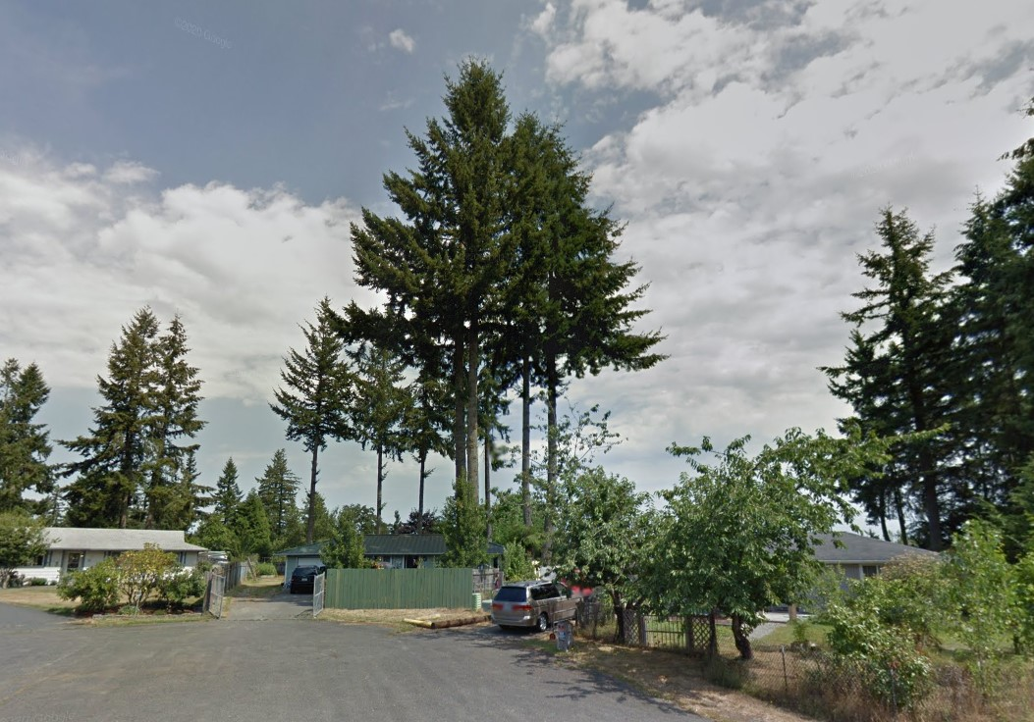
Mustoe v. Ma 371 P.3d 544 (Ct. App. 2016)
Notes:
2013 on Raintree Loop, a cul-de-sac in Rainier, WA
Jennifer Mustoe owned 2 Douglas Firs growing 2.5 feet from the property line
Xiaoya Ma and Anthony Jordan neighbors to the south
Dug a trench 20 inches deep along property line

Slide 3
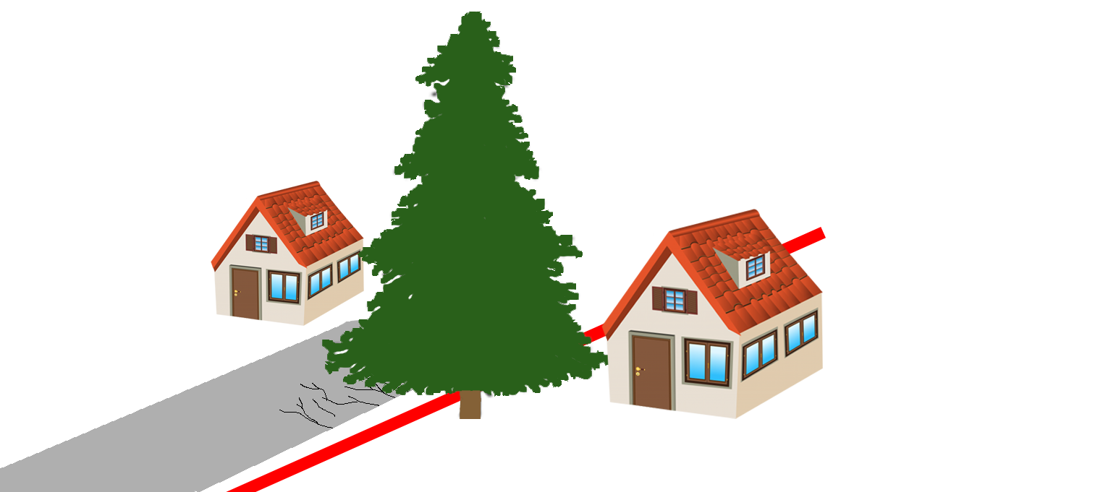
Mustoe v. Ma 371 P.3d 544 (Ct. App. 2016)

Slide 4
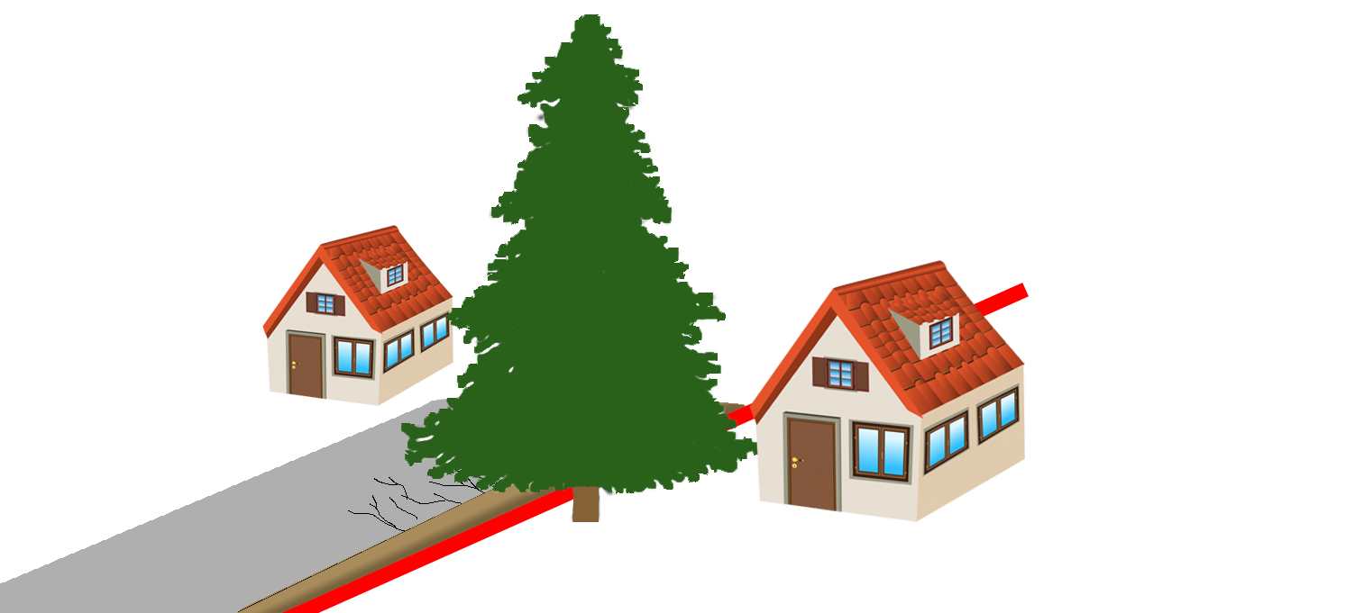
Mustoe v. Ma 371 P.3d 544 (Ct. App. 2016)

Slide 5
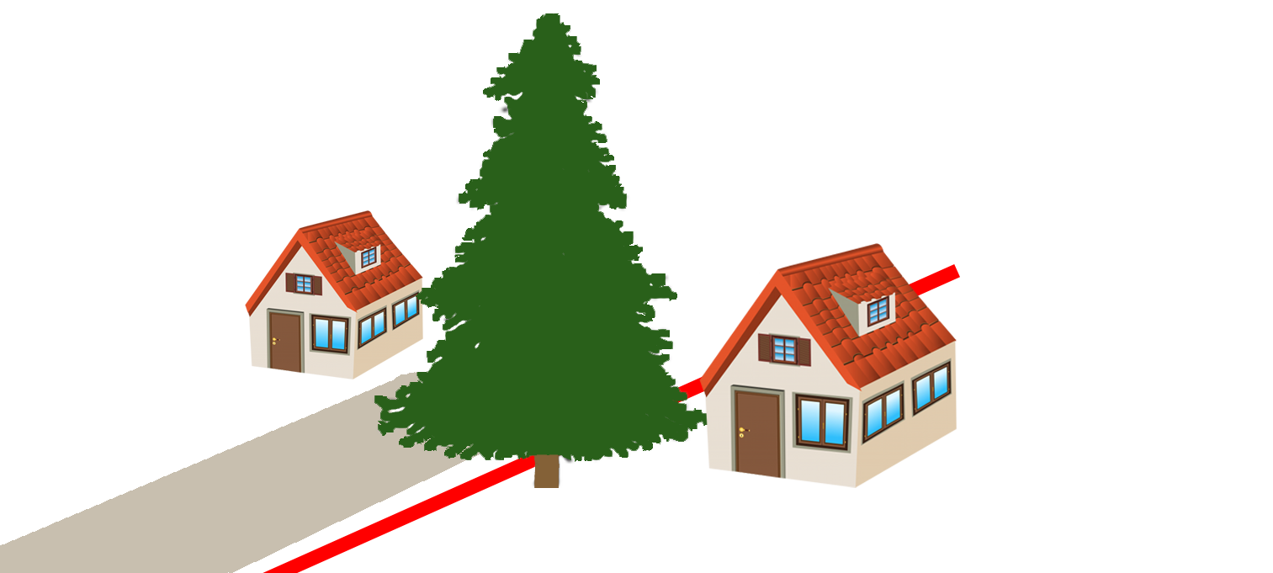
Mustoe v. Ma 371 P.3d 544 (Ct. App. 2016)

Slide 6
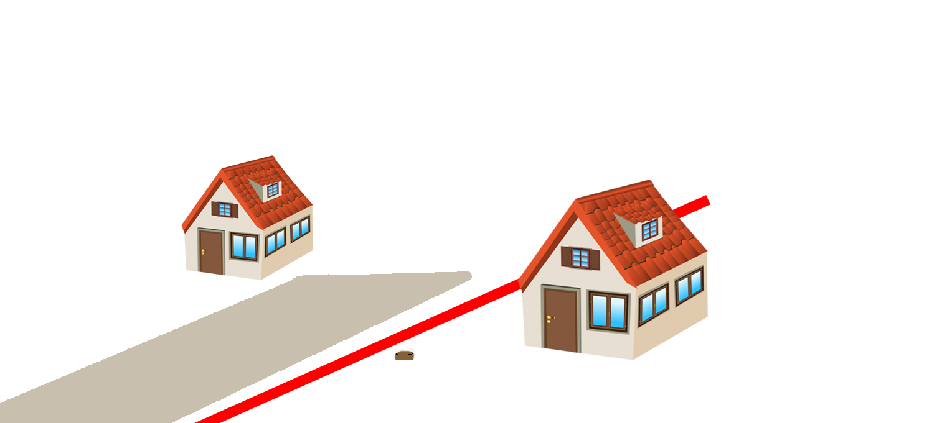
Mustoe v. Ma 371 P.3d 544 (Ct. App. 2016)

Slide 7
Mustoe v. Ma 371 P.3d 544 (Ct. App. 2016)
Notes:
2013 on Raintree Loop, a cul-de-sac in Rainier, WA
Jennifer Mustoe owned 2 Douglas Firs growing 2.5 feet from the property line
Xiaoya Ma and Anthony Jordan neighbors to the south
Dug a trench 20 inches deep

Slide 8
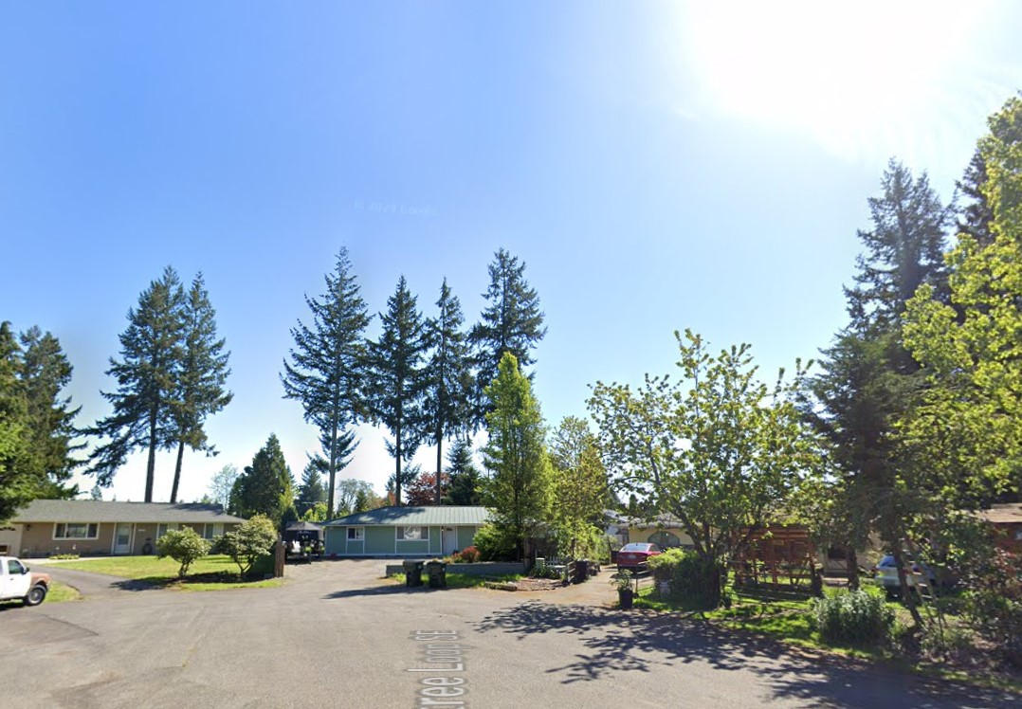
Mustoe v. Ma 371 P.3d 544 (Ct. App. 2016)

Slide 9
Mustoe v. Ma 371 P.3d 544 (Ct. App. 2016)
“…the right to self-help does not extend to removing the tree itself.”

Slide 10
Mustoe v. Ma 371 P.3d 544 (Ct. App. 2016)
“…the right to self-help does not extend to removing the tree itself.”
HOWEVER

Slide 11
Mustoe v. Ma 371 P.3d 544 (Ct. App. 2016)
“…the right to self-help does not extend to removing the tree itself.”
HOWEVER
Defendant could lawfully remove roots on his side

Slide 12
Mustoe v. Ma 371 P.3d 544 (Ct. App. 2016)
“…the right to self-help does not extend to removing the tree itself.”
HOWEVER
Defendant could lawfully remove roots on his side
“Mustoe has not established that she has any legal cause for complaint…”

Slide 13
Mustoe v. Ma 371 P.3d 544 (Ct. App. 2016)
Rejects out-of-state authority:
Booska v. Patel (1994 Cal. Ct. App.)
Fliegman v. Rubin (2003 NY Sup. Ct. App.)

Slide 14
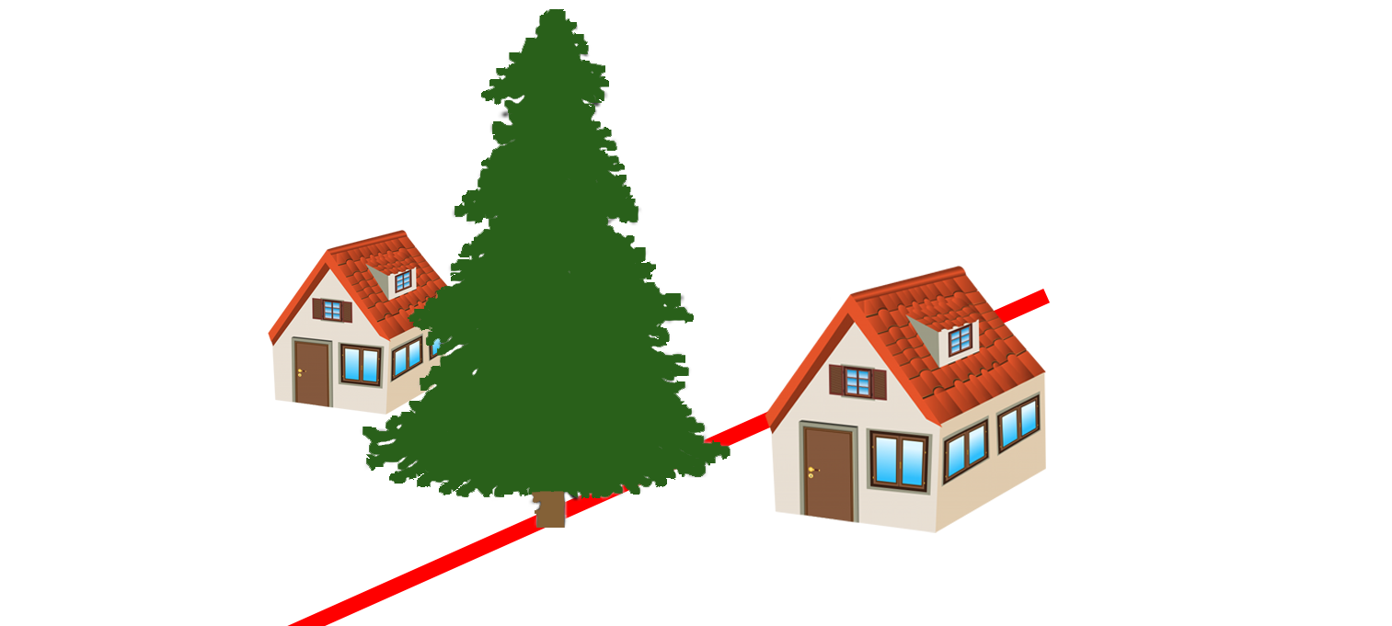
Herring v. Pelayo 198 Wn. App. 828 (Ct. App. 2017)
Notes:
December 2, 2011 in Pierce County
Herring pruned branches on his side
Pelayo pruned branches on his side, killing the tree
Pelayo admitted (1) he knew the tree was common property and (2) the pruning would likely kill the tree
Pelayo’s trimmer admitted tree could have been “made safer” by removing some branches without killing the tree

Slide 15
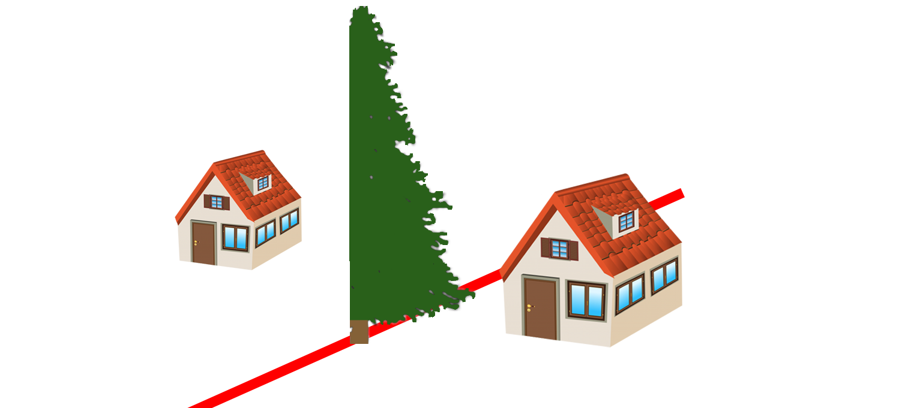
Herring v. Pelayo 198 Wn. App. 828 (Ct. App. 2017)

Slide 16
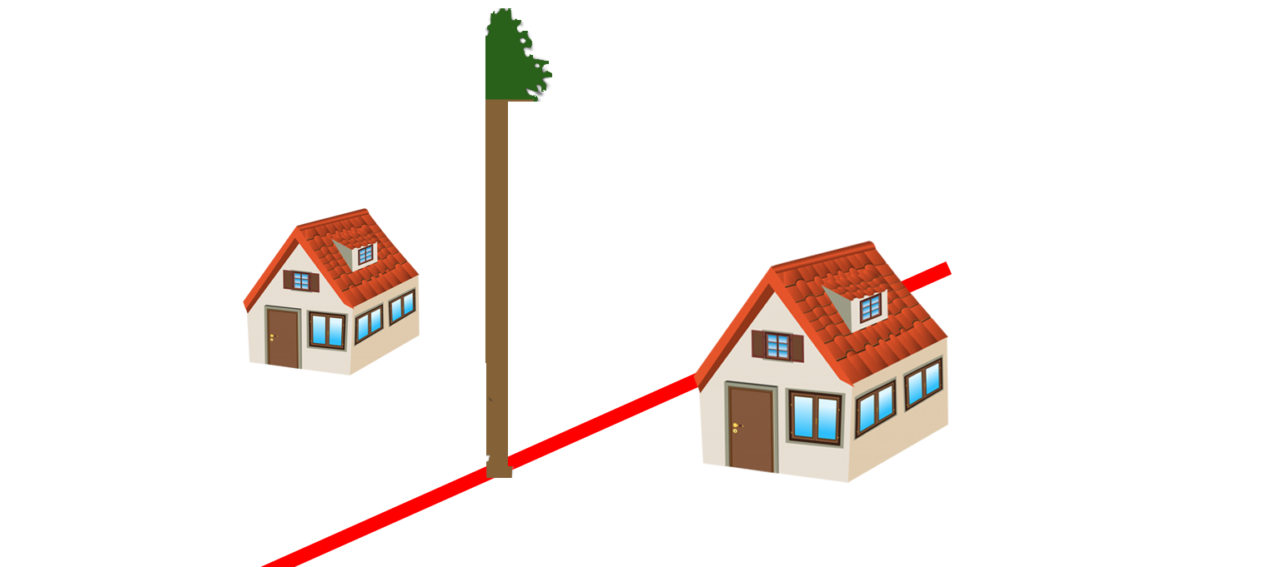
Herring v. Pelayo 198 Wn. App. 828 (Ct. App. 2017)

Slide 17
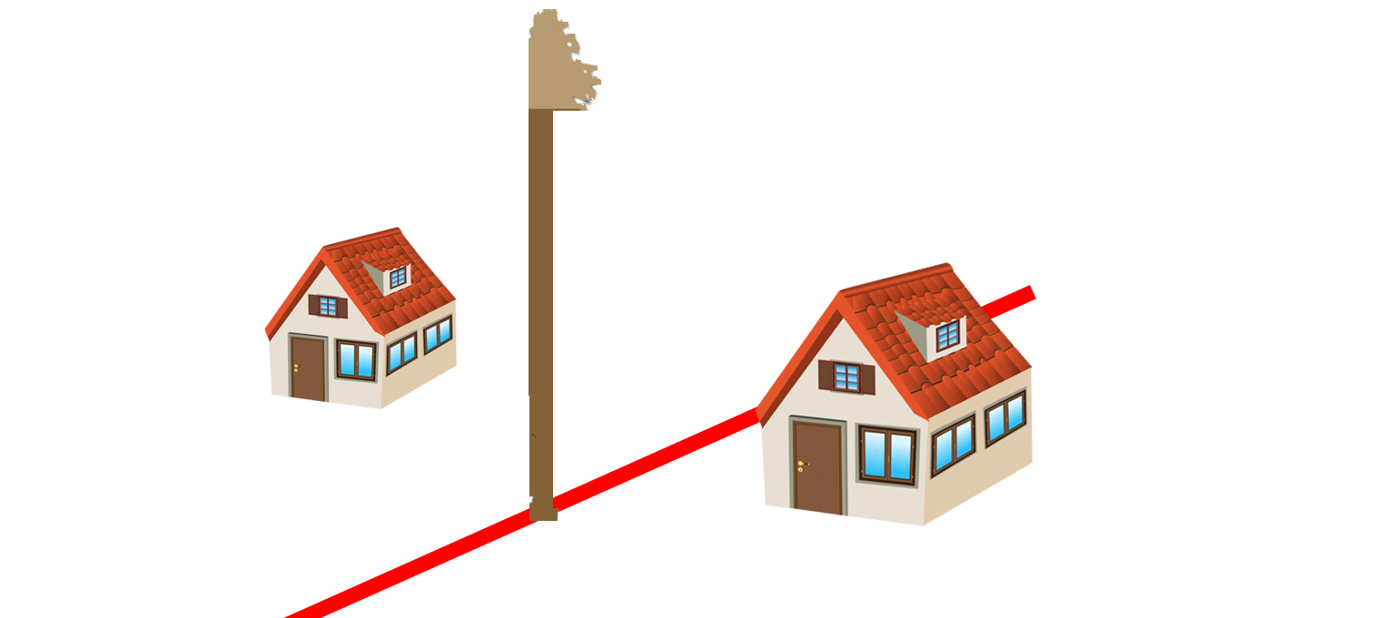
Herring v. Pelayo 198 Wn. App. 828 (Ct. App. 2017)

Slide 18
Herring v. Pelayo 198 Wn. App. 828 (Ct. App. 2017)
“…where a tree stands on a common property line, the common owners…may lawfully trim vegetation overhanging their property,

Slide 19
Herring v. Pelayo 198 Wn. App. 828 (Ct. App. 2017)
“…where a tree stands on a common property line, the common owners…may lawfully trim vegetation overhanging their property, but not in a manner that the common owner knows will kill the tree.”

Slide 20
Herring v. Pelayo 198 Wn. App. 828 (Ct. App. 2017)
“…where a tree stands on a common property line, the common owners…may lawfully trim vegetation overhanging their property, but not in a manner that the common owner knows will kill the tree.”
“We discern no meaningful distinction between cutting down a tree and trimming a tree in a manner intended to kill the tree.”

Slide 21
Herring v. Pelayo 198 Wn. App. 828 (Ct. App. 2017)
“…it would appear that a property owner has greater rights with respect to trimming a neighboring tree than a tree standing on a common property line…”

Slide 22
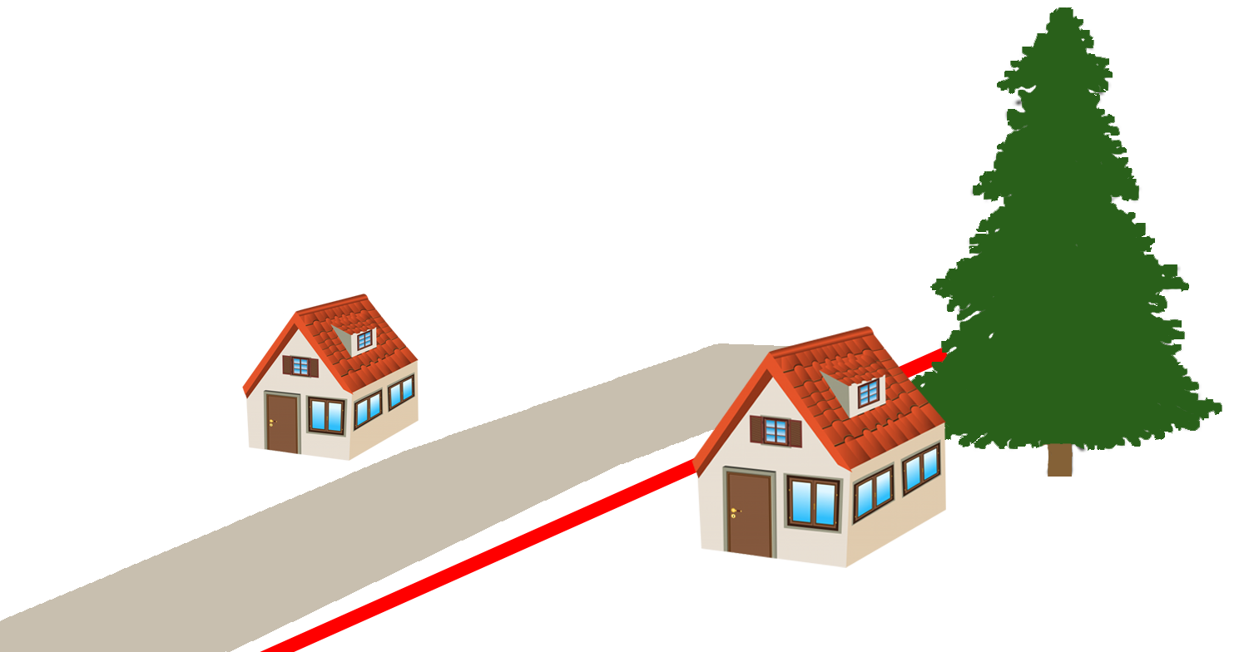
Boyle v. Leech 7 Wash.App.2d 535 (2019 Ct. App.)
Notes:
Since the 1950s, Mr. Leech owned his home and massive coast redwood tree without complaints in Pierce County
Tree and all branches ENTIRELY on Leech side
Debris drop from tree caused staining of Boyle’s concrete

Slide 23
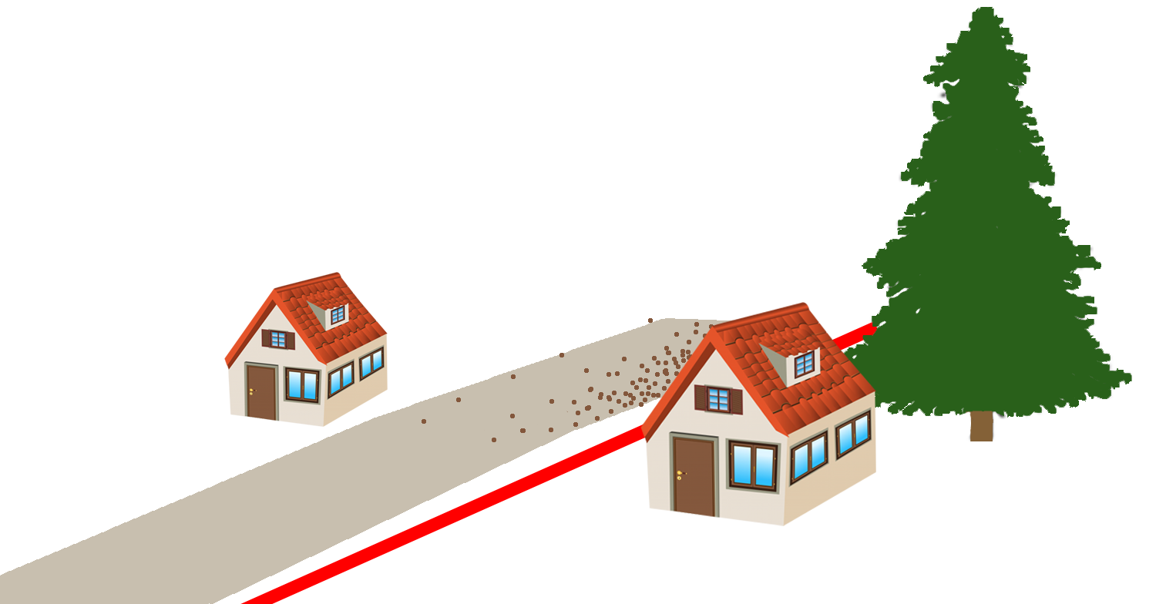
Boyle v. Leech 7 Wash.App.2d 535 (2019 Ct. App.)

Slide 24
Boyle v. Leech 7 Wash.App.2d 535 (2019 Ct. App.)
Nuisance: “an unreasonable interference with another’s use and enjoyment of property.”

Slide 25
Boyle v. Leech 7 Wash.App.2d 535 (2019 Ct. App.)
Nuisance: “an unreasonable interference with another’s use and enjoyment of property.”
“The failure of a landowner to prevent the blowing or dropping of leaves, branches, and sap from a healthy tree onto a neighbor’s property is not unreasonable and cannot be the basis of a finding of negligence or private nuisance.”

Slide 26
Boyle v. Leech 7 Wash.App.2d 535 (2019 Ct. App.)
Nuisance: “an unreasonable interference with another’s use and enjoyment of property.”
“The failure of a landowner to prevent the blowing or dropping of leaves, branches, and sap from a healthy tree onto a neighbor’s property is not unreasonable and cannot be the basis of a finding of negligence or private nuisance.”

Slide 27
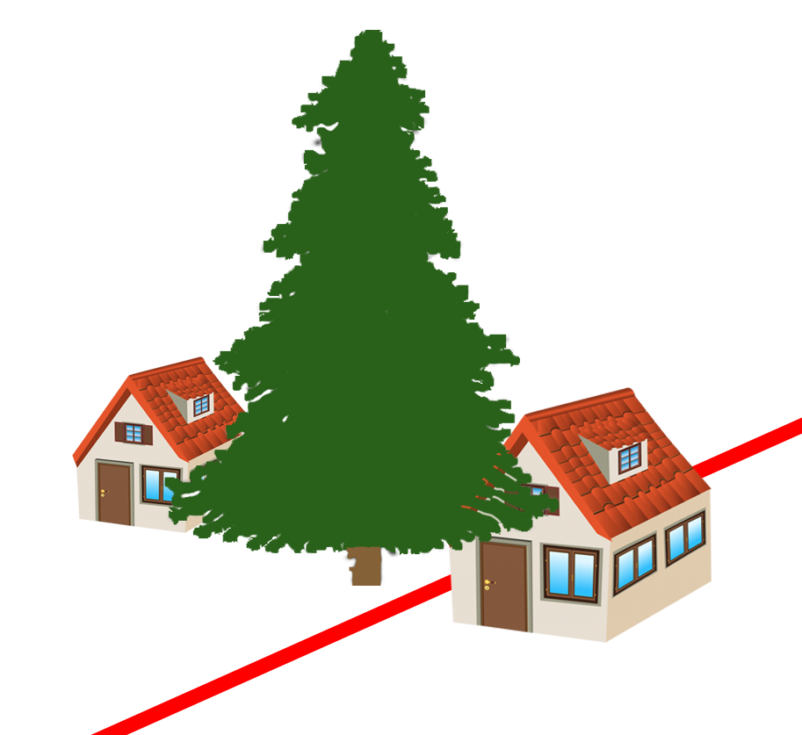
Connolly v. Piest 13 Wash.App.2d 1038 (2020 Ct. App.)
Notes:
2016 in Snohomish County
Mature 81-foot cedar tree grows on Piest’s property
Connolly threatened legal action if Piest didn’t allow pruning to mitigate debris drop
2017: complained about safety risk of branch failure onto Connolly home
Connolly arborist: “moderate risk”; Piest arborist: “low risk” (TRAQ!)
Trial Court granted MSJ

Slide 28
Connolly v. Piest 13 Wash.App.2d 1038 (2020 Ct. App.)
Tree branches overhang house
“Profusely” shed needles
Clogging swimming pool filters and roof gutters and killing grass
Notes:
TRAQ Was applied here!

Slide 29
Connolly v. Piest 13 Wash.App.2d 1038 (2020 Ct. App.)
Tree branches overhang house
“Profusely” shed needles
Clogging swimming pool filters and roof gutters and killing grass
Δ expert: Tree poses “a low overall risk.”
π expert: Tree poses “a moderate risk” of branch failure.
Notes:
TRAQ Was applied here!

Slide 30
Connolly v. Piest 13 Wash.App.2d 1038 (2020 Ct. App.)
Nuisance: “unreasonable interference with another’s use and enjoyment of property.”

Slide 31
Connolly v. Piest 13 Wash.App.2d 1038 (2020 Ct. App.)
Nuisance: “unreasonable interference with another’s use and enjoyment of property.”
“Overhanging branches of a tree, not poisonous or noxious in nature, are not a nuisance [without a showing of damages].”

Slide 32
Connolly v. Piest 13 Wash.App.2d 1038 (2020 Ct. App.)
Nuisance: “unreasonable interference with another’s use and enjoyment of property.”
“Overhanging branches of a tree, not poisonous or noxious in nature, are not a nuisance [without a showing of damages].”
HOWEVER

Slide 33
Connolly v. Piest 13 Wash.App.2d 1038 (2020 Ct. App.)
Nuisance: “unreasonable interference with another’s use and enjoyment of property.”
“Overhanging branches of a tree, not poisonous or noxious in nature, are not a nuisance [without a showing of damages].”
HOWEVER
Debris drop and risk of failure are sufficient damage
“the insignificance of the injury goes to the extent of recovery, and not to the right of action.”

Slide 34
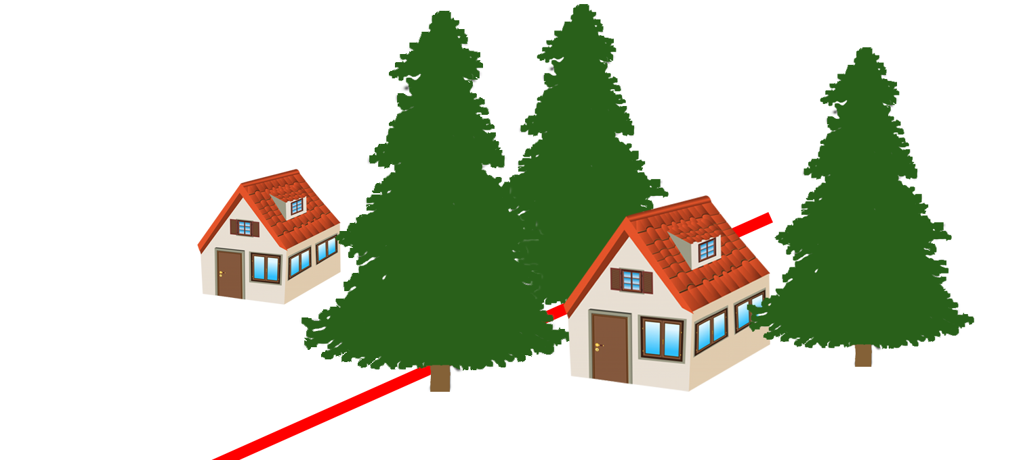
Lewis v. Krussel 101 Wn. App. 178 (2000 Ct. App.)
Notes:
1995 in Grey’s Harbor County
Dawn Lewis and Darold Teitzel expressed concern about safety of Krussel’s trees.
Gary Nancy Krussel said they would do something. They didn’t.
December 3, 1995 – windstorm

Slide 35
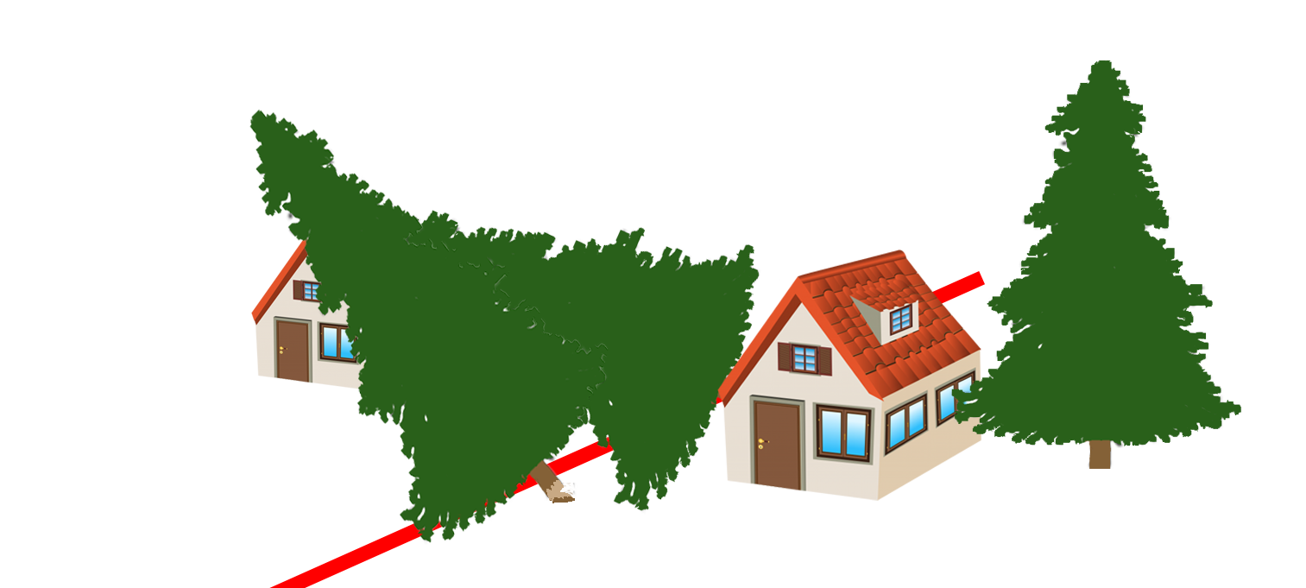
Lewis v. Krussel 101 Wn. App. 178 (2000 Ct. App.)
Notes:
2 large healthy hemlock trees fell on the home of Dawn Lewis and Darold Teitzel

Slide 36
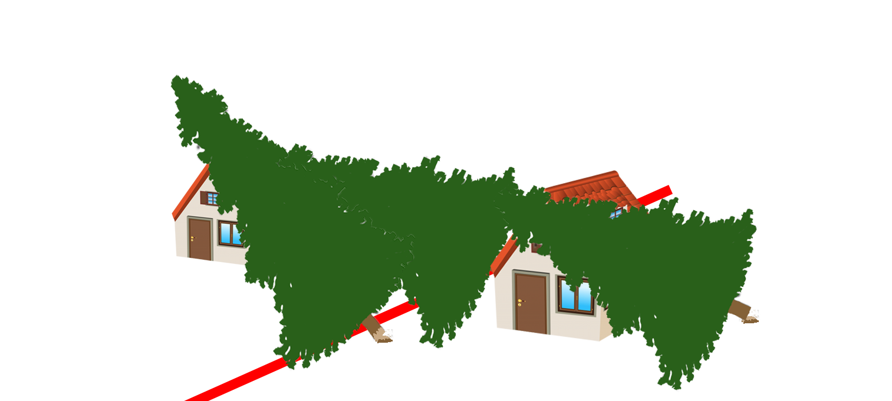
Lewis v. Krussel 101 Wn. App. 178 (2000 Ct. App.)
Notes:
Then a THIRD tree fell on Krussel’s house
Krussels admit:
(1) other trees had fallen on his property
(2) He would have his mother stay elsewhere during windstorms

Slide 37
Lewis v. Krussel 101 Wn. App. 178 (2000 Ct. App.)
π Evidence
Hemlock trees are inherently prone to toppling over
π complained to Δ about tree risk

Slide 38
Lewis v. Krussel 101 Wn. App. 178 (2000 Ct. App.)
π Evidence
Δ Evidence
Hemlock trees are inherently prone to toppling over
π complained to Δ about tree risk
No evidence of rot or disease in the stump
Trees that fell appeared no more dangerous than any other standing tree

Slide 39
Lewis v. Krussel 101 Wn. App. 178 (2000 Ct. App.)
“the landowner is under no duty to consistently and constantly check for defects.”
“The alleged defect must be readily observable…”

Slide 40
Lewis v. Krussel 101 Wn. App. 178 (2000 Ct. App.)
“the landowner is under no duty to consistently and constantly check for defects.”
“The alleged defect must be readily observable…”
NO DUTY to remove healthy trees “merely because the wind might knock them down.”

Slide 41
Lewis v. Krussel 101 Wn. App. 178 (2000 Ct. App.)
“the landowner is under no duty to consistently and constantly check for defects.”
“The alleged defect must be readily observable…”
NO DUTY to remove healthy trees “merely because the wind might knock them down.”
“cannot rely on…bare allegations as to the alleged vulnerability of hemlock trees”

Slide 42
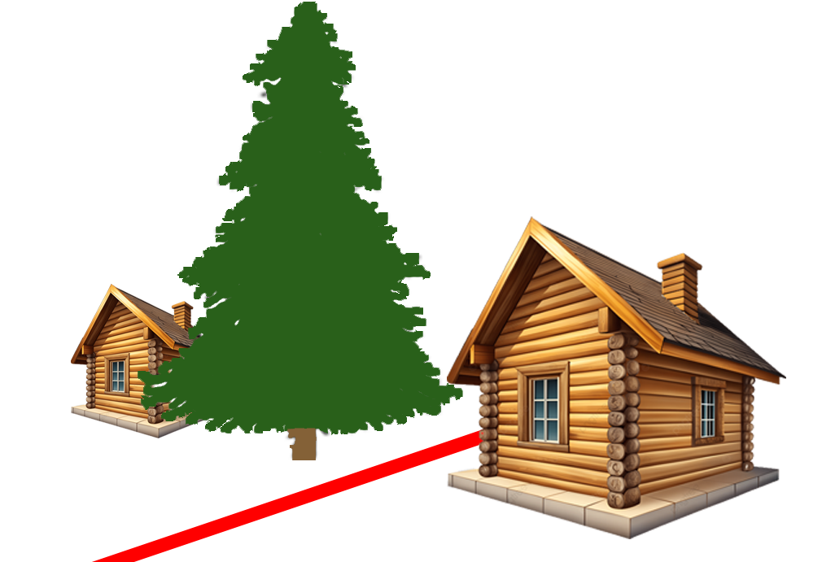
Thompson v. Dale 92 Wash.App. 1022 (1998 Ct. App.)
Notes:
Snohomish County Vacation Home in the forest
1992: upper half of trunk of NATURALLY-OCCURRING tree fell onto DALE’S house
THOMPSON asked for dale to remove the tree

Slide 43
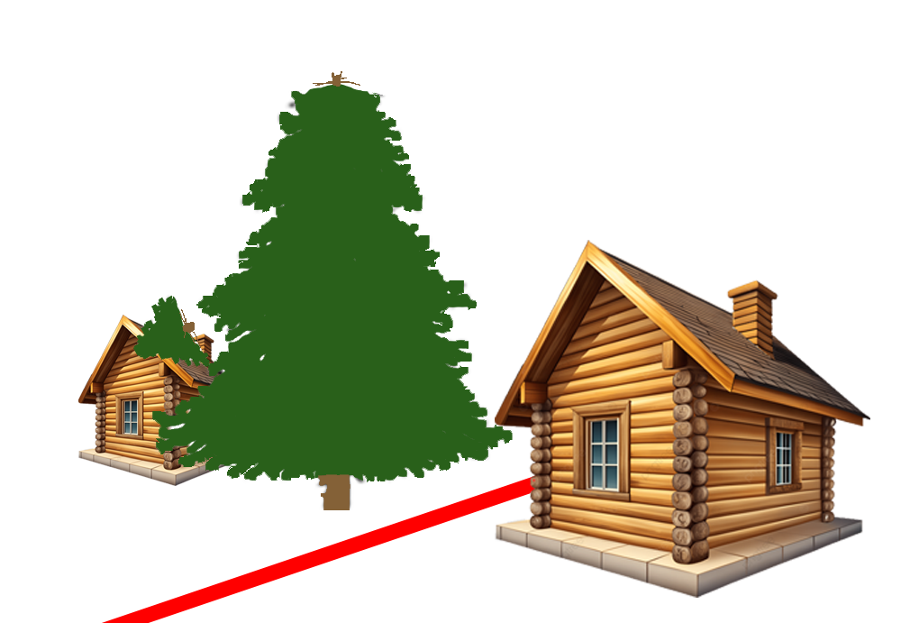
Thompson v. Dale 92 Wash.App. 1022 (1998 Ct. App.)
Notes:
1992: upper half of trunk fell onto DALE’S house
THOMPSON asked for dale to remove the tree
1994: Thompson’s logger recommended removal of Dale’s tree

Slide 44
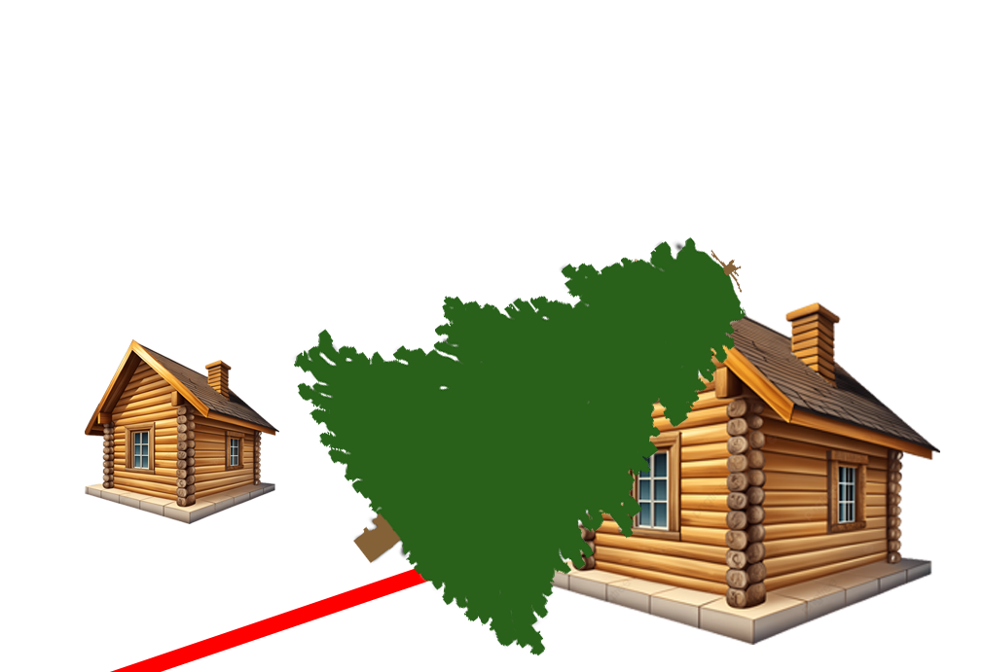
Thompson v. Dale 92 Wash.App. 1022 (1998 Ct. App.)
Notes:
Late 1994: tree fell on Thompson’s house

Slide 45
Thompson v. Dale 92 Wash.App. 1022 (1998 Ct. App.)
“Where the landowner has notice that a tree is dangerous and fails to take steps to make it safe, liability in negligence will lie.”

Slide 46
Thompson v. Dale 92 Wash.App. 1022 (1998 Ct. App.)
“Where the landowner has notice that a tree is dangerous and fails to take steps to make it safe, liability in negligence will lie.”
EVEN IF the tree is naturally occurring

Slide 47
Thompson v. Dale 92 Wash.App. 1022 (1998 Ct. App.)
“Where the landowner has notice that a tree is dangerous and fails to take steps to make it safe, liability in negligence will lie.”
EVEN IF the tree is naturally occurring
WA does NOT follow out-of-state authority for “natural condition immunity”
Notes:
Refuses to follow Restatement 2nd Torts Section 363

Slide 48
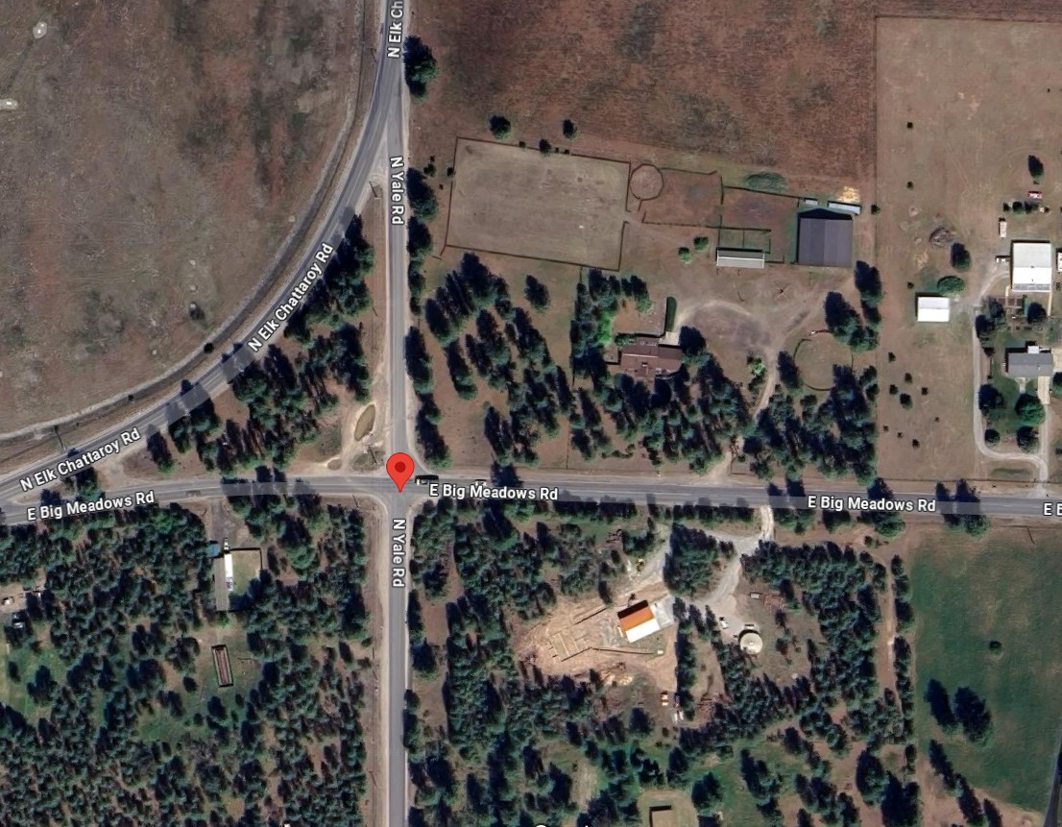
Evans v. Spokane County 15 Wash.App.2d 1011 (2020 Ct. App.)
Notes:
July 23, 2014 – Severe windstorm
Carlton Evans was driving towards Chattaroy on E. Big Meadows Road

Slide 49
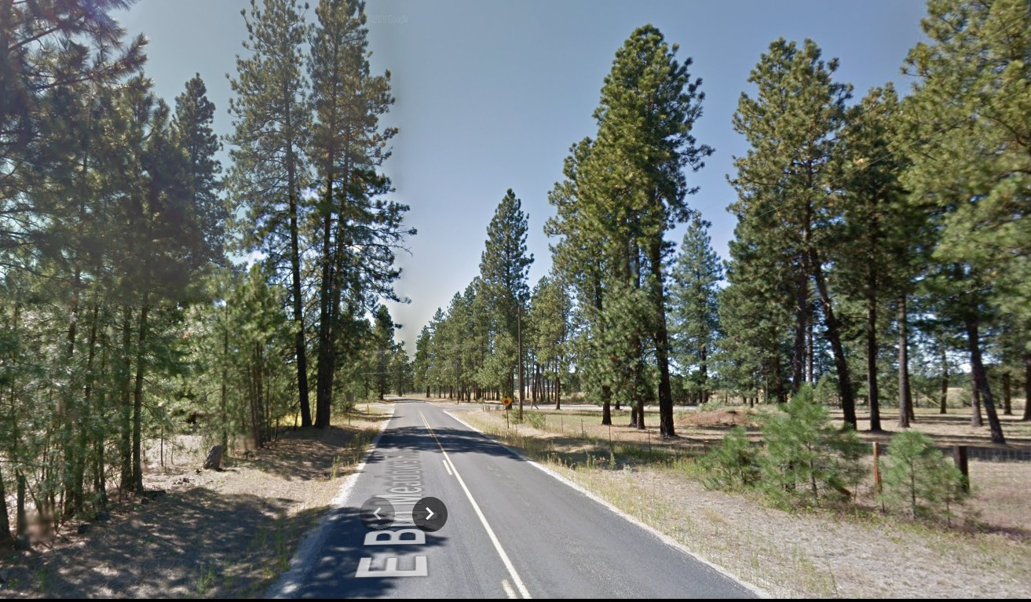
Evans v. Spokane County 15 Wash.App.2d 1011 (2020 Ct. App.)
Notes:
July 23, 2014 – Severe windstorm
Carlton Evans was driving towards Chattaroy on E. Big Meadows Road
80-90 foot Ponderosa pine fell on his car, impaling him and severing his left hand.
He survived.
Jury instructions that “no liab. if no reason to know THIS tree would fail” and “act of god”

Slide 50
Evans v. Spokane County 15 Wash.App.2d 1011 (2020 Ct. App.)
“Act of God”: “natural phenomenon…so far outside the range of human experience that ordinary care did not require that it should be anticipated”
“…it is not sufficient that such phenomena are unusual or of rare occurrence.”

Slide 51
Evans v. Spokane County 15 Wash.App.2d 1011 (2020 Ct. App.)
“…the fact that harm is brought about through the intervention of another force does not relieve the actor of liability.”
“…the risk that a diseased tree would snap in strong winds was within the ambit of the hazards covered by the County’s duty.”

Slide 52
Evans v. Spokane County 15 Wash.App.2d 1011 (2020 Ct. App.)
“there is no duty to consistently and constantly check…for non-visible rot.”
“…decay must be visible, apparent, and patent…”

Slide 53
Evans v. Spokane County 15 Wash.App.2d 1011 (2020 Ct. App.)
“there is no duty to consistently and constantly check…for non-visible rot.”
“…decay must be visible, apparent, and patent…”
FOR A LAYPERSON

Slide 54
Evans v. Spokane County 15 Wash.App.2d 1011 (2020 Ct. App.)
“there is no duty to consistently and constantly check…for non-visible rot.”
“…decay must be visible, apparent, and patent…”
FOR A LAYPERSON
But “…for those who have acquired knowledge beyond that of an ordinary person in the course of their work, the law will demand conduct consistent with that acquired knowledge.“

Slide 55
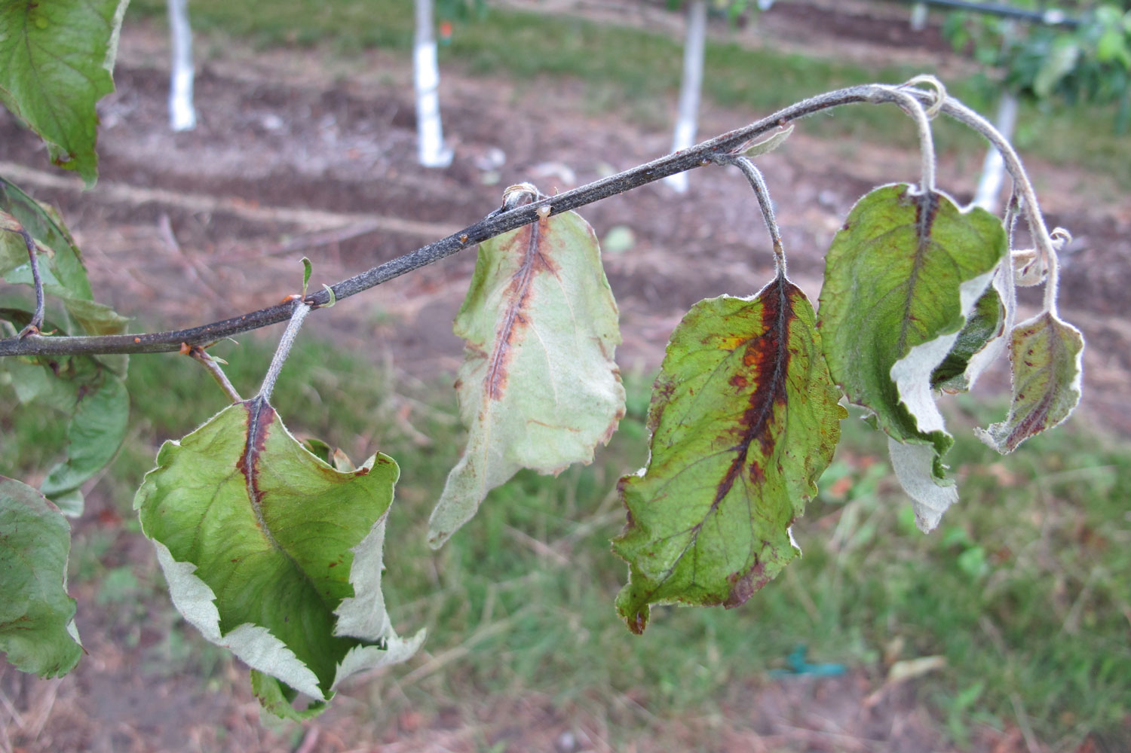
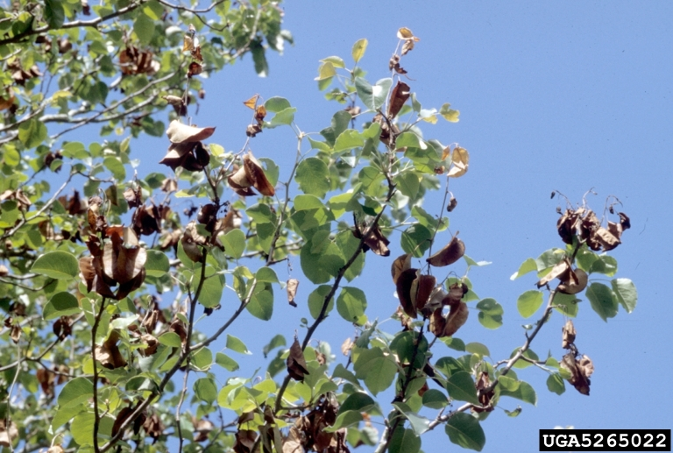
Carstens v. De Sellem 82 Wash. 643 (1914 WA Supr. Ct.)
Notes:
1914 in Yakima County – Carstens owned a pear orchard
Ag inspector De Sellem found fireblight in the orchard, demanded destruction of Carsten’s trees
Over Carsten’s objections, De Sellem’s crew destroyed all of Carstens’ infected pear trees

Slide 56
Carstens v. De Sellem 82 Wash. 643 (1914 WA Supr. Ct.)
“Salus populi suprema lex”
Public welfare is supreme law

Slide 57
Carstens v. De Sellem 82 Wash. 643 (1914 WA Supr. Ct.)
“Salus populi suprema lex”
Public welfare is supreme law
Ag. commissioner MAY destroy infected trees

Slide 58
Carstens v. De Sellem 82 Wash. 643 (1914 WA Supr. Ct.)
“Salus populi suprema lex”
Public welfare is supreme law
Ag. commissioner MAY destroy infected trees
No compensation is owed

Slide 59
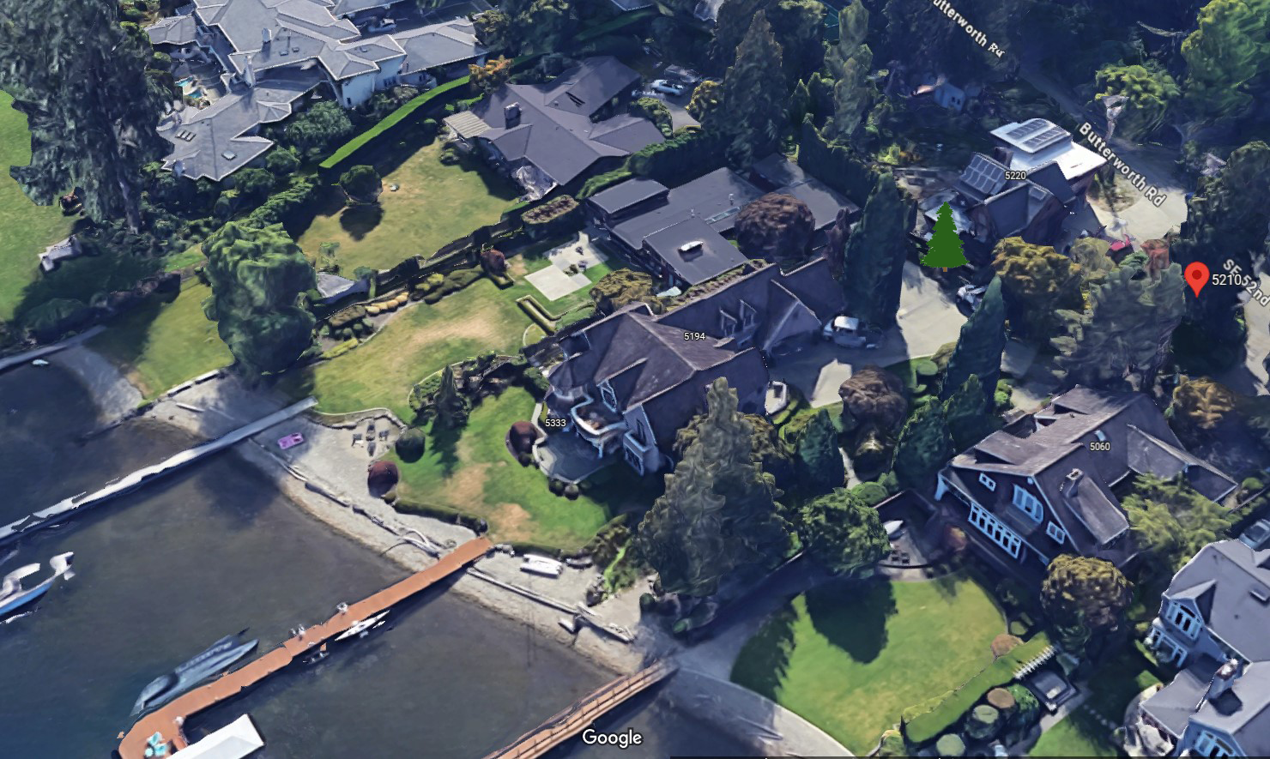
MJD Props., LLC v. Haley 189 Wn. App. 963 (2015 Ct. App.)
Notes:
2015 – Mercer Island
Copper beech tree on Oyler prop adjacent to Haley’s view window
For years, Haley attempted to acquire view easement

Slide 60
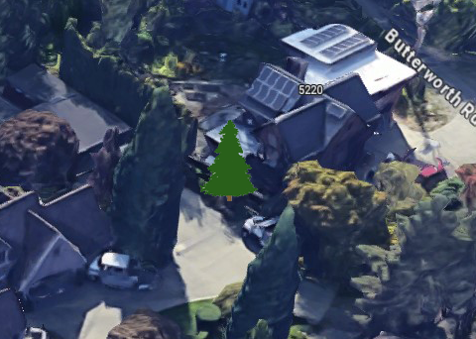
MJD Props., LLC v. Haley 189 Wn. App. 963 (2015 Ct. App.)
Notes:
2015 – Mercer Island
Copper beech tree on Oyler prop adjacent to Haley’s view window
For years, Haley attempted to acquire view easement

Slide 61
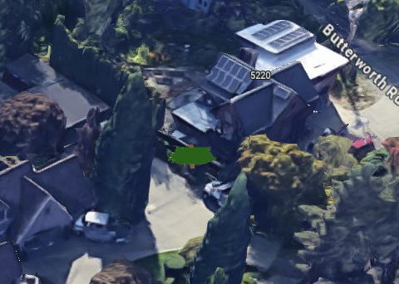
MJD Props., LLC v. Haley 189 Wn. App. 963 (2015 Ct. App.)
Notes:
In 2011 when Oylers moved out, before completing sale to MJD Props, Haley topped the tree

Slide 62
MJD Props., LLC v. Haley 189 Wn. App. 963 (2015 Ct. App.)
Notes:
November 2012: MJD removed the topped tree and planted a new 18-foot cedar tree
Trial court found Haley guilty of timber trespass and dismissed Haley’s claim of spite structure

Slide 63
MJD Props., LLC v. Haley 189 Wn. App. 963 (2015 Ct. App.)
Spite Structure: “malicious erection…of any structure intended to spite, injure, or annoy an adjoining proprietor.” RCW 7.40.030
“…manifestly erected with a leading purpose to annoy the adjoining owner…”

Slide 64
MJD Props., LLC v. Haley 189 Wn. App. 963 (2015 Ct. App.)
“…a row of trees along a property line…may constitute a fence”
“Strategically planting a single tree can accomplish the same spiteful purpose as planting a row.”

Slide 65
MJD Props., LLC v. Haley 189 Wn. App. 963 (2015 Ct. App.)
“…a row of trees along a property line…may constitute a fence”
“Strategically planting a single tree can accomplish the same spiteful purpose as planting a row.”
“A single tree artificially located and planted with spiteful intent may…constitute a [spite structure].”

Slide 66
Selections from Washington Case Law
Boundary Trees
Nuisance
Tree Failure
Spite Structures

Slide 67
Selections from Washington Case Law
Boundary Trees
Nuisance
Tree Failure
Spite Structures
Appraisal cases covered at 3:20pm in the Advanced Arboriculture Track

Slide 68
Selections from Washington Case Law
James Komen
BCMA #WE-9909B
RCA #555

