Slide 1
Restatement of Torts §929 A Legal Perspective on Tree Losses
James Komen
BCMA #WE-9909B
RCA #555

Slide 2
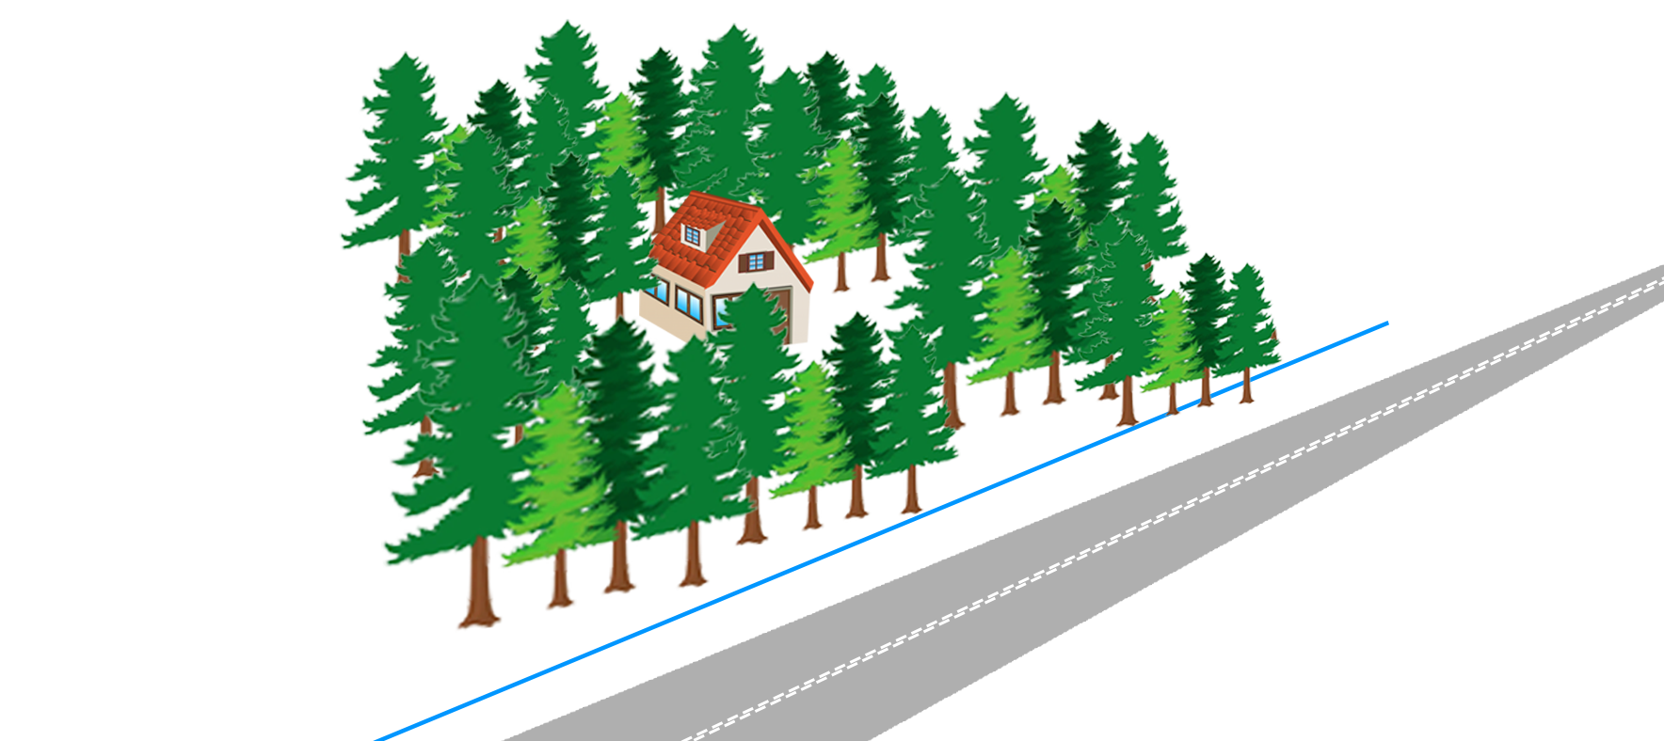
Morris v. Ciborowski 113 N.H. 563 (1973) NH Supr. Ct.

Slide 3
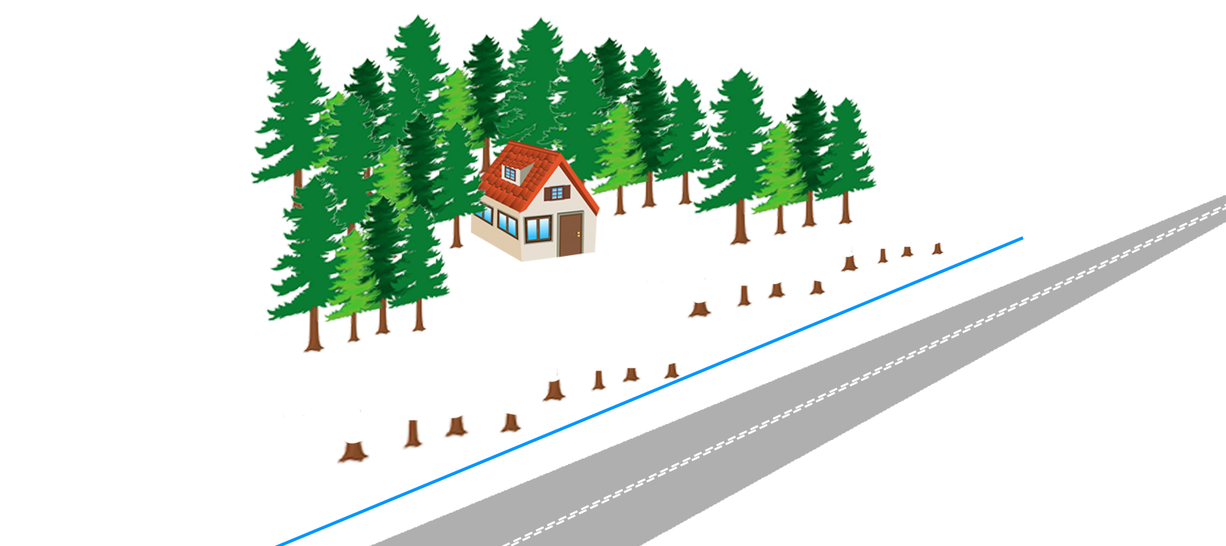
Morris v. Ciborowski 113 N.H. 563 (1973) NH Supr. Ct.

Slide 4
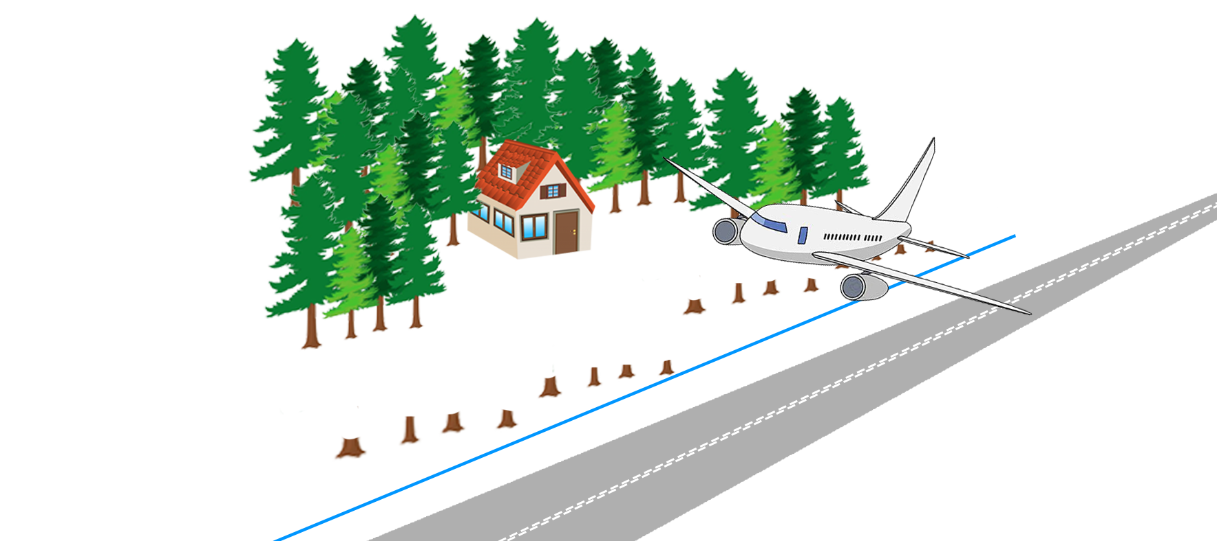
Morris v. Ciborowski 113 N.H. 563 (1973) NH Supr. Ct.

Slide 5
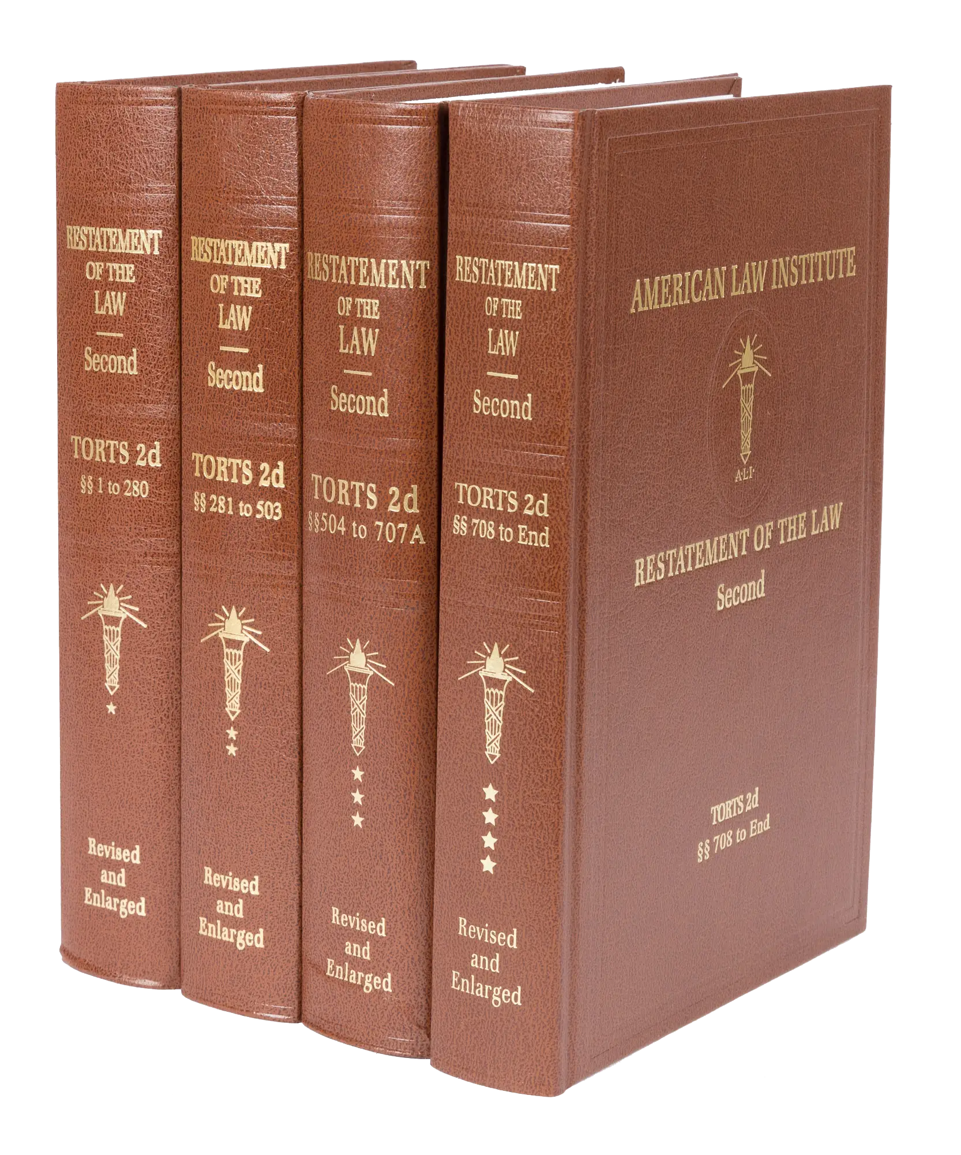
Restatement of the Law of Torts, 2d.

Slide 6
R2D Torts §929(1)
If one is entitled to a judgment for harm to land resulting from a past invasion and not amounting to a total destruction of value, the damages include compensation for:

Slide 7
R2D Torts §929(1)
If one is entitled to a judgment for harm to land resulting from a past invasion and not amounting to a total destruction of value, the damages include compensation for:
the difference between the value of the land before the harm and the value after the harm, or at his election in an appropriate case, the cost of restoration that has been or may be reasonably incurred,

Slide 8
R2D Torts §929(1)
If one is entitled to a judgment for harm to land resulting from a past invasion and not amounting to a total destruction of value, the damages include compensation for:
the difference between the value of the land before the harm and the value after the harm, or at his election in an appropriate case, the cost of restoration that has been or may be reasonably incurred,
the loss of use of the land, and

Slide 9
R2D Torts §929(1)
If one is entitled to a judgment for harm to land resulting from a past invasion and not amounting to a total destruction of value, the damages include compensation for:
the difference between the value of the land before the harm and the value after the harm, or at his election in an appropriate case, the cost of restoration that has been or may be reasonably incurred,
the loss of use of the land, and
discomfort and annoyance to him as an occupant.

Slide 10
R2D Torts §929(1)
If one is entitled to a judgment for harm to land resulting from a past invasion and not amounting to a total destruction of value, the damages include compensation for:
the difference between the value of the land before the harm and the value after the harm, or at his election in an appropriate case, the cost of restoration that has been or may be reasonably incurred,
the loss of use of the land, and
discomfort and annoyance to him as an occupant.

Slide 11
R2D Torts §929(1)
If one is entitled to a judgment for harm to land resulting from a past invasion and not amounting to a total destruction of value, the damages include compensation for:
the difference between the value of the land before the harm and the value after the harm, or at his election in an appropriate case, the cost of restoration that has been or may be reasonably incurred,
the loss of use of the land, and
discomfort and annoyance to him as an occupant.

Slide 12
R2D Torts §929(1)
If one is entitled to a judgment for harm to land resulting from a past invasion and not amounting to a total destruction of value, the damages include compensation for:
the difference between the value of the land before the harm and the value after the harm, or at his election in an appropriate case, the cost of restoration that has been or may be reasonably incurred,
the loss of use of the land, and
discomfort and annoyance to him as an occupant.

Slide 13
R2D Torts §929 cmt. b
“If…the cost of replacing the land in its original condition is disproportionate to the diminution in the value of the land...,
unless there is a reason personal to the owner for restoring the original condition,
damages are measured only by the [diminution in the value of the land].”

Slide 14
R2D Torts §929 cmt. b
“If…the cost of replacing the land in its original condition is disproportionate to the diminution in the value of the land...,
unless there is a reason personal to the owner for restoring the original condition,
damages are measured only by the [diminution in the value of the land].”

Slide 15
R2D Torts §929 cmt. b
“If…the cost of replacing the land in its original condition is disproportionate to the diminution in the value of the land...,
unless there is a reason personal to the owner for restoring the original condition,
damages are measured only by the [diminution in the value of the land].”

Slide 16
R2D Torts §929 Analysis
Restoration Cost vs. Diminution in Value
“Reason Personal”
“Reasonably Incurred” vs. “Disproportionate”

Slide 17
Restoration Cost vs. Diminution in Value

Slide 18
Morris v. Ciborowski 113 N.H. 563 (1973) NH Supr. Ct.

Slide 19
Morris v. Ciborowski 113 N.H. 563 (1973) NH Supr. Ct.
“Replacement cost is allowable as a measure of damages instead of the value of the land before and after the harm where, as here, there is substantial evidence of the owner's personal residential and recreational use of the land.”

Slide 20
Morris v. Ciborowski 113 N.H. 563 (1973) NH Supr. Ct.
“Replacement cost is allowable as a measure of damages instead of the value of the land before and after the harm where, as here, there is substantial evidence of the owner's personal residential and recreational use of the land.”

Slide 21
Morris v. Ciborowski 113 N.H. 563 (1973) NH Supr. Ct.
“Replacement cost is allowable as a measure of damages instead of the value of the land before and after the harm where, as here, there is substantial evidence of the owner's personal residential and recreational use of the land.”

Slide 22
Restoration Cost > Diminution in Value OK
Osborne v. Hurst (AK 1997)
Worthington v. Roberts (AR 1991)
Klingshirn v. McNeal (GA 1999)
Samson Constr. Co. v. Brusowankin (MD 1958)
Morris v. Ciborowski (NH 1973)
Denoyer v. Lamb (OH 1984)
Thatcher v. Lane Construction Co. (OH 1970)

Slide 23
“Reason Personal”

Slide 24
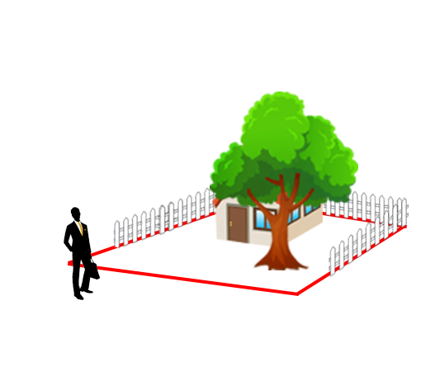
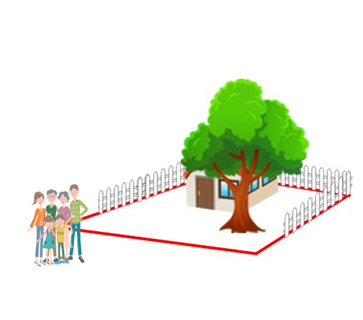
“Reason Personal”

Slide 25
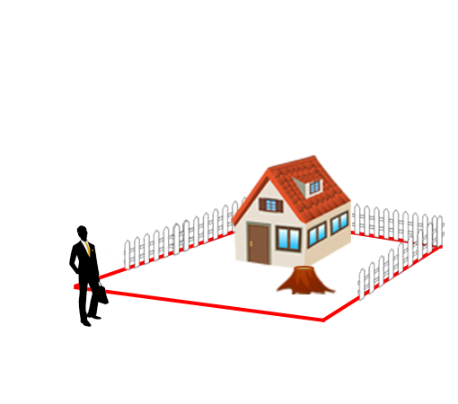
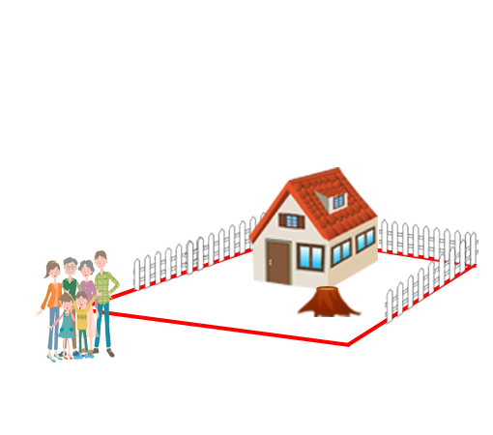
“Reason Personal”

Slide 26
“Reason Personal”
No “Reason Personal”

Slide 27
“Reason Personal”
No “Reason Personal”
“Reason Personal”

Slide 28
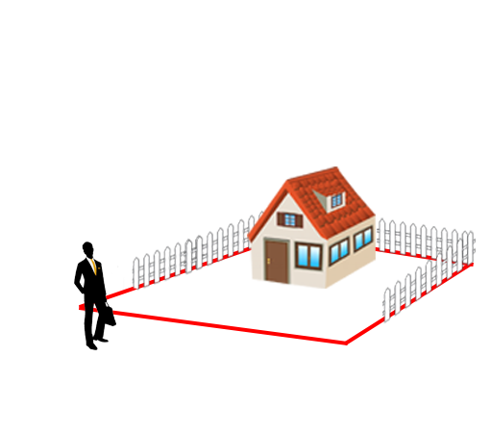
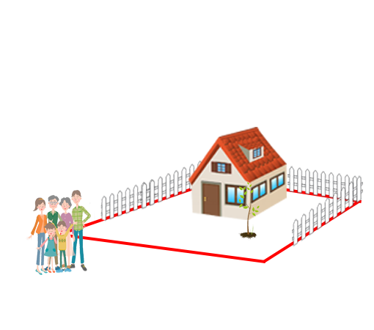
“Reason Personal”
No “Reason Personal”
“Reason Personal”

Slide 29
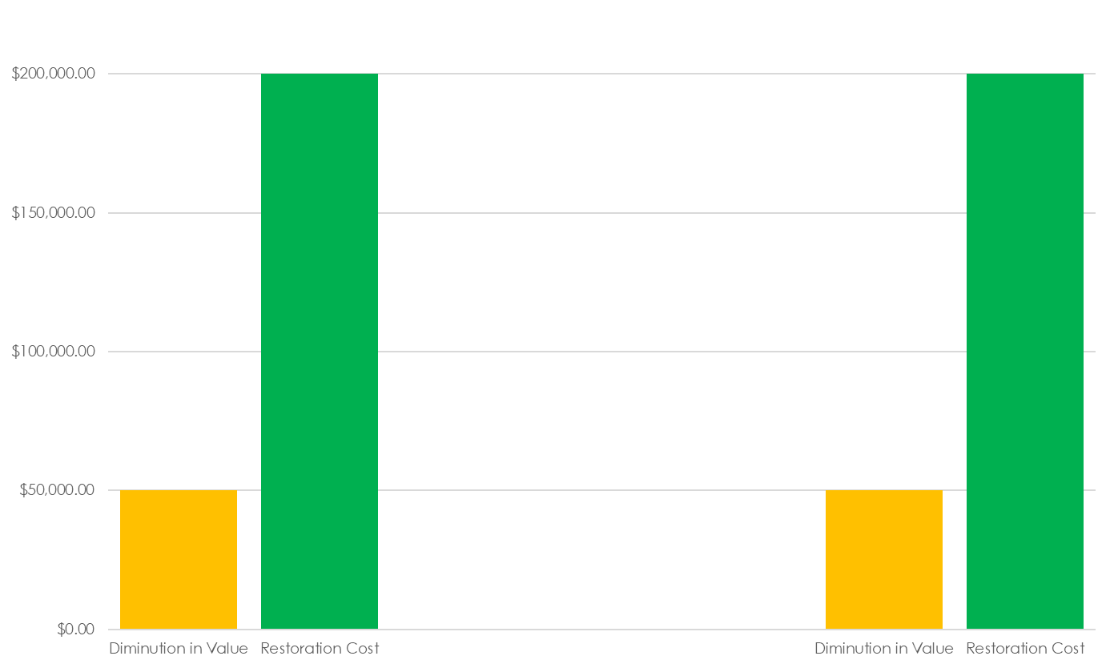
“Reason Personal”
No “Reason Personal”
“Reason Personal”

Slide 30
“Reason Personal”
No “Reason Personal”
“Reason Personal”
Max Award

Slide 31
“Reason Personal”
No “Reason Personal”
“Reason Personal”
Possible
Award
Max Award

Slide 32
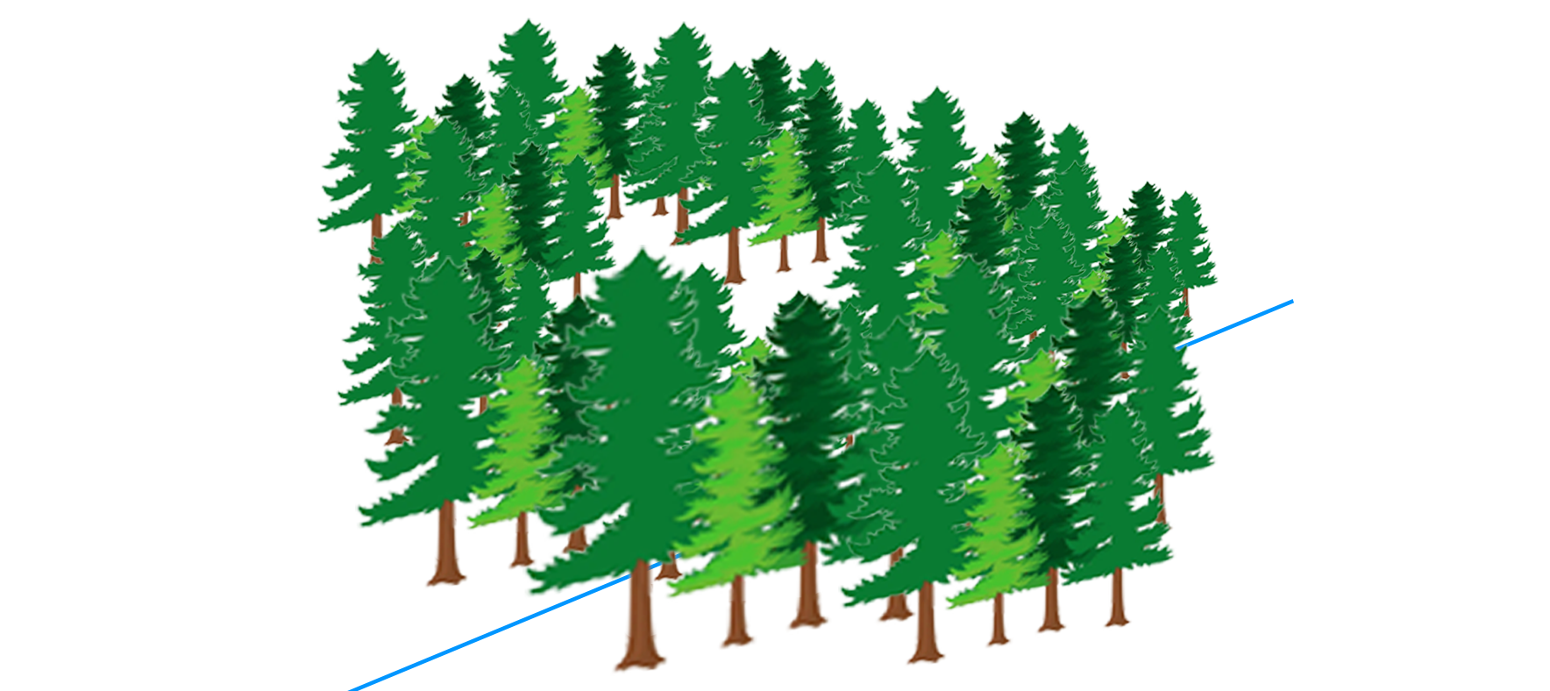
Wiersum v. Harder 316 P.3d 557 (2013) AK Supr. Ct.

Slide 33
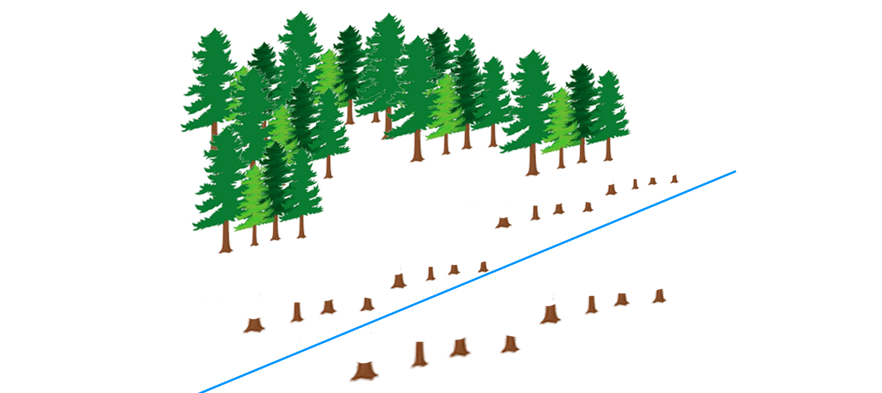
Wiersum v. Harder 316 P.3d 557 (2013) AK Supr. Ct.

Slide 34
Wiersum v. Harder 316 P.3d 557 (2013) AK Supr. Ct.
“…intended to build a house and live [there] once his son graduated from college because ‘it's a very beautiful piece of property.’”
“A real estate agent…approached π about selling the land, but π refused to sell.”
“…the property was very private, because the tall trees screened the neighboring houses from view.”

Slide 35
Wiersum v. Harder 316 P.3d 557 (2013) AK Supr. Ct.
“…intended to build a house and live [there] once his son graduated from college because ‘it's a very beautiful piece of property.’”
“A real estate agent…approached π about selling the land, but π refused to sell.”
“…the property was very private, because the tall trees screened the neighboring houses from view.”
“…sufficient evidence of a reason personal for the issue of restoration costs to be submitted to the jury.”

Slide 36
Hornsby v. Bayou Jack Logging 902 So. 2d 361 (2005) LA Supr. Ct.

Slide 37
Hornsby v. Bayou Jack Logging 902 So. 2d 361 (2005) LA Supr. Ct.

Slide 38
Hornsby v. Bayou Jack Logging 902 So. 2d 361 (2005) LA Supr. Ct.
“when π was a child, he and his cousins would play on the property every Sunday”
“the land has primarily been used for cattle grazing”
“there are no utility lines, water lines, or structures on the land”
“intent to build, at a future date, but failed to produce any tangible proof or documentation to support their intent”

Slide 39
Hornsby v. Bayou Jack Logging 902 So. 2d 361 (2005) LA Supr. Ct.
“We do not find that plaintiffs' self-serving testimony of their inchoate intent to develop the land at some undetermined future point is sufficient to justify recovery of restoration costs in excess of the actual market value of the land and the trees cut. “

Slide 40
Hornsby v. Bayou Jack Logging 902 So. 2d 361 (2005) LA Supr. Ct.
“We do not find that plaintiffs' self-serving testimony of their inchoate intent to develop the land at some undetermined future point is sufficient to justify recovery of restoration costs in excess of the actual market value of the land and the trees cut. “

Slide 41
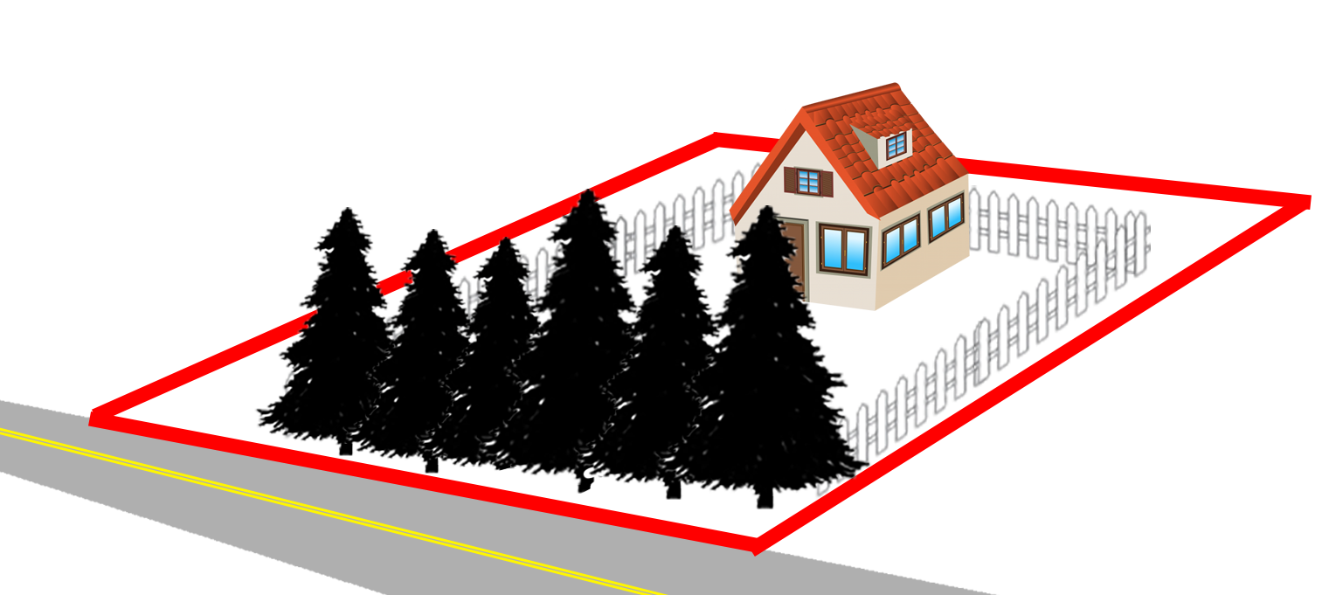
Gross v. Jackson Township 328 Pa. Super. 226 (1984) PA Superior Ct.

Slide 42
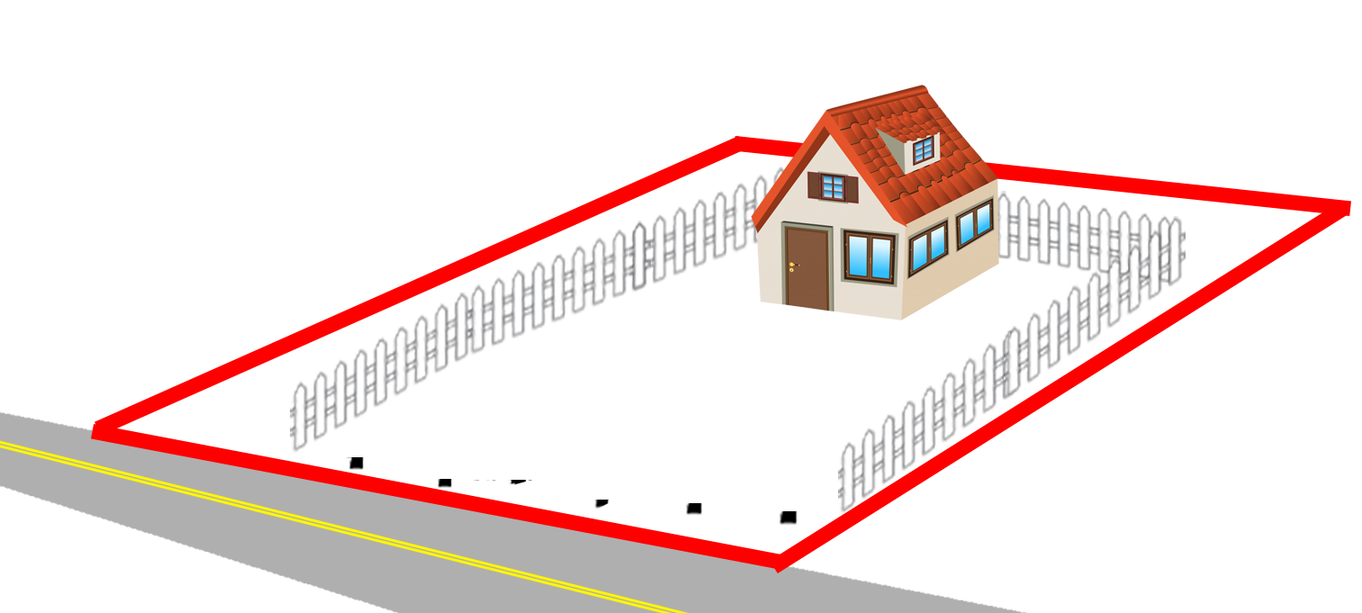
Gross v. Jackson Township 328 Pa. Super. 226 (1984) PA Superior Ct.

Slide 43
Gross v. Jackson Township 328 Pa. Super. 226 (1984) PA Superior Ct.
“[Plaintiffs] made their residence on this property and the hedges and shrubs provided them with privacy and a natural fence for their pets. The destruction did harm to [their] use as well as enjoyment of their property.”

Slide 44
Gross v. Jackson Township 328 Pa. Super. 226 (1984) PA Superior Ct.
“[Plaintiffs] made their residence on this property and the hedges and shrubs provided them with privacy and a natural fence for their pets. The destruction did harm to [their] use as well as enjoyment of their property.”
“Under these circumstances, the use of restoration costs…was certainly proper.”

Slide 45
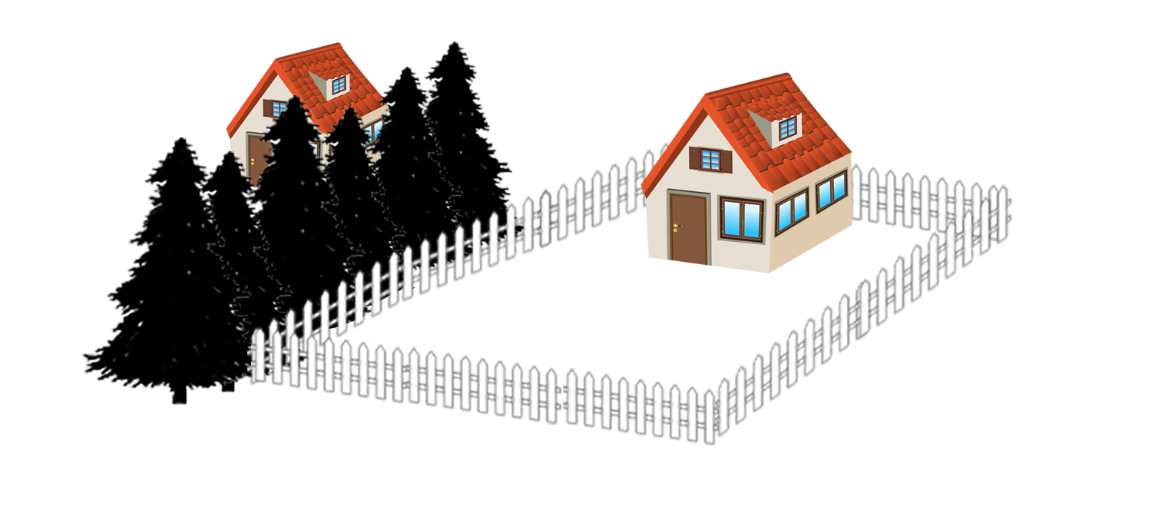
Mosteller v. Naiman 416 N.J. Super. 632 (2010) NJ Ct. App.
Δ
π
Notes:
Mosteller owned a rental property surrounded by a fence

Slide 46
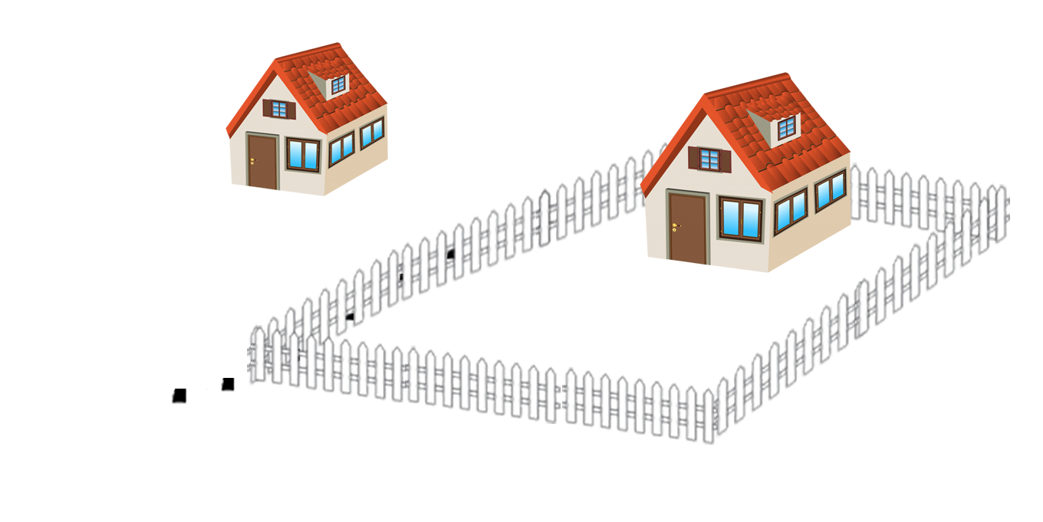
Mosteller v. Naiman 416 N.J. Super. 632 (2010) NJ Ct. App.
Δ
π
Notes:
Naiman chopped down the trees on his side of the fence

Slide 47
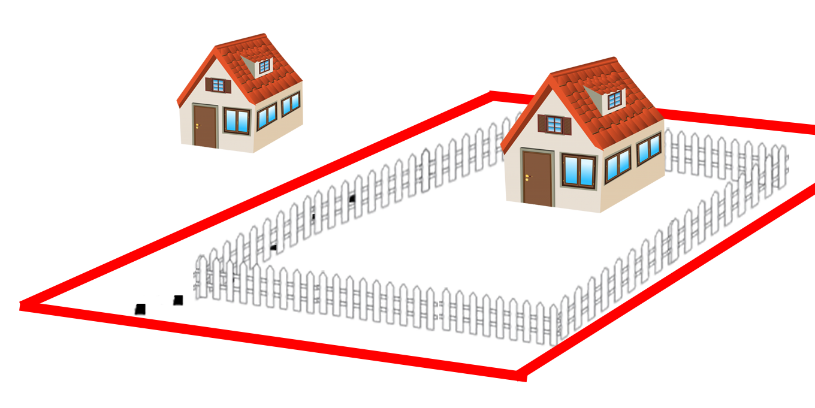
Mosteller v. Naiman 416 N.J. Super. 632 (2010) NJ Ct. App.
Δ
π
Notes:
Turns out the fence was not the property line

Slide 48
Mosteller v. Naiman 416 N.J. Super. 632 (2010) NJ Ct. App.
“Peculiar value to the owner is a fair and equitable consideration in deciding whether to enhance an owner’s recovery beyond the diminution of the property’s value.”

Slide 49
Mosteller v. Naiman 416 N.J. Super. 632 (2010) NJ Ct. App.
“Peculiar value to the owner is a fair and equitable consideration in deciding whether to enhance an owner’s recovery beyond the diminution of the property’s value.”
“…loss of shade, increased erosion, insect risks…are typical negative consequences that unfortunately result from the destruction of trees and shrubbery

Slide 50
Mosteller v. Naiman 416 N.J. Super. 632 (2010) NJ Ct. App.
“Peculiar value to the owner is a fair and equitable consideration in deciding whether to enhance an owner’s recovery beyond the diminution of the property’s value.”
“…loss of shade, increased erosion, insect risks…are typical negative consequences that unfortunately result from the destruction of trees and shrubbery, and they do not establish that plaintiff’s trees were of peculiar value to him.”

Slide 51
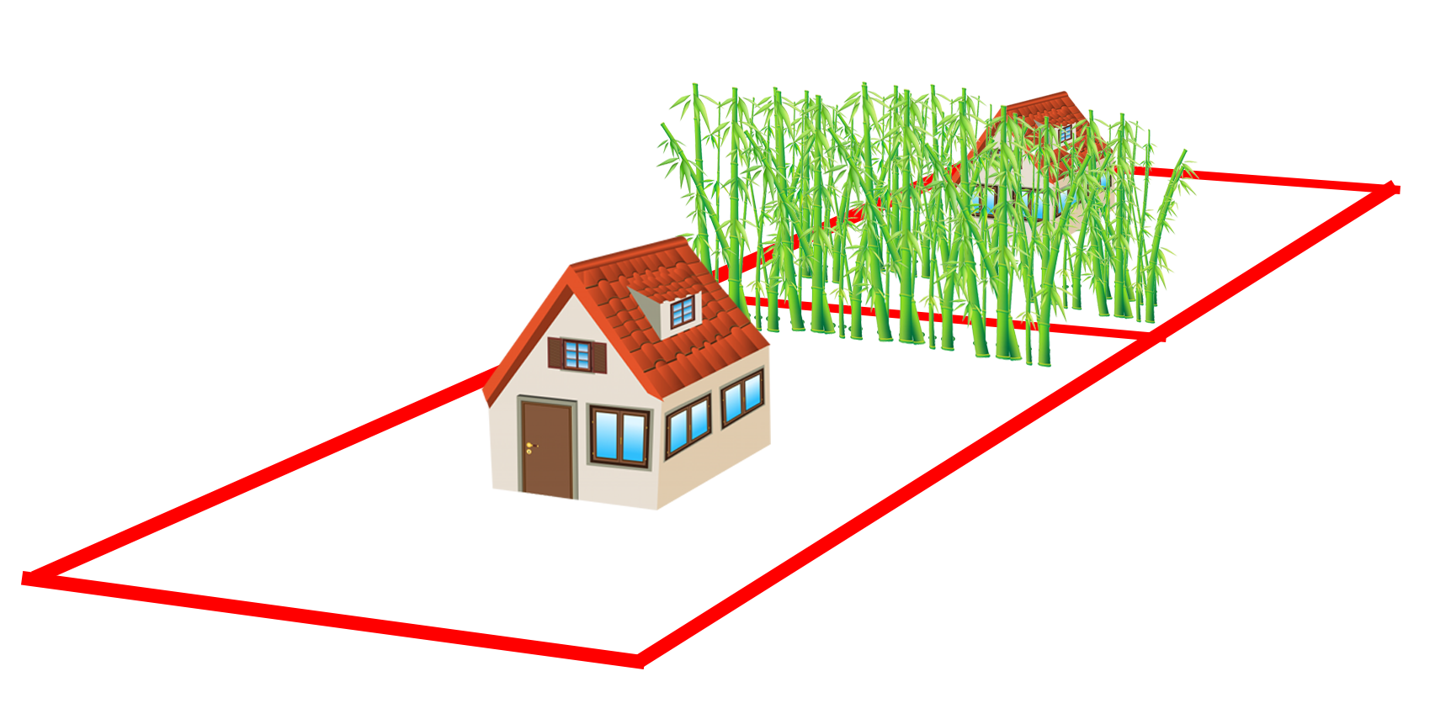
Kornbleuth v. Westover 241 N.J. 289 (2020) NJ Supr. Ct.

Slide 52
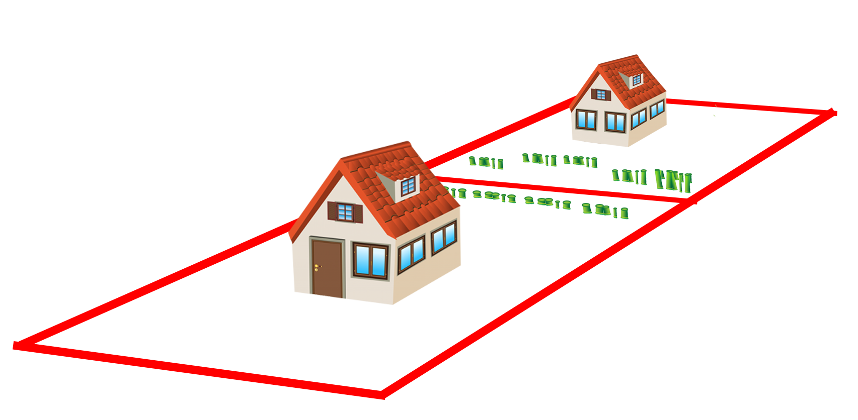
Kornbleuth v. Westover 241 N.J. 289 (2020) NJ Supr. Ct.

Slide 53
Kornbleuth v. Westover 241 N.J. 289 (2020) NJ Supr. Ct.
“…general interest in privacy and vague assertions of aesthetic worth cannot…establish value personal to the owner”

Slide 54
“Reason Personal”
“Reason Personal”
No “Reason Personal”
Morris v. Ciborowski (NH 1973)
Wiersum v. Harder (AK 2013)
Gross v. Jackson Twp. (PA 1984)
King v. Duke Energy (NC 2021)
Leavitt v. Continental Tel. (ME 1989)
Rector etc. v. McCrossen (MN 1975)
Threlfall v. Town of Muscoda (WI 1994)
Hornsby v. Gulliot (LA 2005)
Mosteller v. Naiman (NJ 2010)
Kornbleuth v. Westover (NJ 2020)
Anderson v. Edwards (AK 1981)
Chung v. Rora Park (AK 2014)
Huberth v. Holly (NC 1995)

Slide 55
“Reasonably Incurred” vs. “Disproportionate”

Slide 56
Heninger v. Dunn 101 Cal.App.3d 858 (1980) CA Ct. App.
Notes:
Henninger (landowner) v. Dunn (bulldozer)
Santa Clara County, CA

Slide 57
Heninger v. Dunn 101 Cal.App.3d 858 (1980) CA Ct. App.
Notes:
Henninger (landowner) v. Dunn (bulldozer)

Slide 58
Heninger v. Dunn 101 Cal.App.3d 858 (1980) CA Ct. App.
Notes:
Henninger (landowner) v. Dunn (bulldozer)

Slide 59
Heninger v. Dunn 101 Cal.App.3d 858 (1980) CA Ct. App.
Notes:
Henninger (landowner) v. Dunn (bulldozer)

Slide 60
Heninger v. Dunn 101 Cal.App.3d 858 (1980) CA Ct. App.
Notes:
Henninger (landowner) v. Dunn (bulldozer)

Slide 61
Heninger v. Dunn 101 Cal.App.3d 858 (1980) CA Ct. App.
+$$$
Notes:
Henninger (landowner) v. Dunn (bulldozer)

Slide 62
Heninger v. Dunn 101 Cal.App.3d 858 (1980) CA Ct. App.
“To hold that [Heninger] is without remedy merely because the value of the land has not been diminished would be to decide that by the wrongful act of another, an owner of land may be compelled to:
- accept a change in his property, or - perform…restoration at his own expense”

Slide 63
Heninger v. Dunn 101 Cal.App.3d 858 (1980) CA Ct. App.
HOWEVER

Slide 64
Heninger v. Dunn 101 Cal.App.3d 858 (1980) CA Ct. App.
HOWEVER
“a reasonable approximation of the land’s former condition may involve something less than substantially identical restoration.”

Slide 65
Heninger v. Dunn 101 Cal.App.3d 858 (1980) CA Ct. App.
HOWEVER
“a reasonable approximation of the land’s former condition may involve something less than substantially identical restoration.”
“transplanting a large number of mature trees…is …a manifestly unreasonable expense in relation to the value of the land.”

Slide 66
“Reasonably Incurred” vs. “Disproportionate”
Heninger v. Dunn (CA 1980): “Reasonableness” is the maximum
Weirsum v. Harder (AK 2013): Replacement cost 4x property value is unreasonable
Vaught v. A.O. Hardee & Sons (SC 2005): Max replacement cost 1x prop. val.

Slide 67
“Reasonably Incurred” vs. “Disproportionate”
Heninger v. Dunn (CA 1980): “Reasonableness” is the maximum
Weirsum v. Harder (AK 2013): Replacement cost 4x property value is unreasonable
Vaught v. A.O. Hardee & Sons (SC 2005): Max replacement cost 1x prop. val.
Kornbleuth v. Westover (NJ 2020): compare to land value for reasonableness
Morabit v. Hoag (RI 2013): compare to land value for reasonableness
Regal Construction v. West Lanham (MD 1958): can’t exclude land value evid.

Slide 68
R2D Torts §929 Analysis
Restoration Cost vs. Diminution in Value
“Reason Personal”
“Reasonably Incurred” vs. “Disproportionate”

Slide 69
Restatement of Torts §929 A Legal Perspective on Tree Losses
James Komen
BCMA #WE-9909B
RCA #555

